Slide 1
Unit3 This is my father.
人教精通版三年级下册
WWW.PPT818.COM

Slide 2
Review
Let’s sing

Slide 3
Lead-in
Look and guess
This is my father.
This is my mother.
This is my …
This is my ...
brother.
sister.
This is me.

Slide 4
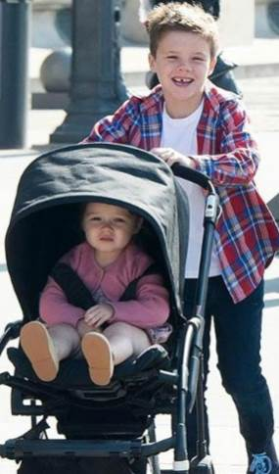
Presentation
brother
(哥哥，弟弟)
He is my brother.

Slide 5
Presentation
sister
(姐姐，妹妹)
She is my sister.

Slide 6
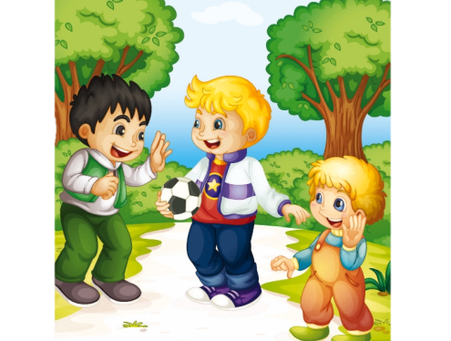
Presentation
Listen and say
1. Who are they?
They’re Yang Ming, Sam, Sam’s brother.
2. How old is Sam?
He’s six.

Slide 7
Presentation
Hi, Yang Ming. This is my brother, Sam.
Hello, Sam! How old are you?
I’m six.

Slide 8
Practice
Tips for actors
（演员考核标准）
Let’s act
Read fluently
流利地朗读
Act fluently
流利地表演
Act it out with emotions
有感情的表演

Slide 9
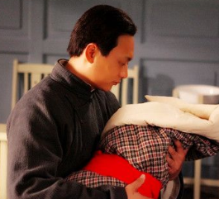
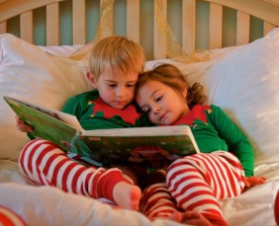
Practice
Let’s match
brother and sister
father
mother

Slide 10
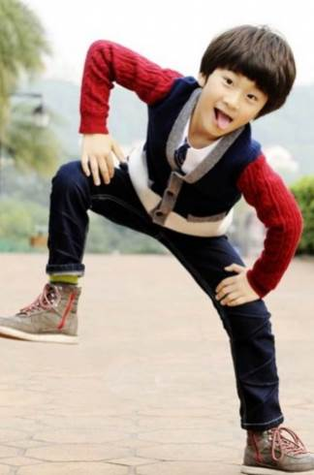
Presentation
Show me your ________ photo.
brother’s
How old is your
brother?

Slide 11
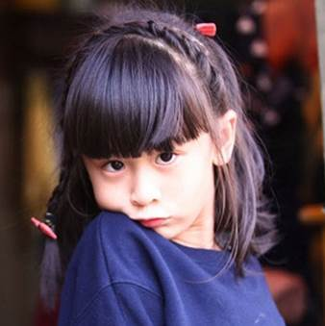
Presentation
Show me your ______ photo.
sister’s
How old is your
sister?

Slide 12
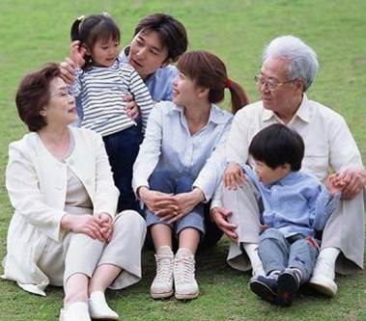
Presentation
Show me your ______ photo.
family

Slide 13
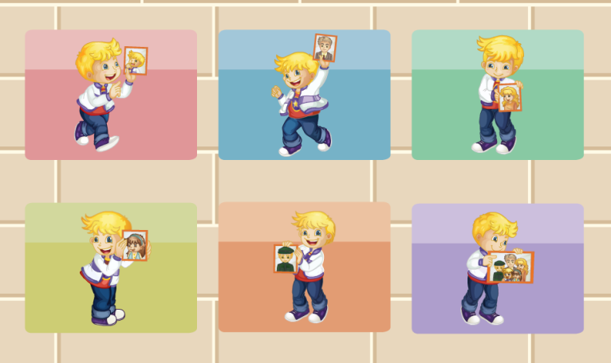
Practice
Let’s do

Slide 14
>> practice
Practice
活动
照片秀

Slide 15
Summary
1. 本课的重点单词：
brother
sister
2. 本课的重点句型：
This is my brother, Sam.
How old are you?

Slide 16
Homework
跟读课文Just talk部分的录音，注意语音、语调。
在四线三格中正确抄写本课对话，不少于3遍。
预习Lesson 15。
Close

