Slide 1
Unit 6 Plan for the Summer
What are you going to do this summer holiday?
WWW.PPT818.COM

Slide 2
This summer holiday,
I 'm going to Beijing.

Slide 3
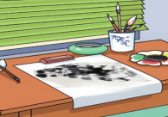
Listen and answer
What is Jenny going to do this summer holiday?
I’m going to ________
________________.
read some
Chinese storybooks
I want to ___________
______________.
take Chinese
painting classes

Slide 4
a storybook

Slide 5
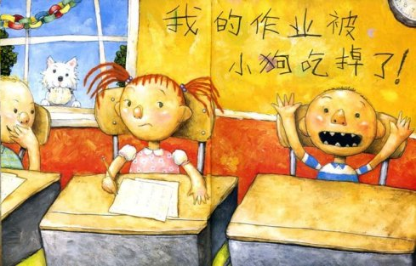
a picture book

Slide 6
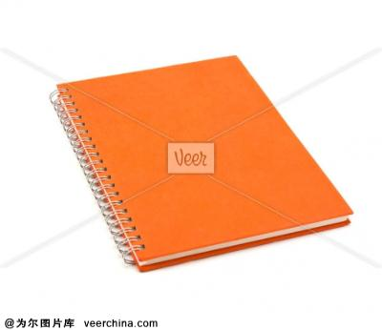
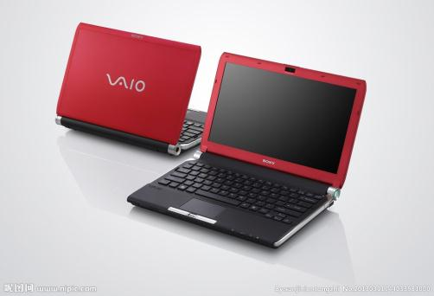
a notebook

Slide 7
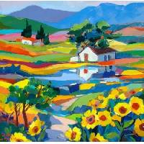
a painting

Slide 8
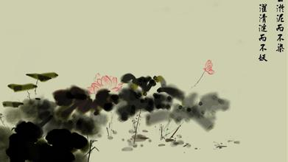
a Chinese painting

Slide 9
take Chinese painting classes

Slide 10
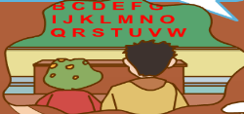
Listen and answer:
What about Li Ming?
I’ll go to
_____________ in Britain.
a summer camp
I’ll go to _____________
and visit some famous places.
English classes

Slide 11
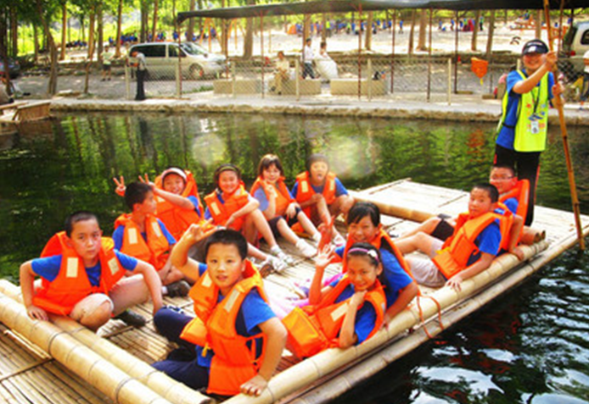
a summer camp

Slide 12
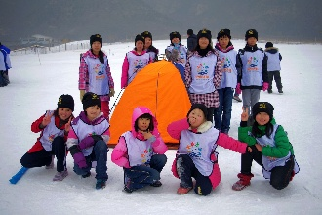
I'm going to _____________.
a winter camp

Slide 13
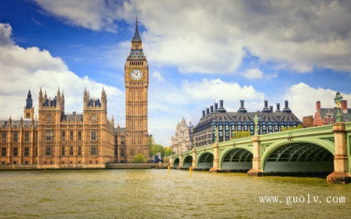
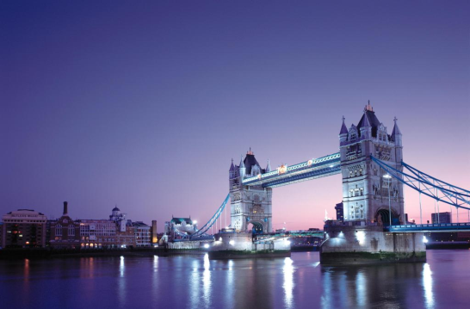
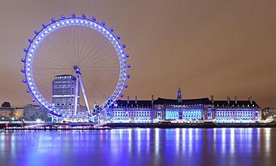
famous places in Britain

Slide 14
小组学习
1Read together(齐读第三、四段一遍)
2Role play(分角色读第三、四段一遍)
3Dicuss(讨论):What are their plans?
4New word:一起读生词三遍;组长开火车检查一遍生词。

Slide 15
What is Peter going to do this summer holiday?
I’m going to _________________.
travel around China
Then I’ll go back to Canada with my parents.

Slide 16
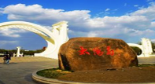
What is Wang Hong going to do this summer holiday?
I'm going to _____.
I’m going to _______.
travel
Harbin

Slide 17
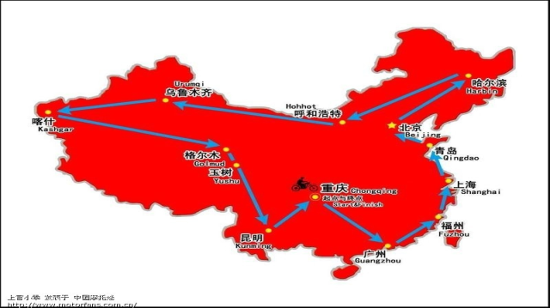
travel around China.

Slide 18
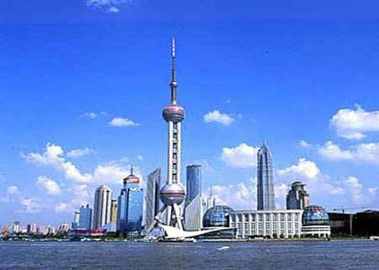
travel to Shanghai

Slide 19
Read and show in groups
Tips:（选择你喜欢的方式）
1 Read together (齐读)；
2 follow (组长领读)；
3 Role play (分角色朗读课文)。
Notes:
19

Slide 20
Read and fill in the blanks:
In the summer holiday,
Jenny is going to __________________________.
And she wants to __________________________.
Li Ming will _____________________ in Britain.
He will __________________ and
read some Chinese storybooks
take Chinese painting classes
go to a summer camp
visit some famous places.
go to English classes

Slide 21
Peter is going to __________________________.
Then he’ll go back to Canada with his parents.
Wang Hong is going to ____________.
Danny is going to________________.
travel around China
Harbin
go with Li Ming

Slide 22
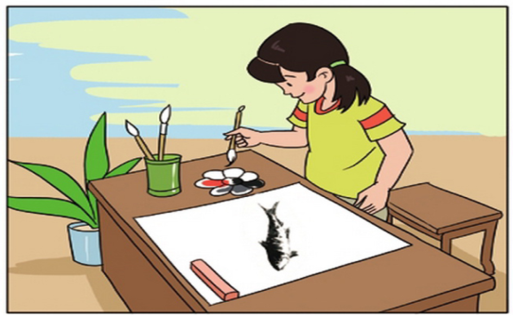
Let’s talk:
A:What are you going to do this summer holiday?
B: I’m going to_________________________.
take Chinese painting classes

Slide 23
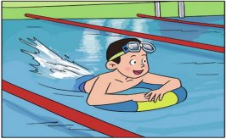
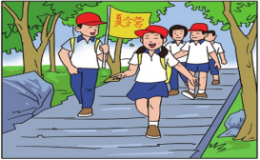
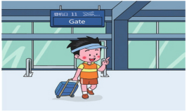
Let’s talk in pairs
A:What are you going to do this summer holiday?
B: I’m going to...

Slide 24
Let’s talk in groups
A:What are you going to do this summer holiday?
B: I’m going to ________.
C: I want to ________.
D: I’ll ________.

Slide 25
My weekend plan

Slide 26
My name is Jack. Tomorrow is the weekend. my parents aren't going to work. But we are going to be very busy tomorrow.

Slide 27
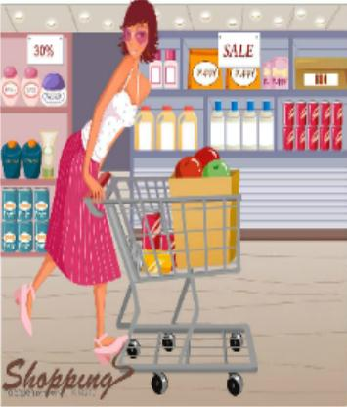
My mother
is going to buy something for next week.

Slide 28
My father
is going to visit my aunt and uncle.

Slide 29
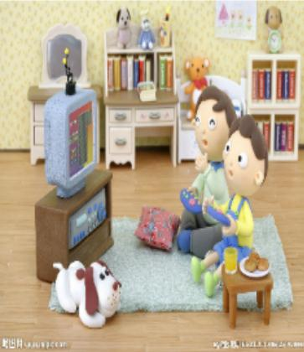
I'm going to play computer games with my cousin.

Slide 30
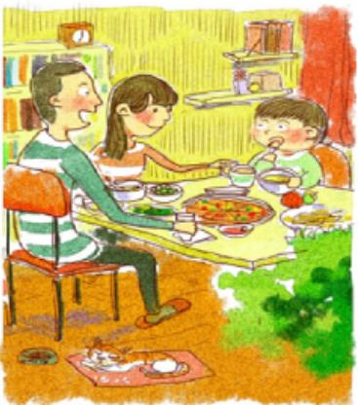
Tomorrow evening we are going to have a big dinner.

Slide 31
After that we are going to the cinema.

Slide 32
I think we are going to have a nice weekend.

Slide 33
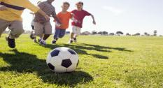
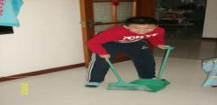
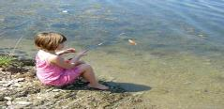
Holiday life is colourful!

Slide 34
Arrange your holiday,
make your life colourful and meaningful!

Slide 35
Homework
1 Listen and read the text.
2 Make a family plan about your holiday.
为自己的假期制作一个家庭计划。

