Slide 1
Unit 2 Topic 2 All these problems are very serious.
Section B
WWW.PPT818.COM

Slide 2
Who can fill it quickly
 | thing | body | one | where
some
any
every
no
something
somebody
someone
somewhere
anything
anybody
anyone
anywhere
everything
everybody
everyone
everywhere
pron.人人，每个人
nothing
nobody
nowhere
pron.没有人
n.小人物，无足轻重的人

Slide 3
Let’s have a match
Group 1 | Group 2

Slide 4
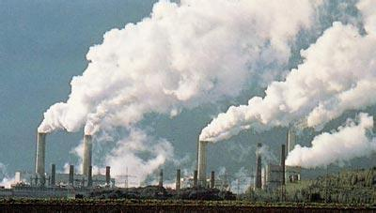
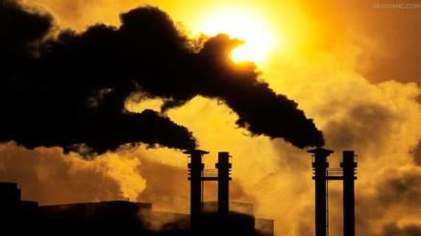
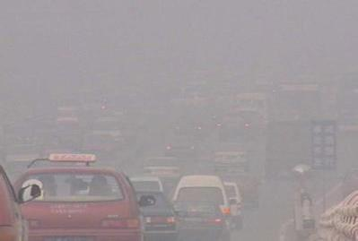
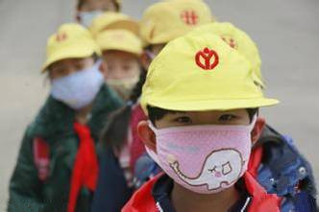
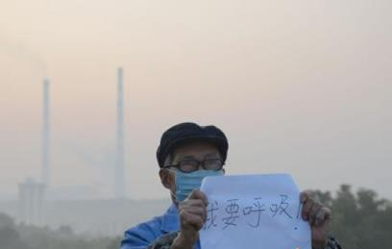
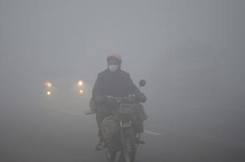
What can we do to protect our environment?
Air pollution

Slide 5
Answer the questions.
(1) What’s the article about?
(2) What should we do and not do to protect the environment?

Slide 6
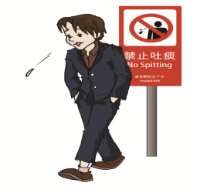
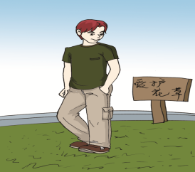
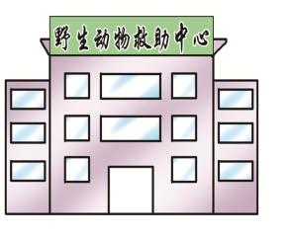
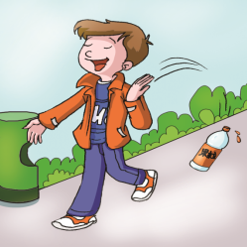
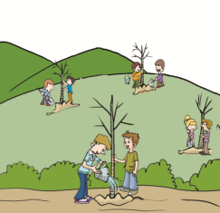
1b Listen to 1a and number the following pictures.
2
3
4
1
5

Slide 7
Language Points
1.None of us likes pollution. 没人喜欢污染。
pron.没有一个， 毫无
none和no one 的区别;
No one 1)不与of连用；2)谓语动词用单数；3)只能指人，但不具体指什么人；4)一般用来回答who,及含anyone, anybody引起的疑问句。
None 1)可与of连用；2)谓语动词用单或复数；3)具体指什么人或物；4)一般用来回答how many +n, how much +n及含any +n引起的疑问句。

Slide 8
Language Points
adj.野生的，野的
2. Everyone should care for wild animals and plant more trees .每一个人都应该爱护野生动物，种更多的树。
3.We shouldn’t leave rubbish here and there.我们不应该随处乱扔垃圾。
在多处
n.垃圾，废弃物
4.But the government is doing something useful to protect the environment. 政府正在做一些有益的事情来保护环境。
不定代词+形容词

Slide 9
1c Read 1a and complete the table.
Should do | Shouldn’t do
1.____ ____ wild animals 2.plant _____ _______ 3.do ___________ we can | 1._______ rubbish here and there 2._______anywhere in public 3.________ on grass 4. pick _________
care for
leave
more trees
spit
everything
walk
flowers

Slide 10
Exercises
Use everything, everyone, anywhere, something to fill in the blanks.
But the government is doing _________ useful to protect the environment.
____________ should care for wild animals and plant more trees.
Don’t spit _____________ in public.
We should do _________ we can to protect the environment.
something
Everyone
anywhere
everything

Slide 11
2 Listen to the letter and help Kangkang to complete it . Then read it aloud as accurately as possible.
Dear Headmaster,
I’m writing to tell you _________important. Nobody likes to be untidy. However, some students throw waste paper and bottles ___________. We all need a quiet place to study, but some students often make too much noise at school. Worst of all, some of them are quite rude when talking to_______. __________________ knows their behavior is bad, but ______of us knows how to stop them.
I think we should make rules to change the situation. ________ who breaks the rules will be punished. Perhaps it will be hard for us to keep the rules in the beginning, but if___________________does his or her best to follow the rules, our school environment will improve.
Sincerely,
Kangkang
something
everywhere
others
Everyone/Everybody
none
Anyone
everyone/everybody

Slide 12
3 Read and understand the first sentence. Then complete the second one and read them aloud, paying attention to the weak form, liaison and intonation.

Slide 13
Example :
As we all know, air pollution has become a serious problem?
Everybody knows air pollution has become a serious problem.
1.None of us would like to see dirty water and rubbish
lying around .
________ would like to see the dirty water and rubbish
lying around .
2. We should follow social rules and spit nowhere in public .
We should follow social rules and not spit __________
in public.
3. We should do everything to protect the
environment in our daily lives .
We shouldn’t do ________ to destroy the
environment in our daily lives .
Nobody
anywhere
anything

Slide 14
4 Discuss the following questions in groups and try to find the solutions.
1.Do you have any bad habits when you are
at school? What are they?
___________________________________
2.How can you make your school look better?
___________________________________

Slide 15
Make a speech about protecting our environment.
You can choose the phrases to use:
1. It says that … 2. as a result
3. something useful 4. None of …
5. here and there 6. care for
7. Worst of all 8. make rules
9. change the situation 10. Perhaps
11. obey the rules 12. do one’s best

Slide 16
We learn: 1. some words : none, rubbish, wild, nobody, worst,
situation, punish, everybody
2. some phrases: here and there, worst of all
3. some sentences :
①None of us likes pollution .
② Don’t spit anywhere in public.
③ Everyone should care for wild animals and plant more
trees .
④We should do everything we can to protect the
environment.
⑤ We shouldn’t leave rubbish here and there.
We can: 1. Use the indefinite pronouns and adverbs correctly.
2. Use the proper ways to protect the environment.
Summary

Slide 17
Assignment
Read 1a.
Memorize the useful expressions and key sentences which we learn today.
Finish Section B in your workbook.
Preview Section C.

