Slide 1
Module10 The weather
Unit 1 It might snow.
WWW.PPT818.COM

Slide 2

cold cool freezing hot warm
45 ℃
hot
warm
cool
cold
freezing
20 ℃
-5 ℃

Slide 3
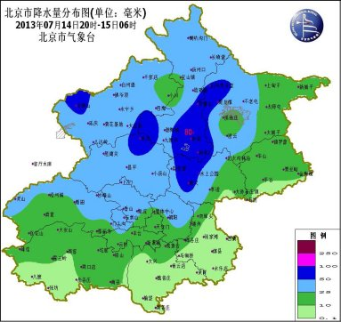
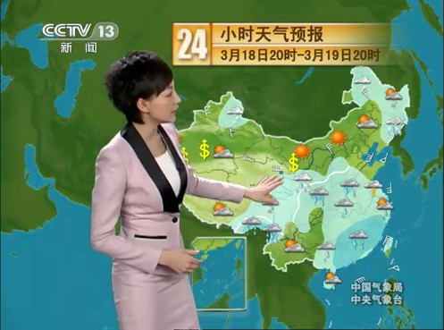
We can know the weather through the weather forecast.
天气预报

Slide 4





Warming-up
rain
snow
sunny
windy
wind
shower
Weather
cloudy
rainy
cloud
storm
snowy

Slide 5






snow
y
rain
y
cloud
y
weather
wind
y
sun
ny
shower
y
storm
y

Slide 6

degree(s)
minus
5
℃
一
temperature
What’s the temperature?

Slide 7


-8～-2 ℃
What’s the weather in Beijing?
It’s…
What’s the temperature?
It’s…
between minus eight and minus two degrees.

Slide 8
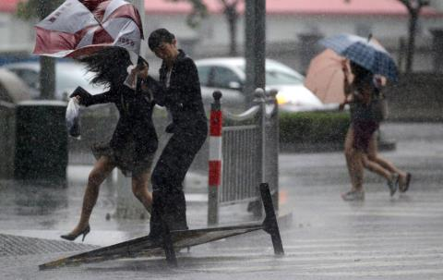
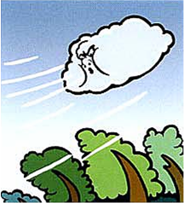
What’s the weather like in Shanghai?
5～8℃
What’s the temperature?
It’s…
between 5 and 8 degrees.

Slide 9
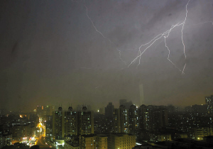
What’s the weather like in Guangzhou?
10～21 ℃
What’s the temperature?
It’s…
between 10 to 21 degrees.

Slide 10
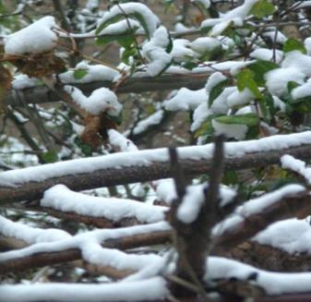
What’s the weather like in Xi’an?
-5～1 ℃
What’s the temperature?
It’s…
between minus 5 to 1 degrees.

Slide 11
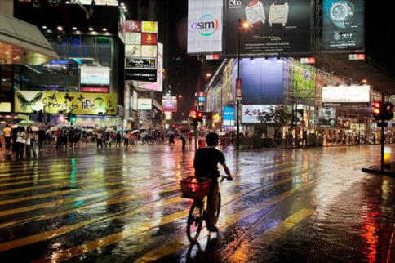
What’s the weather like in Hongkong?
17～20 ℃
What’s the temperature?
It’s…
between 17 and 20 degrees.

Slide 12








Listen and check ( √ ) the correct information in the table.
City | Temperature | Weather
Beijing | -8℃ ～-2℃
Shanghai | 5℃ ～9℃
Xi’an | -5℃ ～1℃
Guangzhou | 10℃ ～21℃
Hong Kong | 17℃ ～20℃
√
√
√
√
√
√
√
√
√
√

Slide 13
Work in pairs. Correct the wrong information in the table.
City | Temperature | Weather
Beijing | -8℃ ～-2℃
Shanghai | 5℃ ～9℃
Xi’an | -5℃ ～1℃
Guangzhou | 10℃ ～21℃
Hong Kong | 17℃ ～20℃
√
√
5℃～8℃
√
√
-4℃～2℃
√
√
√
√
√
√

Slide 14
Then listen and read
Betty: Hey, boys!
Tony: Hi, Betty. Hi, Lingling. Where are you going?
Betty: We’re going to the park to skate. There’s thick ice on the lake. Are you coming with us?
Tony: Are you joking? It’s really cold today.
Daming: And it’s cloudy too, so it might snow.
Lingling: What’s the temperature?
Tony: It’s between minus eight and minus two degrees! Winter is colder here than in England.
Daming: Is it snowy in England in December?
Tony: Not usually, although this year it snowed quite a lot. Most Decembers are wet and rainy.

Slide 15
Daming: What’s the weather like in America in winter,
Betty?
Betty: We have cold winters and hot summers. It’s snowy
in New York in winter.
Tony: Sounds great! I like sunny weather, and I like snow
as well. But I don’t like showers or windy weather.
Betty: Me neither. Rainy weather is terrible! I wish I were
in Australia now. It’s probably sunny and hot there.
Lingling: You can go to Hainan Island if you like sunny weather.
Betty: One day I will.
Lingling: Come on, better get going! We can skate in the park and get warm.

Slide 16
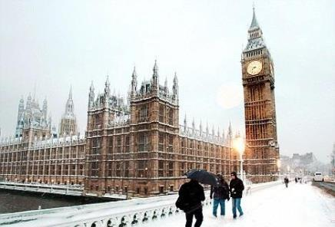

What’s the weather like in England in December?
Not usually, although this year it ________ a lot. Most Decembers are _____ and ______.
snowed
wet
rainy

Slide 17
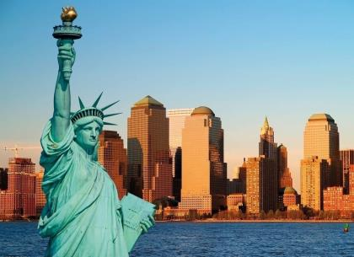
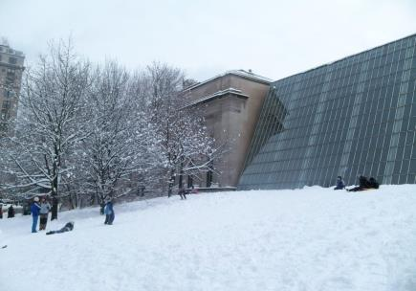
What’s the weather like in America?
It is ____ in winter and ____ in summer. It’s _______ in New York in winter.
cold
hot
snowy

Slide 18
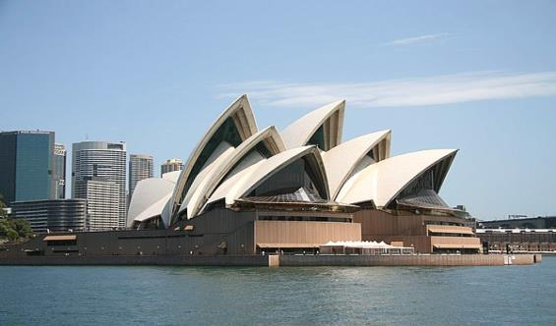

What’s the weather like in Australia in winter?
25℃ ～31℃
sunny
It’s probably ______ and _____ there.
hot

Slide 19
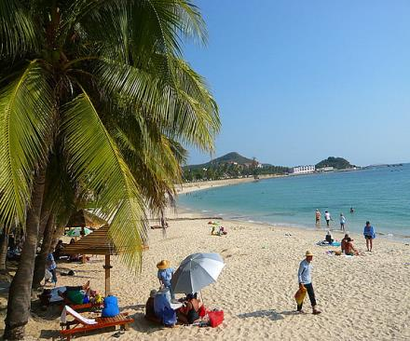
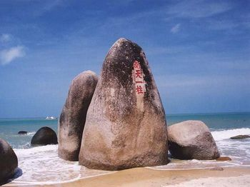
What’s the weather like in Hainan Island?
It’s _______.
sunny

Slide 20
Now check (√) the true sentences.
×
1. Tony and Daming are going to skate.
2. Winter is colder in Beijing than in England.
3. It sometimes snows in England in winter.
4. It is not hot in the US in summer.
5. It usually snows in New York in winter.
6. Tony does not like windy weather.
√
√
×
√
√

Slide 21
5 Complete the passage with the correct form of the words from the box.
dangerous degree joke may minus skate temperature
When it’s very cold it might be safe to (1)_______
on lakes, but be very careful! Although it
(2) _______feel cold, it might not be safe. The
(3) ___________ has to be at least (4) _______ one or two (5) _______ or even colder for several weeks. Falling through the ice is(6) _________.I am not
(7) _______ !
skate
may
temperature
minus
degrees
dangerous
joking

Slide 22
1. 问气温：
— What’s the temperature?
气温怎么样？
— It’s between minus five and minus
two degrees!
零下5度到零下2度之间。

Slide 23
2. 问天气：
— What’s the weather like in …?
= How is the weather in …?
天气怎样？
— It’s snowy (cloudy, rainy, sunny,
windy ...).
下雪(多云、下雨、晴、有风……)

Slide 24
3. … although this year it snowed quite a lot.
虽然今年下了很多雪。
although = though conj. 然而; 尽管
引导的从句不能与 but, however 连用, 但可与 yet, still 连用。例如：
1) 虽然他很累，但他继续工作。
Although / Though he was tired, he went on working. = He was tired, but he went on working.

Slide 25
2) 尽管他相当忙，但是还常常帮我学英语。
He often helps me with my English
although / though he is quite busy.
= He is quite busy, but he often helps me with my English although.

Slide 26
4. Come on, better get going! 好了，走吧！
better get going 是 we’d better get going 的省略形式, 意思是“最好现在去/ 走”。
例如：
We’d better get going, or we’ll be late.
(= We’d better go now)
我们最好现在就走，不然要迟到了。

Slide 27
5. It’s probably sunny and hot there.
那里的天气可能晴朗、热。
It’ll probably be cold tomorrow.
明天可能冷。
probably adv. 大概; 或许; 很可能
英语中表示可能的方式有许多，除使用情态动词may / might 以外，还可以通过will 以及表示“可能” 的形容词和副词表达。

Slide 28
常用的有：
It is possible to do sth. ...,
It is possible that …,
主语 + will probably / possibly + v.等。
例如：
Is it possible to visit Alaska in December?
十二月去阿拉斯加游览有可能吗？

Slide 29
It is possible that it’ll be snowy in the night.
晚上有可能会下雪。
It’ll probably be cold and wet.
天气很可能会又湿又冷。
注: probably 表示“很可能”，所以表示的可能性要比 possible 大。

Slide 30




Say what the weather might or might not be like.
It will be …/It will probably be …
tomorrow next week next month

Slide 31

Try to understand the sentences
may
might
It may not even be cold...
We might go to Australia.
It’ll probably be hot and sunny.
When’s the best time to visit the USA?
What is the weather like?
= How is the weather?
What will the weather be like?
+do

Slide 32

What will the weather be like?
It might be quite windy.
It may be quite cool.
It will probably be hot and sunny.
肯定程度：
might +
May ++
probably +++

Slide 33
6 Listen to the speaker asking a
question or showing surprise.
What’s the weather like?
What’s the weather like?

Slide 34
7 Listen and write * if the speaker is
asking a question or ** if he is showing
surprise.
*
1 When is the best time to visit your country?
2 What clothes should she bring?
3 What is the temperature?
4 Where are you going?
*
**
**
Now listen again and repeat.

Slide 35
8 Work in pairs. Tell the story.
Make a weather forecast for different cities in China. Use the correct information in the table in Activity 2 to help you.
Now say what the weather might or might not be like in your town.
tomorrow next week next month
It’ll probably be cold tomorrow.

Slide 36

1. — I have read the film introduction of Ye Wen. It tells the Kung Fu master’s story in Foshan.
— ___________. Why not go to see it tonight?
A. I am afraid not
B. Sounds exciting
C. That is boring
2. — Do you have any plans for this weekend?
— I’m not sure. I _______ go climbing Mount Yuntai.
A. must B. need C. may D. can

Slide 37
3. In Britain, you ____ be 18 if you want
to drive a car.
A. can B. must C. may D. might
4. — _____ I go to play basketball now?
— Yes, since you have finished your homework.
A. Must B. Should
C. Need D. May

Slide 38
5. — Mum, how do you like my handwriting?
— __! It’s the best one you have ever written.
A. How terrible
B. What an interesting one
C. How wonderful
D. What a terrible one
6. — The weather has been dry for a month.
— Yes. If it still _____, the plants will die.
A. doesn’t rain B. rains
C. won’t rain D. is raining

Slide 39
根据句子意思，用适当的单词填空。
1. It rains a lot in summer in Beijing.
It’s often _______.
2. There’re a lot of clouds. It’s ________.
3. The weather is snowy and there’s a lot
of _______ in the park.
4. The sun is out. It’s very today.
5. The wind is very strong. It’s so _________
that it’s difficult to walk.
rainy
cloudy
snow
sunny
windy

