Slide 1
Unit 7
Seasons
ReadingⅠ
WWW.PPT818.COM

Slide 2
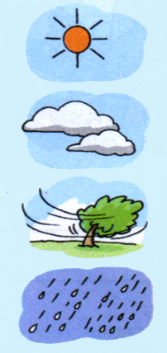
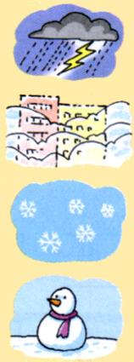
Talk about weather and seasons
A: Which season do you like best?
B: It’s…
A: Why?
B: Because …

Slide 3
Read and answer
Seasons of the year
winter
Winter days are full of snow,
When trees and flowers forget to grow,
And the birds fly far away
To find a warm and sunny day.
What are winter days full of?
Why do the birds fly far away in winter?
Snow.
To find a warm and sunny day.

Slide 4
Read and answer
Seasons of the year
spring
The days of spring are windy and bright.
What a perfect time to fly a kite!
Bees and butterflies play among flowers,
Then hide from the April showers.
What is the weather like in spring?
What can we do in spring?
Windy and bright.
We can fly a kite and see bees and butterflies among flowers.

Slide 5
Read and answer
Seasons of the year
summer
Those sweet memories of summer days
Are about quiet streams and trees and shade,
And lazy afternoons by a pool,
Eating ice cream to feel cool.
What are our sweet memories in summer about?
The streams, trees and shade, lazy afternoons and ice cream.

Slide 6
Read and answer
Seasons of the year
Then autumn leaves turn brown,
Fall into piles upon the ground.
Farmers work to harvest crops,
As the days are shorter and the temperature drops.
Soon the snowy season will begin,
And it will be a new year once again.
autumn
What happens to the leaves in autumn?
What do farmers do in autumn?
The leaves turn brown and fall on the ground.
Farmers work to harvest crops.

Slide 7
Help to complete the sentences
grow
Snow rhymes with .
Away rhymes with .
Bright rhymes with .
Flowers rhymes with .
Days rhymes with .
Pool rhymes with .
Brown rhymes with .
Crops rhymes with .
Begin rhymes with .
day
kite
showers
shade
cool
ground
drops
again

Slide 8
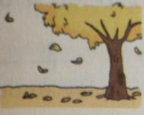
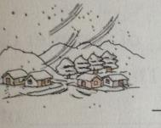
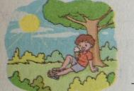
Match the pictures with the sentences
quiet streams, trees and shade
eat ice cream
b. full of snow
birds fly far away
c. a perfect time to fly a kite
bees and butterflies play among flowers
d. brown leaves fall on the ground
farmers harvest crops

Slide 9
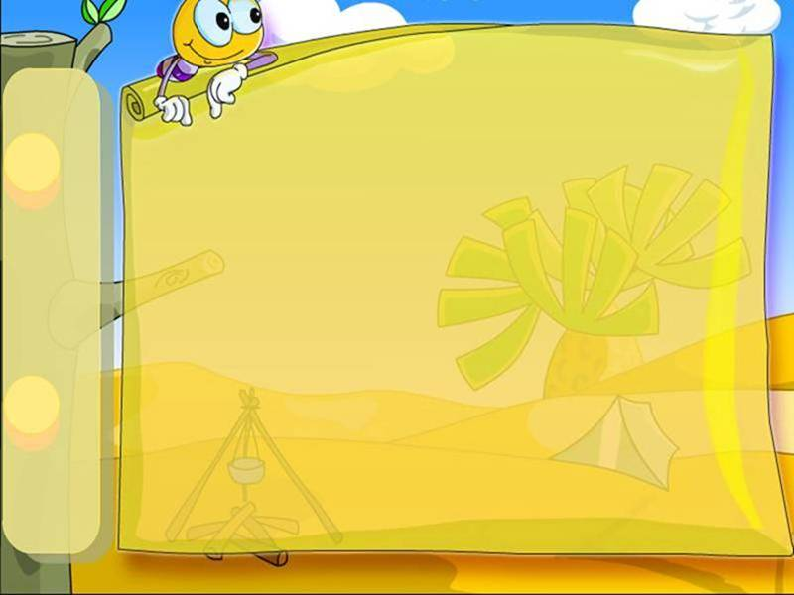
Practice
Finish the exercises on P84.

Slide 10
Homework
1. Read the poem after class.
2. Remember the new words and phrases in the poem.

