Slide 1
In the classroom
第二课时
WWW.PPT818.COM

Slide 2
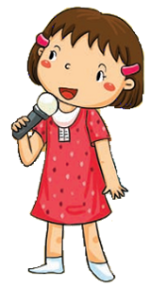
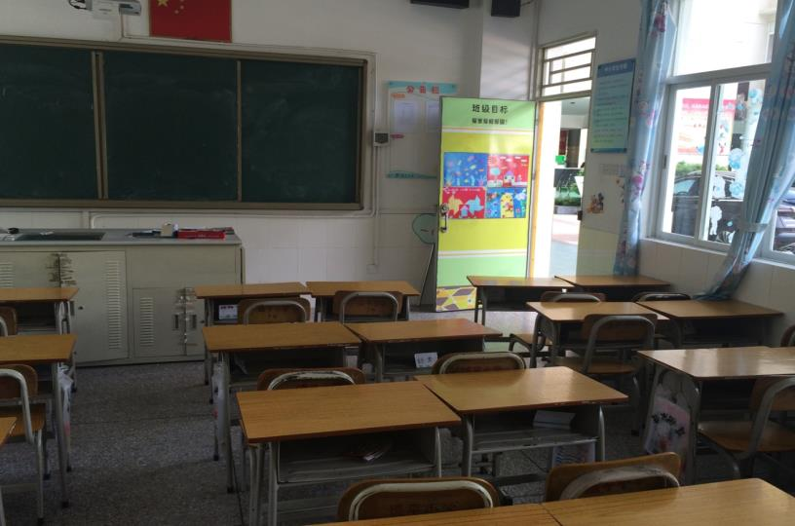
What can we do in the classroom?

Slide 3
Think and say
open
open the door
open the window

Slide 4
Think and say
close
close the door
close the window

Slide 5
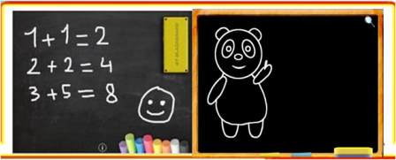
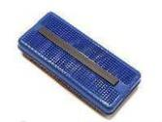
Think and say
look at
write
draw
look at the blackboard
clean
M for mouth ,
N for nose .
What can you do on the blackboard?
Look at your mouth and
your nose.
I can________ on the blackboard.

Slide 6
我是创编小能手
Let’s sing
I can clean. I can clean.
I can clean the blackboard.
I can clean. I can clean.
I can clean the blackboard.
I can close. I can close.
I can close the door.
I can close. I can close.
I can close the door.

Slide 7
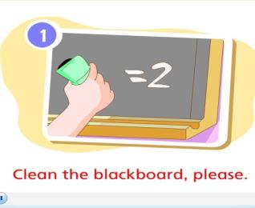
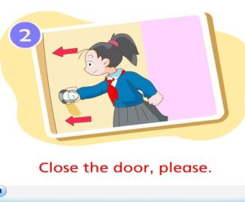
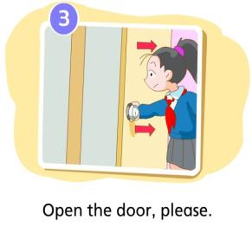
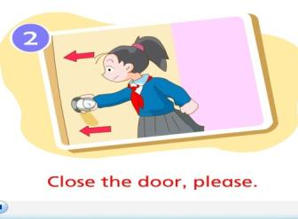
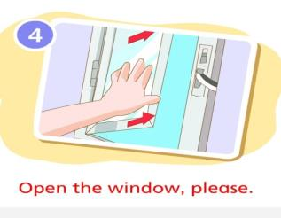
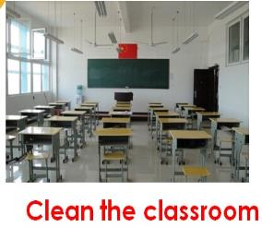
Good memory 好记忆
10
6
7
1
4
5
9
8
3
2
1
2
3
4
5
6
Notes:
7

Slide 8
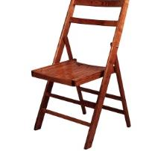
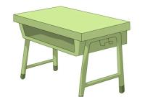
Let’s think and read
look at the _______
clean the _______
close the _______
open the _______

Slide 9
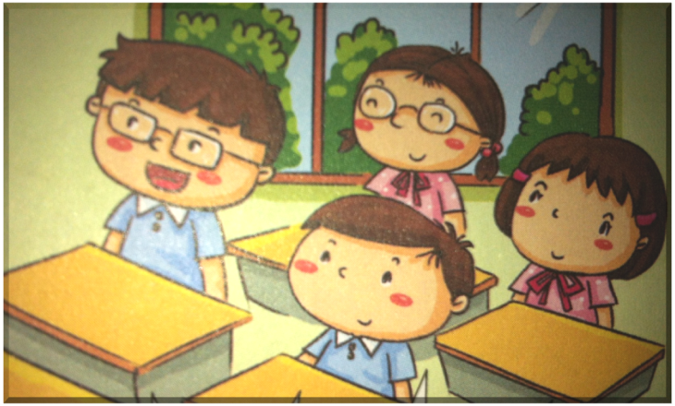
look at...
open...
close...
④
②
③
①
clean…..

Slide 10
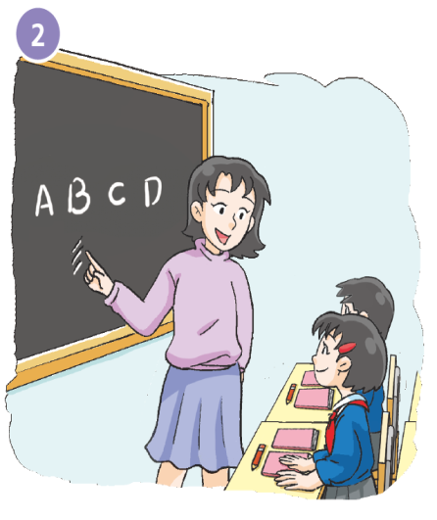
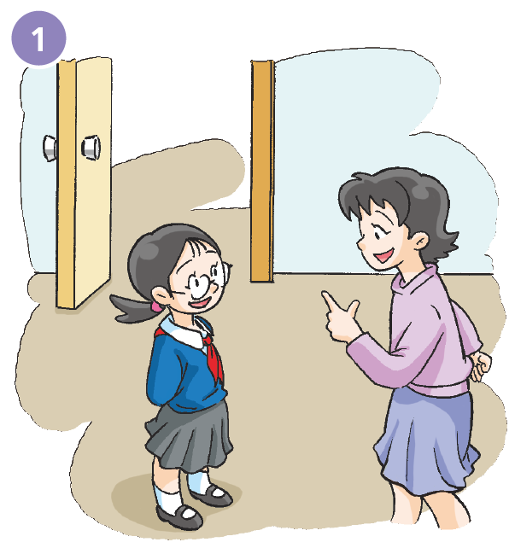
Close the door, please.
Look at the blackboard, please.
Yes, Miss Fang.

Slide 11
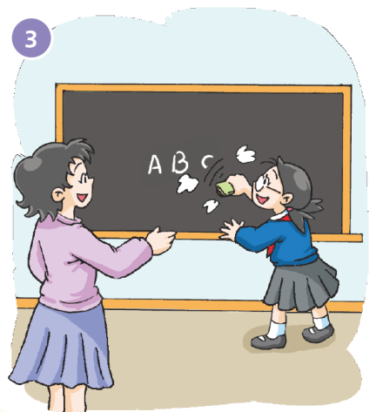
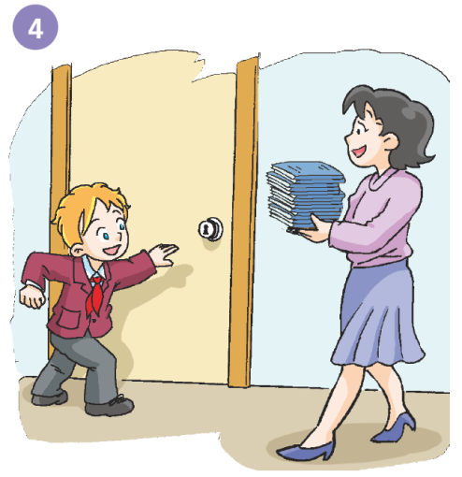
Open the door, please.
Please clean the blackboard, Kitty.
Yes, Miss Fang.
Ok.
Thank you, Peter.

Slide 12
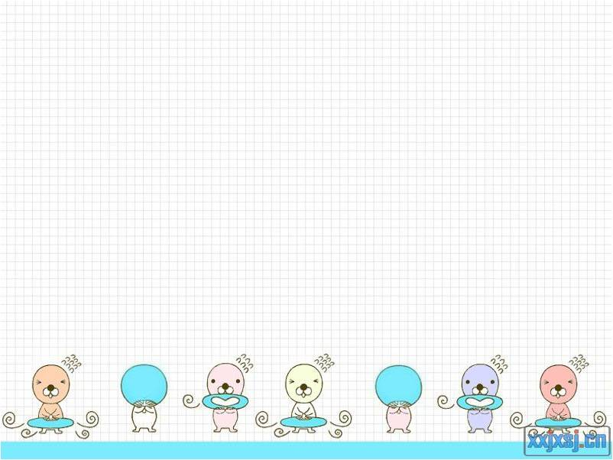
Group work

Slide 13
Role play

Slide 14
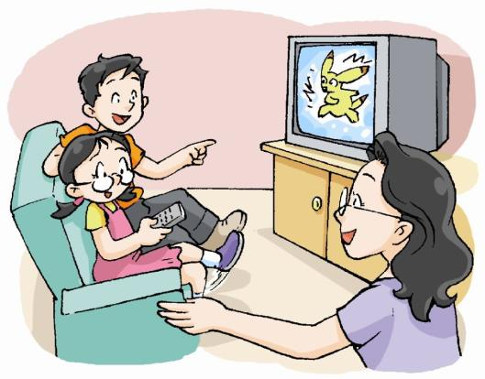
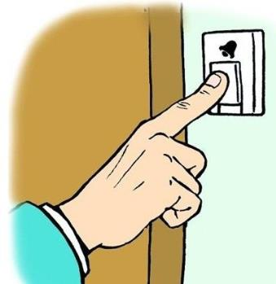
Listen and write
Listen！ The bell is ringing.
Please_________ the door, Ben and Kitty.
At home
Yes, Mum.

Slide 15
Listen and write
In the classroom
Tom, don’t __________ the dog outside!
________ the window ,please!
Ok , I’m sorry.

Slide 16
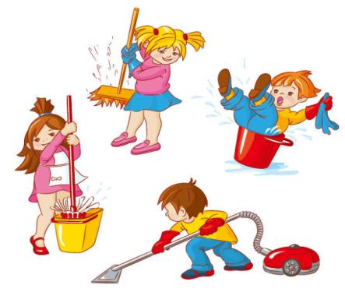
Listen and write
In the classroom
Our classroom is dirty.
We are helpful!
Yes, let’s the classroom together!

Slide 17
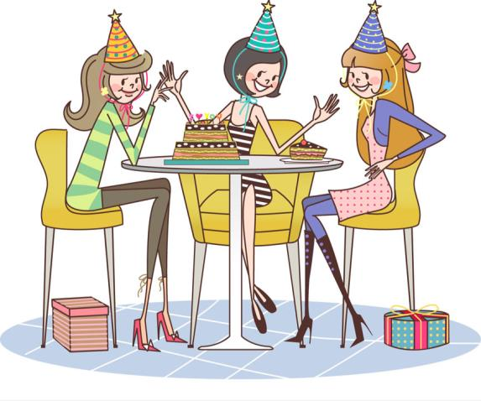
Listen and write
A t the birthday party
_________ the present, Judy.
__________ the cake! How nice! It’s a strawberry cake.
Ok, aha.
Thank you, Lucy and Lily.

Slide 18
连词成句
1. blackboard, please, the , look at.
Look at the blackboard , please.
Please look at the blackboard.
2. the , door, open , please.
Please open the door.
Open the door , please.
3. clean , window, please , the.
Clean the window , please.
Please clean the window.
4. please, book , your, close .
Please close your book.
Close your book, please.

Slide 19
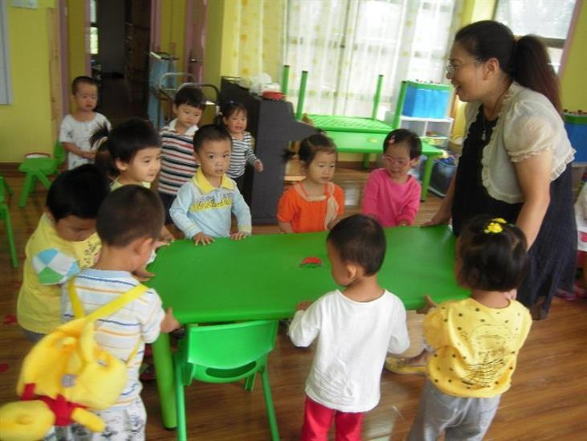
helpful
在学校做老师和同学的好帮手

Slide 20
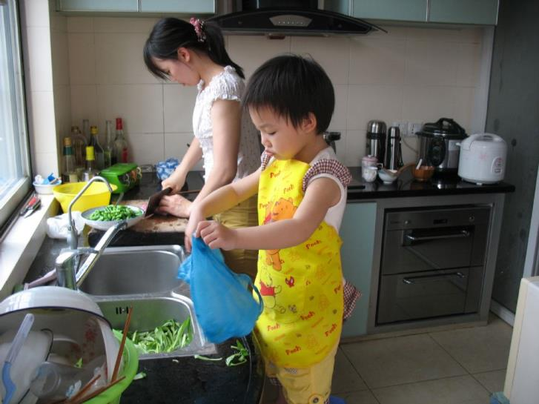
helpful
在家做爸爸妈妈的好帮手

Slide 21
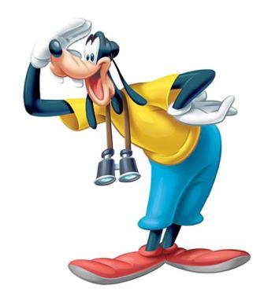
Be helpful in the classroom, at school, at home.

Slide 22
(Necessary for everyone必做)
Watch, listen and read “Letters”.
(You can choose one选做)
Listen and recite Student’s Book pages 34 and 35.
2. Make a dialogue in the classroom.

