Slide 1
Module 5
Unit 1 He is playing the suona, but the phone rings.
WWW.PPT818.COM

Slide 2
Learning goals
能识别、认读新单词：play, third, time, bark, loudly。
能听懂会说目标语句：He is playing the suona, but the phone rings.
运用已学语言描述正在做一件事情时另一件事情同时发生的场景。

Slide 3
Lead-in
Let’s chant.
Clap, clap, We are clapping.
Swim, swim, We are swimming.
Run, run, We are running.
Sing, sing, We are singing.
Dance, dance, We are dancing.

Slide 4
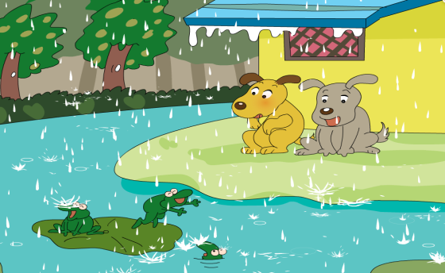
课文学习
1. Look, listen and say.
It is…
They are…

Slide 5
It is raining. They are singing and dancing. They are having a party.

Slide 6
It's raining. What are they doing?
They're singing and dancing.
They're having a party.
They are very happy, but we are not! It's very cold!

Slide 7
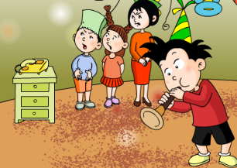
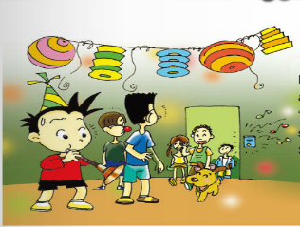
2 Listen and read.
Daming is having a birthday party.
He is playing the suona, but the
phone rings. He stops and
everyone waits.
Daming is playing the suona
again, but the bell rings. "Stop!"
says Simon. Daming stops.
More friends come in.
Simon's dog cames in too.

Slide 8
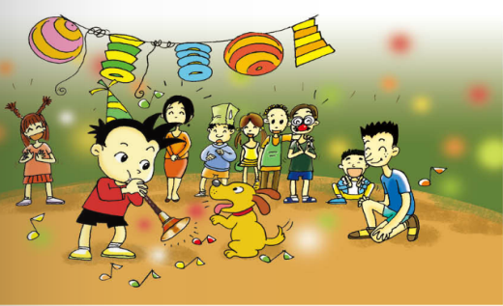
Daming is playing the suona for the third time, but the dog starts to bark very loudly. His friends can't hear him. “Stop!” Simon says. The dog stops. They all laugh.

Slide 9
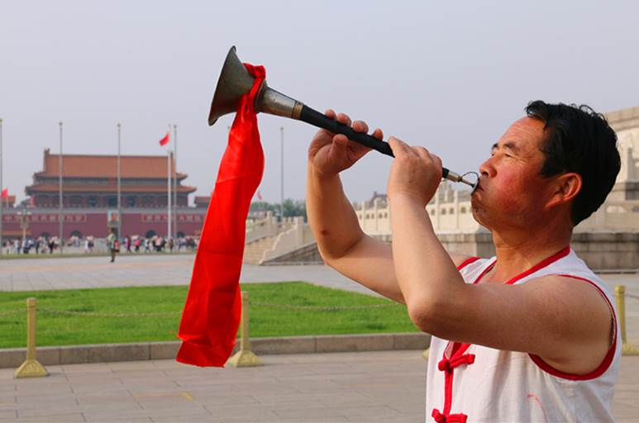
New words
play the suona

Slide 10
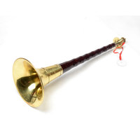
唢呐是中国历史悠久、流行广泛、技巧丰富、表现力较强的民间吹管乐器。它发音开朗豪放，高亢嘹亮，轻快活泼，刚中有柔，柔中有刚，深受广大人民喜爱和欢迎的民族乐器之一，广泛应用于民间的婚、丧、嫁、娶、礼、乐、典祭等仪式伴奏，是中国各地广泛流传的民间乐器。
代表曲目《百鸟朝凤》：乐曲以热情欢快的旋律与百鸟和鸣之声，表现了生机勃勃的大自然景象。

Slide 11
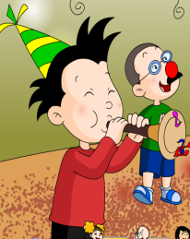
He is playing the suona for the third time(第三次).
girl
bird
ir
third
第三（个）

Slide 12
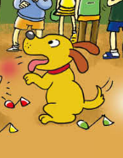
car
farm
bark
Wow！
ar
（狗）吠叫
out
ou
loudly
大声地
quickly
ly
The dog starts to bark very loudly.

Slide 13
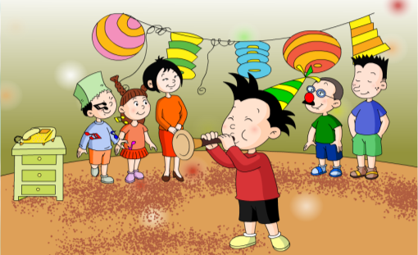
课文理解
Daming’s party
How many times does Daming play the suona?
Three times.

Slide 14
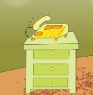
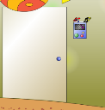
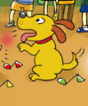
Fill in the blanks.
the phone rings
1. He is playing the suona, but .
the bell rings
2. He is playing the suona, but .
3. He is playing the suona, but .
the dog starts to bark very loudly

Slide 15
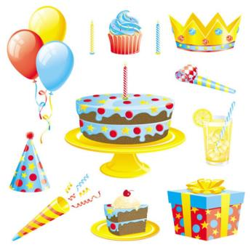
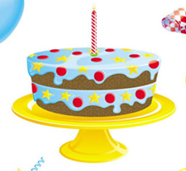
Daming’s birthday
Daming is having a birthday party.

Slide 16
Daming is playing the suona,
but the phone rings.

Slide 17
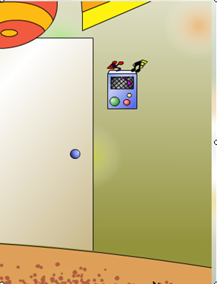
Daming is playing the suona again,
but the bell rings.

Slide 18
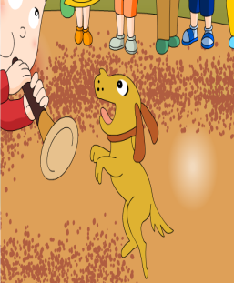
Daming is playing the suona for the third time,
but the dog starts to bark very loudly.

Slide 19
Daming is a birthday party. He is playing suona, but the phone He and everyone .
Daming the suona again, but the bell rings. More friends in. Simon’s dog in too.
Daming is playing the suona for the third , but the dog starts bark very .
having
the
rings
stops
waits
is
playing
come
comes
time
to
loudly

Slide 20
重点句型
如何表达“当某人正在做某事的时候，另一件事情突然发生”
他正在吹唢呐，这时突然电话响了。
He is playing the suona,
but the telephone rings.
（现在进行时）
（一般现在时）

Slide 21
句型结构：
主语+be+动词-ing形式（+其他），
but+主语+动词原形/动词单三形式（+其他）.
这个句型主要用于表达正在做一件事时发生了另一件事情。这个句型的前半句使用现在进行时，后半句使用一般现在时，强调第一件事发生的过程中，第二件事也发生了。but意为“但是”，表示转折。

Slide 22
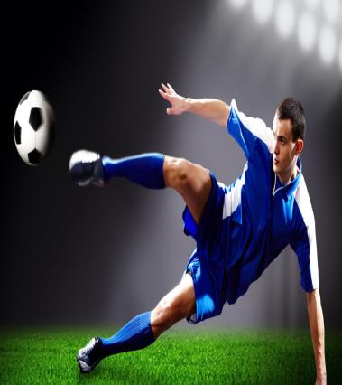
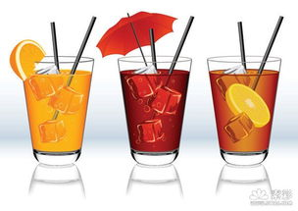
He is playing football, but he feels thirsty.
(feel thirsty)

Slide 23
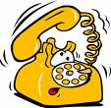
She is reading books, but the phone rings.

Slide 24
课文学习
3. Listen and say.
Daming is playing the suona,
but the phone rings.
Daming is playing the suona again, but the bell rings.

Slide 25
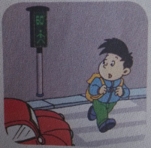
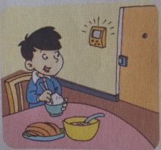
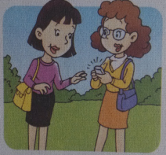
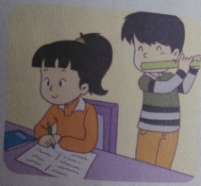
4. Practice.
1. He' s crossing the street,
2. He' s eating dinner,
3. She' s talking to her friend,
4. She' s doing her homework,
a car comes.
but
the bell rings.
the phone rings.
the boy plays the flute.

Slide 26
Exercise
B
1. She is eating dinner, the phone rings.
A. and B. but C. so
A
2. The dog is barking very .
A. loudly B. loud C. louding
B
3. Daming is playing suona.
A. a B. the C. /
A
4. Daming is a birthday party.
A. having B. haveing C. have

Slide 27
Homework
Listen to the tape and read after it.
2. Tell the story to your family and friends.

