Slide 1
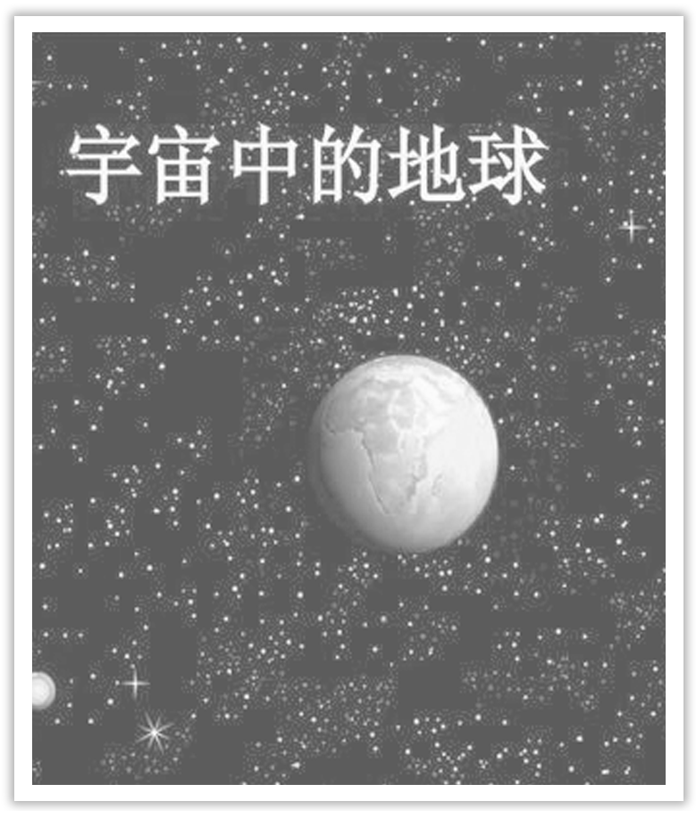
Unit 4 Space Exploration
Section Ⅱ Reading and Thinking(1)
WWW.PPT818.COM

Slide 2
1.Discussing—Look at the following pictures and answer the questions.
(1)What events are these pictures related to?
________________________________________________________________________
The answer is open.

Slide 3
(2)Do you know any other famous astronauts at home and abroad? What can you learn from them?
The answer is open.
________________________________________________________________________

Slide 4
2.Predicting—Look at the pictures and the titles on Page 40 and predict what the text is probably about?
The text is probably about space exploration.
________________________________________________________________________

Slide 5
1.First reading—Match the main idea with each paragraph.
Para.1 A.China’s development of space exploration.
Para.2 B.Earlier achievements of space exploration.
Para.3 C.Bright future of space exploration.
Para.4 D.The desire to explore the outer space.
Para.5 E.Continuous effort in spite of disasters.
答案 Para.1 D Para.2 B Para.3 E Para.4 A Para.5 C

Slide 6
2.Second reading
(1)Read the text and finish Ex.2 on Page 40.
(2)Fill in the blanks according to the passage.
Space：the Final Frontier
Introduction | •People is exploring space in the hope to find out more about the ①____________.
universe

Slide 7
Setbacks and ②___________ of space exploration | •Inventing rockets makes it possible to escape Earth’s ③_________. •It is risky and ④____________ to explore the universe，but people will never ⑤__________ and many dreams have come ⑥________. •Though ⑦____________ late，space programme in China has made great ⑧____________ in a short time.
Conclusion | •⑨____________ many countries working together，space exploration still have a ⑩____________ future.
gravity
dangerous
give up
true
Development
starting
progress
With
bright

Slide 8
3.Third reading
Summarizing：Read the text again and try to summarize the main idea in one sentence.
________________________________________________________________________
________________________________________________________________________
In order to know more about the universe，many scientists and countries make great progress in space exploration with firm confidence in spite of difficulties.

Slide 9
1.Group work：If you are a journalist of your school English newspaper，please make an interview with Yang Liwei according to the text.You may start like this.
A：Hello，I’m a journalist of our school English newspaper.What do you think of space exploration?
B：...
2.With the scientific development，human beings have realized many dreams.What should you do for it as students in high school?
____________________________________________________________________
The answer is open.

Slide 10
阅读技巧点拨
如何预测课文内容？
1.By looking at the pictures in the passage.
2.By thinking about the content before reading.
3.By relating what you will read to what you have.

Slide 11
语言现象感知
Ⅰ.单词理解
体会句中加黑单词的词性和含义
1.They make ①vehicles to carry brave people into space to find out the secrets of the
②universe. ①_________________
②____________
2.On 4 October 1957，the Sputnik 1 ①satellite was ②launched by the USSR and successfully ③orbited around Earth.①____________
②____________
③_______________
n.交通工具；车辆
n.宇宙
n.人造卫星
vt.发射
vt.沿轨道飞行

Slide 12
3.These disasters made everyone sad and disappointed，but the desire to explore the universe never died.①____________
②____________
4.In space，astronauts collected all dirty water so that it can be recycled for later use. ____________
5.Astronauts have to use tape to stick everything down while working in space because everything would float off otherwise.___________________
adj.失望的
n.愿望
vt.回收利用
adv.否则；要不然

Slide 13
Ⅱ.词块积累
写出下列词块的含义
1.transmit date ____________
2.one giant leap ____________
3.carry on space exploration ______________
4.astronauts on board __________________
5.the lack of gravity ____________
6.figure out a way ____________
传输数据
一大步
继续太空探索
在飞船上的宇航员
缺少重力
找出办法

Slide 14
Ⅲ.句式欣赏
1.动名词短语作主语
Before the mid-20th century，most people felt travelling into space was an impossible dream.
2.现在分词作状语
Following this，many more goals were achieved.

Slide 15
3.不定式作目的状语
American’s NASA space agency launched Voyage 1 on 5 September 1977 to study deep space.
4.when引导定语从句
China became the third country in the world to independently send humans into space in 2003，when Yang Liwei successfully orbited Earth in the Shenzhou 5 spacecraft.

