Slide 1
Unit 4
Don’t eat in class.
R 七年级下册
第1课时
WWW.PPT818.COM

Slide 2
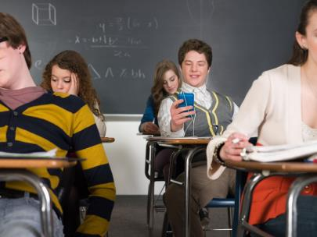
Lead-in
What is he doing?
He is listening to music.
Can you listen to music in class?
No, we can’t.

Slide 3
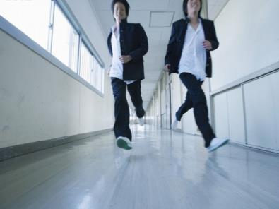
What are they doing?
They are running in the hallways.
Can you run in the hallways?
No, we can’t.

Slide 4
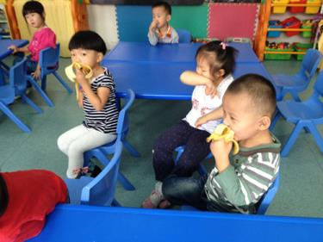
What are they doing?
They are eating in the classroom.
Can you eat in the classroom?
No, we can’t.

Slide 5
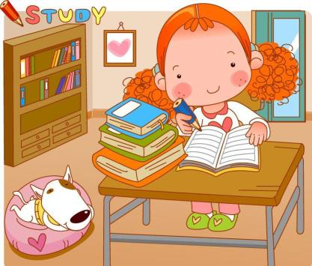

Slide 6
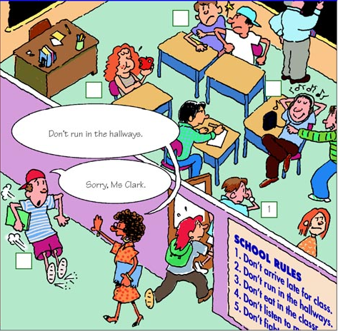
Which rules are these students breaking? Write the number of the rule next to the student.
1a

Slide 7
SCHOOL RULES
1. Don’t arrive late for class. You must be on time.
2. Don’t run in the hallways.
3. Don’t eat in the classroom. You must eat in the dining
hall.
4. Don’t listen to music in class.
5. Don’t fight.

Slide 8
5
3
4
2

Slide 9
Listen. What rules are these students breaking? Write the numbers after the names.
1b
Peter _____ Amy _____ Mike _____
2
3
4

Slide 10
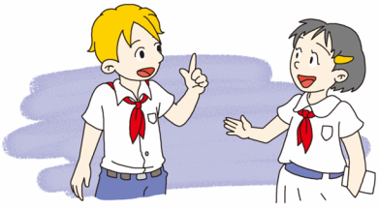
Student A is a new student. Student B tells Student A about the rules above.
1c
Well, we can’t arrive late for class. We must be on time.
What are the rules?

Slide 11
What are the rules?
We can’t eat in classroom, you must eat in dining hall.
And we can’t listen to music in class.

Slide 12
Listen check (√) the activities Alan and Cindy talk about.
2a
1. ___ listen to music in the classroom or hallways
2. ___ listen to music in music room
3. ___ listen to music outside 4. ___ eat in the classroom
√
√
√
√
5. ___ eat in the dining hall 6. ___ eat outside
7. ___ wear a hat 8. ___ fight
√
√
√

Slide 13
Listen again. Can Alan and Cindy do these activities? Circle can or can’t above.
2b
Activity
1. Listen to music in the classroom or hallways | can | can’t
2. listen to music in music room | can | can’t

Slide 14
3. listen to music outside | can | can’t
4. eat in the classroom | can | can’t
5. eat in the dining hall | can | can’t
6. eat outside | can | can’t
7. wear a hat | can | can’t
8. fight | can | can’t

Slide 15
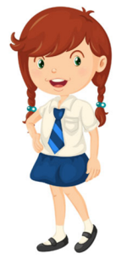
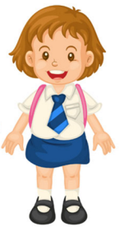
Student A is Alan and Student B is Cindy. Talk about the rules in 2a.
2c
Can we listen to music, Alan?
We can’t listen to music in the hallways, but we can listen to it outside.

Slide 16
Can we wear a hat in class?
No, we can’t. What else? Oh, you can’t fight with your classmates.

Slide 17
2d
Role-play the conversation.
Read the conversation and complete the sentences.
1.John’s new school has ____________ .
2.It’s important ______________ .
3.John can’t _________ music players to __________.
4.John________wears uniforms to school and ________
in the library.
a lot of rules
to be on time
bring
school
always
is quite

Slide 18
John: Hi, my name’s John. It’s my first day at school.
Alice: Hi, John. I’m Alice. This is a great school, but there
are a lot of rules.
John: Really? What are some of the rules?
Alice: Well, don’t be late for class. This is very important.
John: OK, so we must be on time. Can we bring music
players to school?

Slide 19
Alice: No, we can't. And we always have to wear the school
uniform.
John: I see.
Alice: Oh, and we also have to be quiet in the library.

Slide 20
Language points
1. Sorry, Ms. Clark. 对不起，克拉克女士。
Ms.（女士）常用于婚姻状况不明的女子的姓名前。
辨析：Ms. Mrs. Miss 与 Mr.
Ms.
“女士”是对婚姻状况不明的女子的称呼
例：格林女士
Ms. Green

Slide 21
Mrs.
Miss
Mr.
(夫人，太太)用于已婚女子丈夫的姓氏前
例：王夫人
Mrs. Wang
(小姐) 用于未婚女子的姓氏前
例：刘小姐
Miss Liu
(先生) 用于一切男子（不论婚否）的姓氏前
例：史密斯先生
Mr. Smith

Slide 22
2. Don’t listen to music in class. 不要在课堂上听音乐。
in class意为“在课上；上课时”
in the class 意为“在这个班”
介词+（不带限定词的）名词
介词+（带限定词的）名词

Slide 23
类似用法：
in hospital in the hospital
at table at the table
in bed in the bed
at school
at the school
在医院里
住院
吃饭
在桌子旁
卧床，睡觉
在床上
（在校）上学，求学
在学校里

Slide 24
3. It’s my first day at school. 这是我在学校的第一天。
first 此处为形容词，意为“最早的，第一的”。
常用短语：
first and last 完全地； at first 起初；
first of all 首先，第一。
first 作数词，意为“第一”，其前通常加定冠词the。
first 还可作副词，意为“最初；首先”。

Slide 25
4. This is very important. 这是非常重要的。
important为形容词，意为“重要的”
常用句型：
It is important for sb. to do sth.
“做某事对某人来说是重要的”
例: 对我们来说遵守规则是重要的。
It is important for us to follow the rules.

Slide 26
Exercise
把下列祈使句改成否定形式。
1. Be on time. 2. Eat in the hall.
_____________________ _____________________
3. Talk loudly.
_____________________
Don’t be on time.
Don’t eat in the hall.
Don’t talk loudly.

Slide 27
翻译下列句子。
放学后不可以在街上踢足球。（not, after）
外面很冷，你必须带上帽子。（outside, hat）
你们学校的制度是什么？（at your school）
Don’t play football in the street after school.
It’s cold outside. You must wear your hat.
What are the rules at your school?

Slide 28
上学不要迟到。(not，late)
_____________________________________________
我们必须要穿校服（have to）
_____________________________________________
Don’t be late for class.
We have to wear the school uniform.

