Slide 1
人教精通版四年级上册
This is my new friend
WWW.PPT818.COM

Slide 2
Review
Brother, brother, this is my brother.
I love my brother.
Sister, sister, this is my sister.
I love my sister.
Brother, sister, we play together.

Slide 3
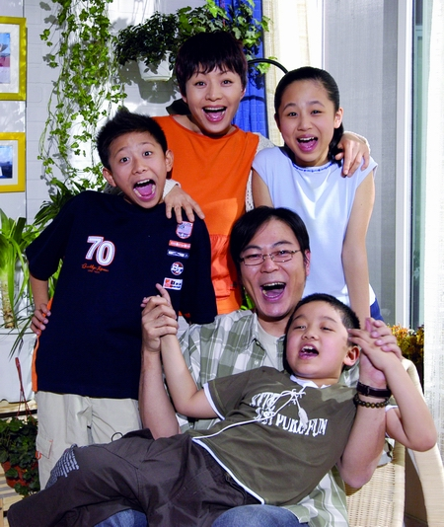
This is Liu Xing’s family. You can ask Liu Xing “Who’s this?”
She is my mother.
She is my sister.
He is my father.
He is my brother.

Slide 4
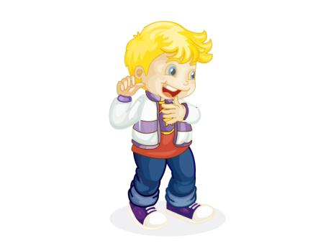
I’m a teacher. Is your father a teacher, too?
No, he isn’t.
Is he a farmer?
No, he’s a postman.

Slide 5
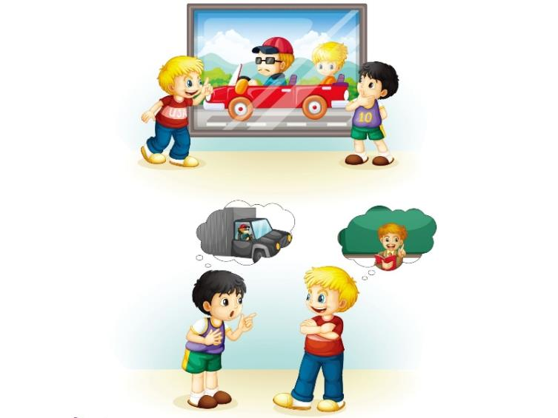
Jim is telling Gao Wei something about his father’s job. Guess what does his father do?

Slide 6
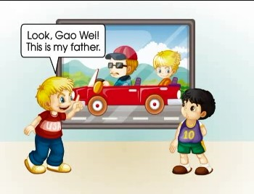
观看动画，模仿回答

Slide 7
询问职业的其他句型
1. What’s your job? 你是做什么工作的？
What’s his/ her job? 他/她是做什么工作的？
2. What do you do?你是做什么工作的？
What does he/ she do?他/她是做什么工作的？

Slide 8
He is cool! 他真酷！
cool一般用在口语中，表示某人打扮时髦、动作潇洒或表示感叹“棒极了”。
例如：Your father is cool！你爸爸太酷了！
cool也可以表示天气情况，意为“凉爽的”。
例如：It’s cool today. 今天很凉爽。

Slide 9
teacher
My mother is a teacher.

Slide 10
farmer
He is a farmer.

Slide 11
postman
My father is a postman.

Slide 13
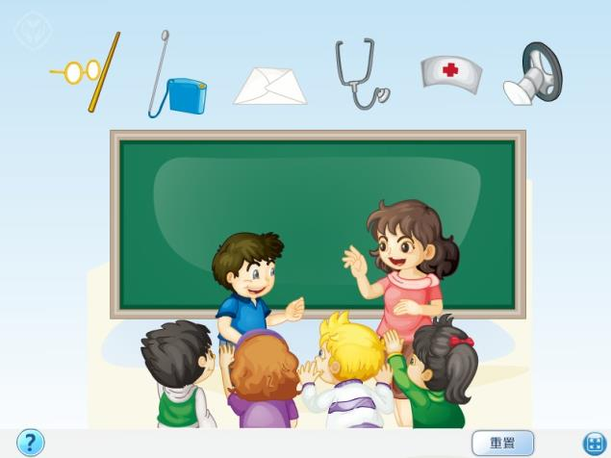
观看动画，学习表演

Slide 14
Practice
情景表演
Kate正在和朋友谈论家人的职业，她该如何询问朋友家人的职业呢？这时就可以时用句型：What does your…do?
例如：What does your brother do?
He is a farmer.

Slide 15
“我的职业理想”游戏
一位同学时用准备好的道具表演相关职业的典型动作，老师提问：“What does he do?”其他学生回答：“He’s a…”。

Slide 16
Language use
假定一位新同学来到班里，他从各个方面接触同学们。今天大家在一起谈论各自家庭的照片。这时新同学很想了解同学爸爸的职业。你们帮他俩编创一个询问并介绍爸爸的职业的对话吧！

