Slide 1
Unit 4 Topic 1
Which do you like better, plants or animals?
Section B
WWW.PPT818.COM

Slide 2
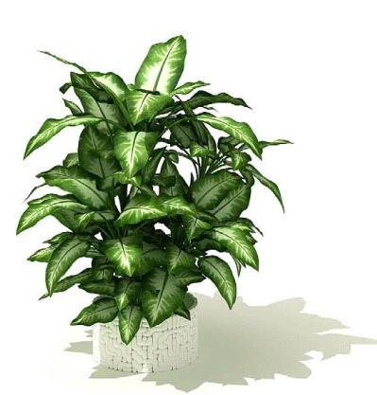
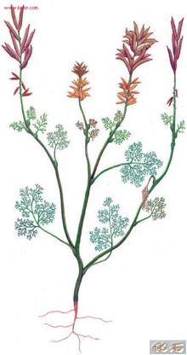
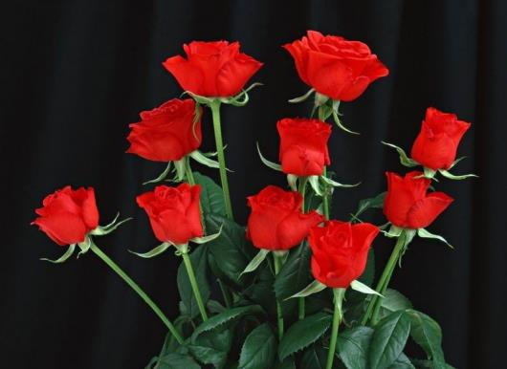
Look and learn.
rose n.玫瑰花
plant n. 植物
v. 种植，播种

Slide 3
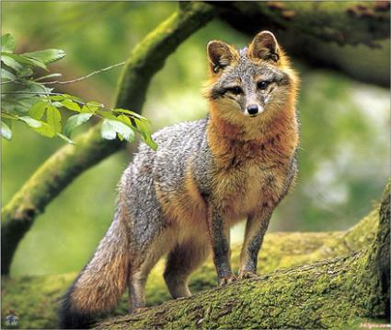
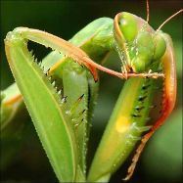
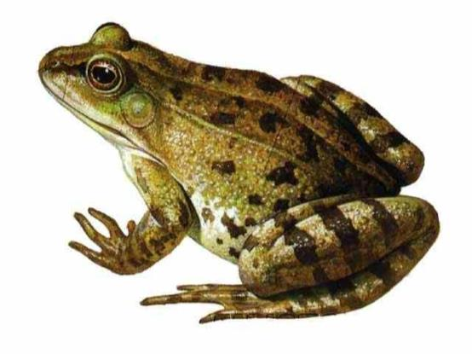
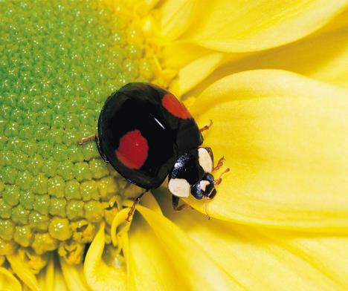
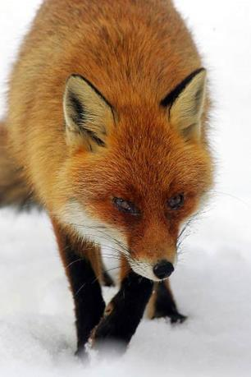
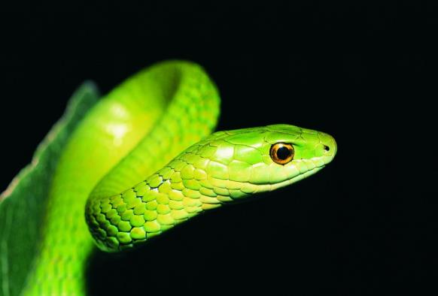
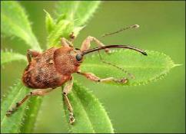
snake n. 蛇
Look and learn.
fox n. 狐狸
(pl.) foxes
frog n. 青蛙
insect n.昆虫

Slide 4
Which do you like better, animals or plants ?
Wang Wei took some photos about animals and plants. He is talking about the beautiful photos with his friends.

Slide 5
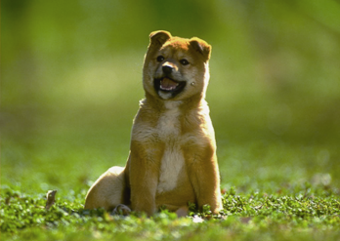
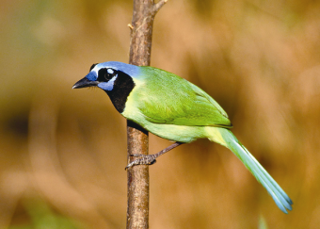
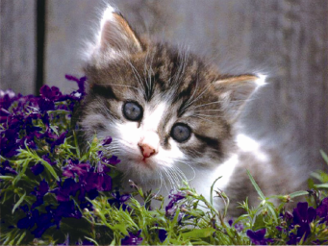
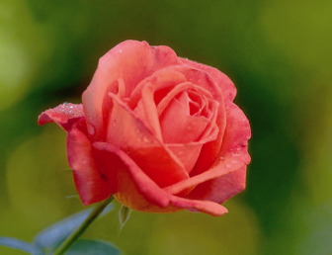
1a
What does each of them like better ? Now watch the flash of 1a, and finish 1b.

Slide 6
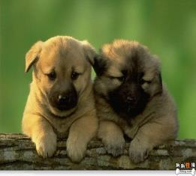
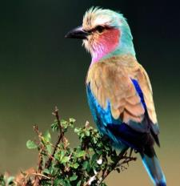
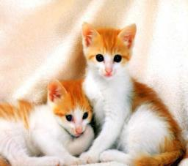
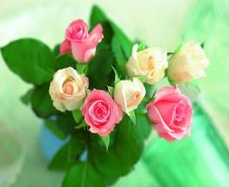
1b
Match the people with the things they like and their reasons.
friendlier
beautiful
the nicest of all
cuter

Slide 7
1c
Read 1a and fill in the blanks. Then report it to your partner.
Wang Wei likes ______ better and he thinks roses are the ______ of all the flowers. Michael likes ______ better because he thinks they are _________. They make us happy. Jane likes _____ best because they are _____ than other animals. Maria likes ______ because they are __________ and they can _____ to us. Kangkang likes both ______ and _______ because they are both _________ to us. We _______ the same world with them.
plants
nicest
animals
friendlier
cats
cuter
birds
beautiful
sing
plants
animals
important
share

Slide 8
Key points
众所周知
As we know, plants and animals are important to us.
be important to sb.

Slide 9
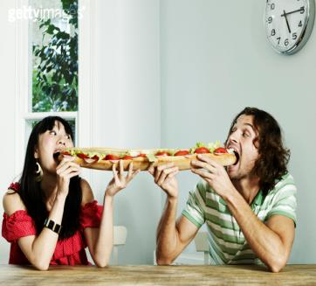
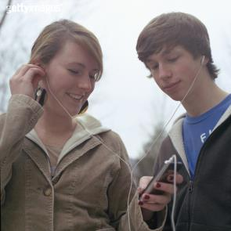
We share the same world with them.
share … with … 与……分享……
Eg： They are sharing a piece of long bread.
They often share beautiful music with each other.

Slide 10
Which do you like better, plants or animals?
like … better
更喜欢……
I like apples better.
I like cats best.
like … best
最喜欢……
I like bananas best.

Slide 11
Pair work
Work in pairs and make up conversations about animals or plants you like. The expressions in 1a may help you.

Slide 12
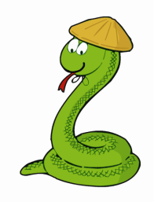
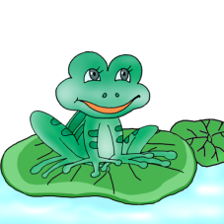
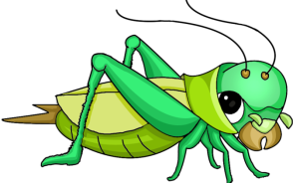
3
Check your sounds
Look at the pictures and write down the words according to the sounds. Then listen and check the vowels and stress.
/ frDg /
______
/ ‘Insekt /
_______
/ snVk /
_______
frog
insect
snake

Slide 13
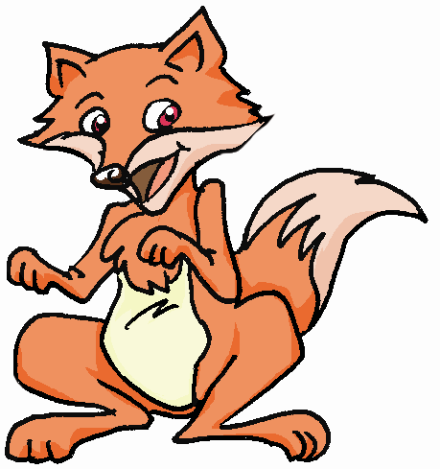
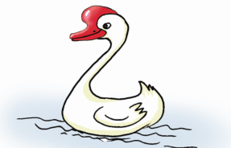
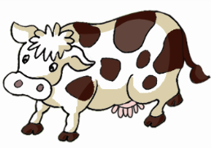
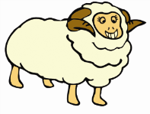
/ gu:s /
_______
/ fDks /
______
goose
fox
/ kau /
_______
/ ʃi:p /
_______
sheep
cow

Slide 14
4a
Read the pairs of words and pay attention to the difference between / r / and / l / .
/r/ - /l/ : poor — pull door — doll
or — all here — hill

Slide 15
Read the conversations and pay attention to the pause in each sentence. Then read after the tape and imitate.
4b
A: Which kind of animal do you like better, / frogs
or snakes?
B: I like frogs better / because they are more
useful.
2.A: What about you, / Maria?
B: I like birds./ They are beautiful, / and they can
sing to us.

Slide 16
3. A: Do you like the countryside?
B: Yes, / I like it very much / because / the air is
fresher, the sky is bluer/ and the rivers are
clearer there.
You often pause when you see a comma or finish a sense group.

Slide 17
Discuss the following questions about animals and plants in groups, then report the results to the class.
Task
1. Do you know the importance of
plants and animals to us?
2. What should we do to protect
plants and animals?

Slide 18
summary
Talk about plants and animals in nature.
2. Useful expressions:
like better
like best
share … with …; give … joy
feed on; be important to

Slide 19
Homework
How many kinds of animals do you know? Write them down and draw a picture to show their relations.

