Slide 1
人教版八年级上册
Unit 4
What’s the best movie theater?
Section A（第2课时）
0
WWW.PPT818.COM
0

Slide 2
学习目标
一、语言知识目标
熟练使用含形容词及副词最高级用法的句型：
A: What’s the best movie theater to go to?
B: Town Cinema. It’s the closest to home. And you can buy tickets the most quickly there.
A: Which is the worst clothes store in town?
B: Dream Clothes. It’s worse than Blue Moon. It has the worst service.
A: What do you think of 970 AM?
B: I think 970 AM is pretty bad. It has the worst music.
二、学习策略：
1. 通过核心句型的集中学习，能更加牢固地掌握形容词和副词的最高级的正确表达形式。
2. 通过组句训练，强化本单元重点知识的学习和突破语法难
点。
3. 通过开放性的口语活动，能够在真实的语境中使用目标词汇和句型。
三、情感态度价值观目标：
学会正确跟同伴谈论及比较身边事物，对事物进行客观评价，了解差异，培养独立思维能力。

Slide 3
自学互研
新词自查
根据句意及首字母提示完成句子
1. I think this movie is bad,but that one is w orse than this one.
2. —What do you think of the clothes store?
—It has the best s ervice , but it has the worst quality clothes.
3. — Can you give me a m enu ? I want to order my food.
—OK, Here you are.
4. People usually have three m eals a day.

Slide 4
情景导入
Do you want to know me?
Hello, I am Ms. Zhang, a teacher from Chayuan Middle School. I am short and a little heavy. I have long hair and wear glasses. I am hard-working and friendly to my students.
And I am a gentle (温和的) mother.
short
heavy
long
hard-
working
friendly
gentle
Am I different from your English teacher?
I think … shorter/ heavier/…than…

Slide 5
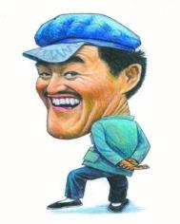
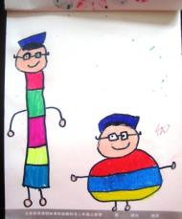
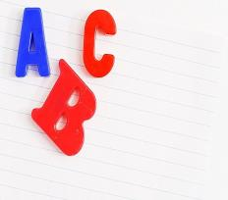
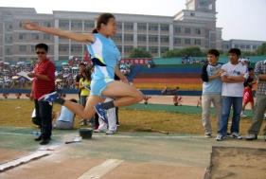
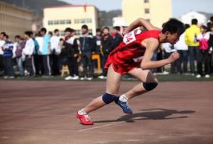
I want to know you!
thinnest
thin
outgoing
tallest
most outgoing
tall
most hard-working
hard-working
funniest
funny
jump farthest
run fastest
jump far
good at English
run fast
best at English
A: Who is the tallest in the class?
B: I think … is the tallest.
A: Who runs the fastest in the class?
B: I think …

Slide 6
Review the superlative form of an adjective or adverb
small __________ nice __________
big __________ easy __________
smallest
nicest
biggest
easiest
beautiful _________________
comfortably ____________________
little _____________
bad/badly __________
most beautiful
most comfortably
least
worst

Slide 7
What’s the best movie theater to go to? | Town Cinema. It’s the closest to home. And you can buy tickets the most quickly there.
Which is the worst clothes store in town? | Dream Clothes. It’s worse than Blue Moon. It has the worst service.
What do you think of 970 AM? | I think 970 AM is pretty bad. It has the worst music.

Slide 8
构成规律：
规则变化
一般加 –est ， 如：
strong—strongest，fast—fastest
以不发音的e结尾， 加-st
nice—nicest, large- largest
单音节词和部分双音节词
以辅音加y结尾, 改y为i, 加-est
happy — happiest
辅音字母结尾的重读闭音节词，双写末尾的辅音字母，加-est, thin — thinnest
多音节词， 和部分双音节词，
在词的前面加most
outgoing — most outgoing
Notes:
中国英语教师网

Slide 9
形容词的原形、比较级和最高级
原级 | 比较级 | 最高级
big | bigger | biggest
cheap | cheaper | cheapest
new | newer | newest
close | closer | closest
expensive | more expensive | most expensive
popular | more popular | most popular
comfortable | more comfortable | most comfortable
interesting | more interesting | most interesting
Notes:
中国英语教师网

Slide 10
常用的不规则形容词比较级和最高级变化形式
原级 | 比较级 | 最高级
good/well | better | best
many/ much | more | most
bad/ill/badly | worse | worst
old | older/elder | oldest/eldest
far | farther/ further | farthest/ furthest
Notes:
中国英语教师网

Slide 11
最高级规则变化口诀：
最高级，很容易，一般词尾加est。
(cheap-cheapest)
词尾若有哑音e, 直接就加st。
(close-closest)
重读闭音节， 单辅音字母要双写。
(big-biggest)
辅音字母若加y, 记得把y变为i。
(friendly-friendliest)
多音节，考考你，most到底加哪里？
(popular-most popular)

Slide 12
形容词最高级的用法
1. 形容词的最高级前一般要加定冠词the，但如果其前有形容词性物主代词或名词所有格等修饰语时，则不再用定冠词the。如：
This is the oldest theater in London.
He is my / Tom’s best friend.

Slide 13
2. 形容词的最高级常与介词in或of短语连用，说明比较范围。一般情况下，如果主语与介词短语中的名词属于同一类，用介词of；如果不是同一类，则用介词in。如：
He is the tallest of these boys.
Sam is the youngest in his class.

Slide 14
即学即练
他在我们班上他最高。
He is __________ ( tall) _____ our class.
玛丽是这三个学生中最小的。
Mary is __________ (young) ______ the three students.
the tallest
in
the youngest
of

Slide 15
3. 形容词的最高级前可用序数词，二者共同修饰后面的名词，其结构为“the +序数词 + 形容词的最高级 + 名词”。如：
The Yellow River is the second longest river in China.

Slide 16
4. “one of + the + 形容词的最高级 + 复数名词”，意为“最……之一”。如：
Miss Wang is one of the most popular teachers in our school.

Slide 17
副词最高级的用法
1. 最高级用于三者或三者以上的比较，副词最高级前定冠词the 可以省略，后面可以带of (in) 短语来说明比较的范围。
句型为：“A+ 动词+ (the) + 副词最高级+of (in)…”。例如：
She runs fastest of the three.
她是三人中跑得最快的。
She works (the) hardest in her class.
她是她班上学习最用功的。

Slide 18
2. Which (Who) +动词+(the) +副词最高级, A, B or C? 表示三个或三个以上的人或事物中“哪一个最……”。例如：
Which runs fastest, a car, a train or a plane?
汽车，火车和飞机，哪一样跑得最快？

Slide 19
知识链接
下列词或短语可修饰最高级：by far, far, much, mostly, almost。例如：
This hat is nearly / almost the biggest.
这帽子差不多是最大的了。
注意：
a. very可修饰最高级，但位置与much不同
This is the very best.
= This is much the best.

Slide 20
b. 序数词通常只修饰最高级。例如：
Africa is the second largest continent.
非洲是第二大洲。
最高级的意义有时可以用比较级表示出来。例如：
Mike is the most intelligent in his class.
马克是班上最聪明的。
= Mike is more intelligent than any other students in his class.

Slide 21
比较级+than
less …than
the+比较级
as… as
the+比较级+句子，the+比较级+句子
比较级
规则变化
原级
词形构成
the+最高级…
不规则变化
最高级
形容词和
副词

Slide 22
3a
Fill in the blanks with the correct forms.
worst
1. We went to the _________ (bad) restaurant in town last night. The menu had only 10 dishes and the service was not good at all!
2. Blue Moon is _________ (good), but Miller’s is ________ (good) in town.
3. The Big Screen is _____________ (expensive) than most cinemas, but Cinema City is ________________ (expensive).
good
the best
more expensive
the most expensive

Slide 23
4. Movie City has the ________ (had) service, but we can sit the __________________ (comfortably) there.
5. Johnny Depp acted the _______ (good) in that movie. He’s much _______ (good) than others at finding the _______________ (interesting) roles.
worst
most comfortably
best
better
most interesting

Slide 24
3b
Think of three stores that sell similar things in your town and fill in the chart. Then write six sentences using the information in the chart.
Service | best: | worst:
Quality | best: | worst:
Prices | cheapest: | most expensive:

Slide 25
1. New World has the best service in town.
2. ____________________________________
3. ____________________________________
4. ____________________________________
5. ____________________________________
6. ____________________________________
Pink Rose has the worst service in town.
Pink Rose has the best quality in town.
Bargain House has the worst quality in town.
Bargain House is the cheapest in town.
New World is the most expensive in town.

Slide 26
3c
Fill in the chart. Then talk in your group and choose the best one.
Restaurants | Danny’s
How much is a meal?
How far is it from your home? | 10 minutes by bus
Is the service good?
Is the food good?
Danny’s is the best one because it’s the closest.

Slide 27
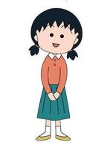
Which do you think is the best restaurant near your home?
… is the best restaurant.
Why?

Slide 28
Because it’s the closest to my home, only five minutes on foot. And the service is the best. There are many kinds of seafood, and I like seafood very much.
But I think it’s very expensive.
Yes, but I don’t order a lot of food.

Slide 29
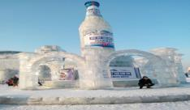
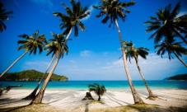
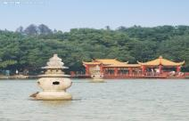
I need your help.
My family plan to have a self-service travel (自助游) during the winter holiday, but I have difficulties in making choices.
Places
Weather
-20℃～-15℃
20 ℃～28℃
4 ℃～10℃
Cost
￥3200
￥2800
￥600
Time on
the way
2 hours and 30 minutes by plane
1 hour by train
3 hours by plane
cheap
The trip to Hangzhou is _______. The trip to Hainan is _______________ than Hangzhou. The trip to Hainan is _________ than Harbin. So, the trip to Hangzhou is __________ and the trip to Harbin is _________________.
It takes __________ time to go to Hangzhou. It takes ________ time to go to Harbin. (little, much)
the least
the most
Hangzhou is ____ in winter. Harbin is _____ than Hangzhou. Hainan is _______ than Hangzhou. So, Harbin is the ________ and Hainan is the ________.
cold
colder
more expensive
cheaper
warmer
the cheapest
coldest
warmest
the most expensive

Slide 30
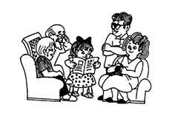
I need your help.
Which city is the most proper choice?
Places
Weather
-20℃～-15℃
20 ℃～28℃
4 ℃～10℃
￥3200
￥2800
￥600
Cost
Time on
the way
2 hours and 30 minutes by plane
3 hours by plane
1 hour by train
My father: I can’t stand the freezing (冰冻的) weather.
My mother: Don’t spend too much money.
My husband: I am afraid of flying.
My 2-year-old daughter: I want to go with you.
Among the three cities, I think you should travel to …, because the weather there is … The cost is … It takes … time on the way. Your …

Slide 31
Group work
places of interest
restaurants
hotels
self-service travel in
Hangzhou
transportation means
…
One is the group leader (组长). The other three students get one piece of paper and keep it well. The leader asks questions and fills the information chart. Then the whole group compares and makes the choice together.
What should we think about when having self-service travel?

Slide 32
1. The fifth orange is______ of all. Give it
to that small child.
A. big B. bigger
C. the bigger D. the biggest
2. Mother is ______ in my family.
A. busy B. busier
C. the busiest D. more busy

Slide 33
3. Who jumped ______ of all?
A. far B. farther
C. farthest D. the most far
4. Li Lei is ______ student in our class.
A. tall B. taller
C. tallest D. the tallest

Slide 34
5. Tom is one of ______ boys in our class.
A. tallest B. taller
C. the tallest D. the tall
6. Which month is______, June, July or
August?
A. hot B. hotter
C. hottest D. the hottest

Slide 35
Summary
形容词或副词的最高级
变化规则
基本用法
最高级，很容易，
一般词尾加est。
词尾若有哑音e,
直接就加st。
重读闭音节，
单辅音字母要双写。
辅音字母若加y,
记得把y变为i。
多音节，要注意，
most加在最前面。
两者相比,比较级，
三者以上,最高级。
the字在前最高级,
比较范围要注意，
碰上 of 、in 短语,
千万别忘最高级。

Slide 36
Homework
(1). Review the grammar focus after class.
(2). Write down the information of your travel
trip.

