Slide 1
Unit 8
It must belong to Carla.
Section B (第1课时)
WWW.PPT818.COM

Slide 2
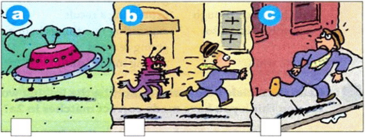
1a
Look at the pictures.Then use the words in the box to write a sentence about each picture.
land man UFO run alien run after
a._____________________________________________________
b._____________________________________________
c.______________________________________________________
A UFO is landing.
An alien is running after a man.
A man is running.

Slide 3
Listen and number the pictures [1-3] in 1a.Then write two or three sentences to finish the story.
1b
2
3
1
_________________________________________________________
_________________________________________________________
_________________________________________________________

Slide 4
1c
Listen again. Complete the sentences.
They see... | The man says... | The woman says...
1.a man running | he might be _________________ | he could be __________________
2.something in the sky | it could be _________________ | it must be _______________
3.something strange | it must be _________________ | I must be _______________
4. a woman with a camera | she could be _________________ | they must be _______________
late for work
running for exercise
a plane
a UFO
an alien
dreaming
from the TV news
making a movie

Slide 5
Role-play a conversation between the man and the woman.
1d
A:Why do you think the man is running?
B:He could be running for exercise.
A:No,he’s wearing a suit.He might be running to catch a bus to work.

Slide 6
Match each linking word or phrase with its purpose.
2a
Linking word or phrase Purpose of linking word or pharse
so expressing a difference
as,because,since giving a choice
but,however,though expressing a result
not only...but also expressing two things happening at the same time
or giving reasons
when,while adding information

Slide 7
Read the article below and underline the linking words and phrases.Do you think you have made correct matches in 2a?
2b
Stonehenge—Can Anyone Explain Why It Is There?
Stonehenge,a rock circle,is not only one of Britain's most famous
historical places but also one of its greatest mysteries.Every year it receives more than 750,000 visitors. People like to go to this place especially in June as they want to see the sun rising on the longest day of the year.
For many years,historians believed Stonehenge was a temple where ancient leaders tried to communicate with the gods.However,historian Paul Stoker thinks this can't be true because Stonehenge was built so many centuries ago.“The leaders arrived in England much later,”he points out.

Slide 8
Another popular idea is that Stonehenge might be a kind of calendar. The large stones were put together in a certain way. On midsummer's
morning,the sun shines directly into the center of the stones.Other people believe the stones have a medical purpose.They think the stones can prevent illness and keep people healthy.“As you walk there,you can feel the energy from your feet move up your body,”said one visitor.No one is sure what Stonehenge was used for,but most agree that the position of the stones must be for a special purpose.Some think it might be a burial place or a place to honor ancestors.Others think it was built to celebrate a victory over an enemy.

Slide 9
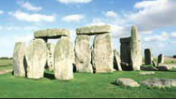
Stonehenge was built slowly over a long period of time.Most historians believe it must be almost 5,000 years old.One of the greatest mysteries is how it was built because the stones are so big and heavy.In 2001,a group of English volunteers tried to build another Stonehenge,but they
couldn't.“We don't really know who built Stonehenge,”
says Paul Stoker.“And perhaps we might never know,
but we do know they must have been hard-working—and
great planners!”

Slide 10
2c
Read the article again and complete the chart.
Mysteries about Stonehenge | What Stonehenge might have been used for...
Who built it?

Slide 11
2d
Complete the sentences with the correct linking words.
1.Midsummer day is in June___________a lot of people go to
Stonehenge during this month.
2.The sun shines straight into the center of Stonehenge
____________the stones were put in a special position.
3.Some people think the rocks can___________stop people from
becoming ill____________keep them healthy.
4.We don't know who built Stonehenge___________how it was built.
5.Historians think Stonehenge was built about 5,000 years
ago;____________,they are not sure.
so
because
not only
but also
or
however

Slide 12
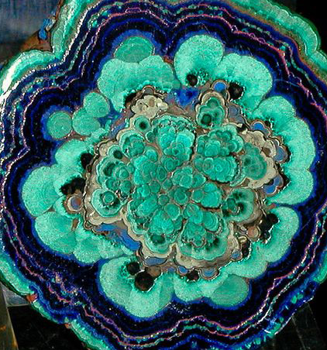
Language Points
1.suit的用法
(1)v.适合
e.g.:The suit doesn't suit you well.
(2)n.西装
e.g.:The man in a suit in the office is a boss.
2.see sb. doing sth.
看见某人正在做某事（侧重于动作正在进行），see sb. do sth.看见某人做某事（侧重动作发生的全过程）。

Slide 13
3.He might be running to catch a bus.他也许是跑着去赶公共汽车。
（1）could be running是“情态动词+be+doing”,表示对正在进行或发生的动作进行推测，意为“一定/可能在做某事”。
e.g.:He must be watching TV now.
（2）catch是动词，在此意为“追上，赶上”。如catch a bus
【拓展】catch还可译为“接住；抓住，捉住，逮住；感染上，传染上”。
catch the ball catch the fish catch the thief catch a cold

Slide 14
4.a woman with a camera
这里的with短语表伴随，修饰其前的名词。
如a girl with long hair

Slide 15
Exercise
一、选择方框中的词并用其正确形式填空。
1.Those___________with glasses are our teachers.
2.He could___________interviewing the star.
3.He got up so early that he___________the bus this morning.
4.We can see two boys___________on the playground now.
5.I didn't find anything__________happen these days.
be catch run woman stranger
women
be
caught
running
strange

Slide 16
二、根据汉语意思完成句子。
1.明明可能正在踢足球。
Mingming__________ __________ __________football.
2.你能看见那人在做什么吗？
What can you__________the man__________?
3.那个拿相机的女士在采访李娜。
The woman__________a__________is interviewing Li Na.
4.她喜欢跑步锻炼。
She likes__________ __________ __________.
5.你认识今天那个穿西装的男士吗？
Do you know the man who is__________a ______today?
might
be
playing
see
doing
with
camera
running
for
exercise
in
suit

Slide 17
Homework
Remember the new words and expressions.

Slide 18
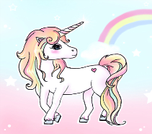
Thank you!

