Slide 1
Unit3 Is It Snowing?
陕旅版
四年级下册
第一课时
WWW.PPT818.COM

Slide 2
>>Review
read write sleep eat
listen cook stand sit
Magic fingers

Slide 3
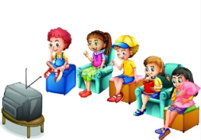
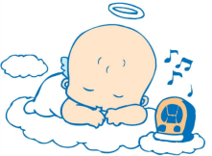
>>Review
Look and say
-What … doing?
-…

Slide 4
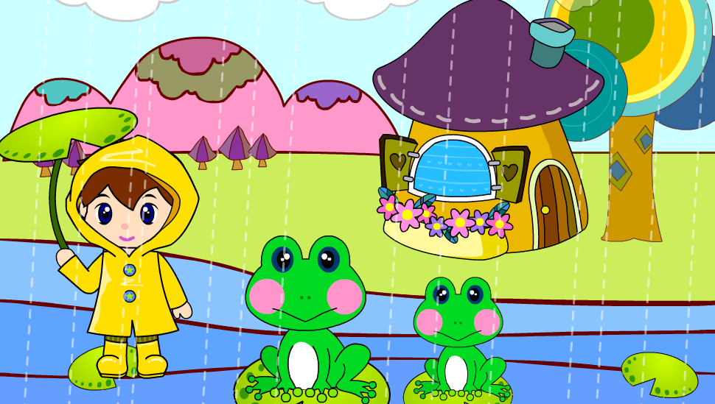
>>Warm-up
Sing a song

Slide 5
>>Lead-in
Draw the weather today

Slide 6
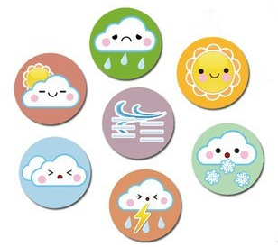
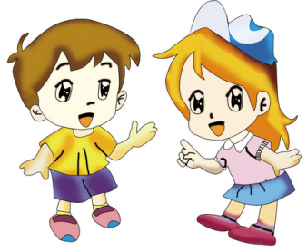
>>Presentation
Let’s talk
What is the weather like today?

Slide 7
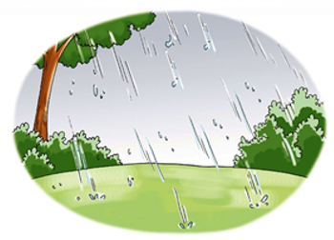
>>Presentation
Let’s learn
rain

Slide 8
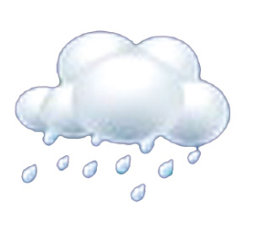
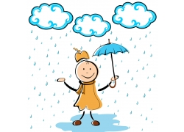
>>Presentation
Look and say
rain

Slide 9
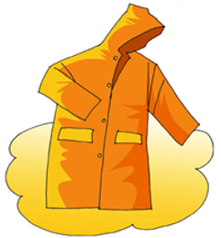
>>Presentation
Let’s learn
raincoat

Slide 10
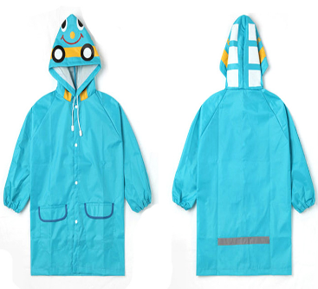
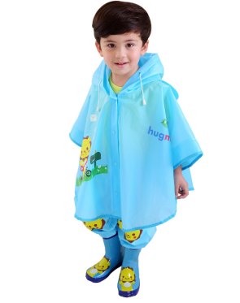
>>Presentation
Look and say
raincoat

Slide 11
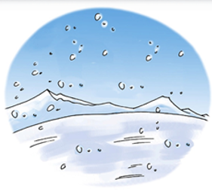
>>Presentation
Let’s learn
snow

Slide 12
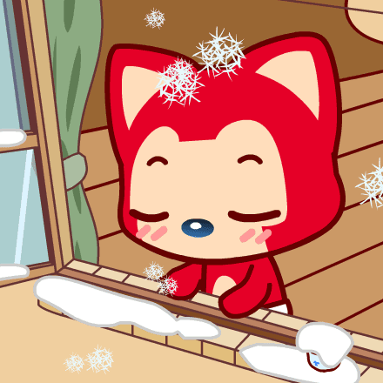
>>Presentation
Look and say
snow
rain

Slide 13
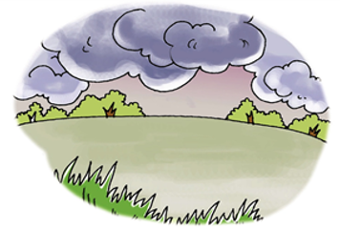
>>Presentation
Let’s learn
cloud

Slide 14
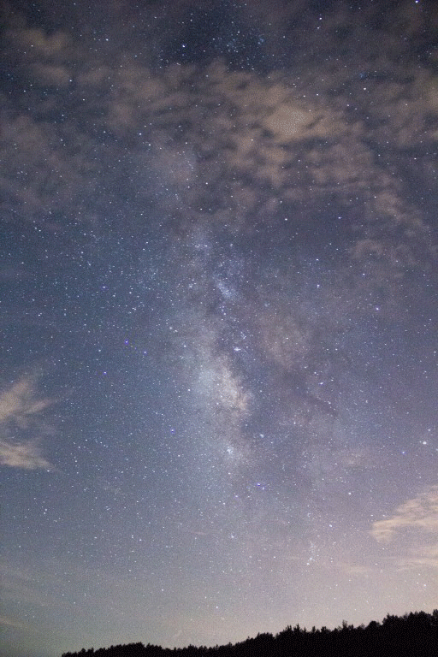
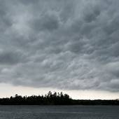
>>Presentation
Look and say
cloud

Slide 15
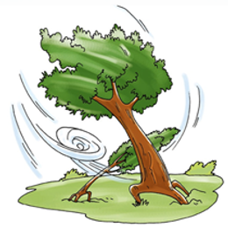
>>Presentation
Let’s learn
wind

Slide 16
>>Presentation
Look and say
wind
cloud

Slide 17
>>Presentation
Let’s learn
What’s this?
The sky is blue. There are some clouds, too. They are white. They are beautiful.
It’s a sky.

Slide 18
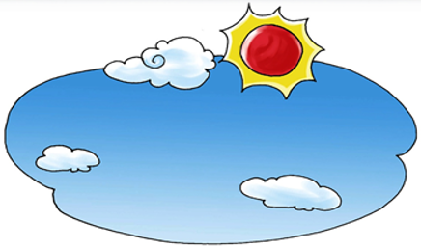
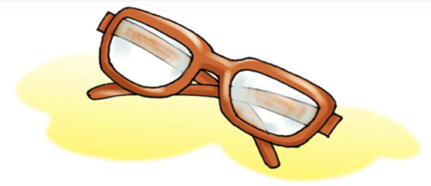
>>Presentation
Let’s learn
sky
glasses

Slide 19
>>Practice
Remember: What’s this?
rain
?
?
?
raincoat
snow

Slide 20
>>Practice
Remember: What’s this?
?
rain
cloud
glasses
?
?

Slide 21
>>Practice
Remember: What’s this?
?
sky
cloud
wind
?
?

Slide 22
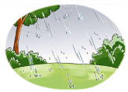
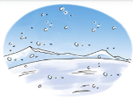
>>Practice
Magic fingers

Slide 23
>>Practice
大转盘
—What’s this?
活动
—It’s …
rain
sky
wind
cloud
snow

Slide 24
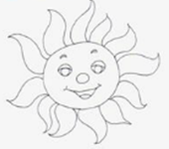
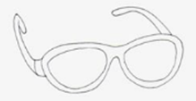
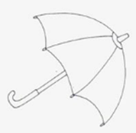
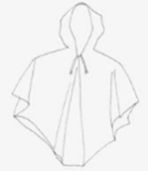
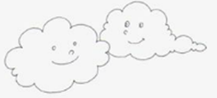
>>Presentation
Look and say
sun
glasses
umbrella
cloud
raincoat

Slide 25
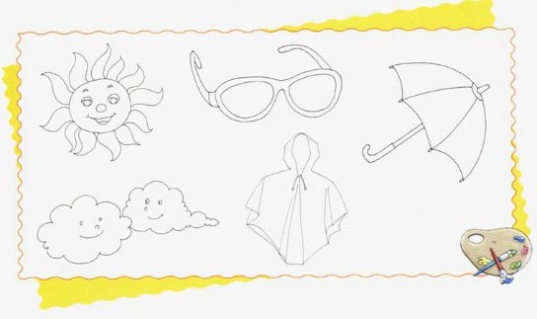
>>Practice
Listen and color

Slide 26
>>Summary
本课所学的新单词有哪些？
rain snow cloud wind
sky raincoat glasses

Slide 27
>>Homework
1.听课文录音并跟读，按照正确的语音、语调朗读并表演课文对话。 2.正确书写本课所学单词5遍，并让家长听写1遍。
3.预习A Let’s talk。
close

