Slide 1
Section B Reading and Thinking
人教版高中英语必修二
UNIT 5 Music
WWW.PPT818.COM

Slide 2
Ⅰ
Ⅱ
Ⅲ
Ⅰ.知识体系图解
virtual
composition
opportunity
performance
onto
studio
ordinary
enable
prove

Slide 3
Ⅰ
Ⅱ
Ⅲ
award
original
phenomenon
stage
altogether
thus
band
nowadays

Slide 4
Ⅰ
Ⅱ
Ⅲ
爱上
提出
组装
有相同的兴趣
把……加到……上
第一次
从……毕业
获得硕士学位
数百万
把……聚集到一起

Slide 5
Ⅰ
Ⅱ
Ⅲ
Ⅱ.释义匹配
1.performance A.to make it possible for someone to do something,or for something to happen
2.opportunity B.a chance to do something or an occasion when it is easy for you to do something
3.enable C.to show that something is true by providing facts,information etc.
4.prove D.a play or a piece of music that someone performs
5.award E.something such as a prize or money given to someone to reward them for something they have done
答案:1.D 2.B 3.A 4.C 5.E

Slide 6
Ⅰ
Ⅱ
Ⅲ
Ⅲ.阅读导学
根据P52课文内容,选择正确答案。
1.What do you need if you want to take part in a virtual choir?
A.A studio and a video camera.
B.An Internet connection and a studio.
C.A video camera and an Internet connection.
D.A studio and an interest in music.
2.What can we know about the virtual choir from the first paragraph?
A.A virtual choir affects many people’s lives positively.
B.A virtual choir connects ordinary people to famous singers.
C.A virtual choir can solve many people’s problems in the real world.
D.A virtual choir makes many people become successful.
答案:C
答案:A

Slide 7
Ⅰ
Ⅱ
Ⅲ
3.How long did Eric Whitacre study at the University of Nevada?
A.Four years. B.Five years.
C.Six years. D.Seven years.
4.What does the last paragraph mainly tell us?
A.The value of the virtual choir.
B.The popularity of the virtual choir.
C.The disadvantage of the virtual choir.
D.The present situation of the virtual choir.
答案:D
答案:A

Slide 8
重点词汇
重点句式
随堂练习
1.opportunity n.机会;时机
【课文原句】Imagine having the opportunity to sing together with hundreds of other people while you are at home alone.
想象一下,当你独自在家的时候,有机会和数百人一起唱歌。
【词汇精讲】opportunity是可数名词,意为“机会;时机”。
In my view,part-time jobs can provide college students with a valuable opportunity to know more about the outside world.
我认为,兼职工作可以给大学生提供一个宝贵的机会去更多地了解外面的世界。
Parents should actively urge their children to take advantage of the opportunity to join sports teams.
父母应该积极地督促孩子抓住机会加入体育队。

Slide 9
重点词汇
重点句式
随堂练习
【词汇拓展】

Slide 10
重点词汇
重点句式
随堂练习

Slide 11
重点词汇
重点句式
随堂练习
2.perform vi.&vt. 表演;履行;执行
【课文原句】Virtual choir members record themselves while they perform alone on video.
虚拟合唱团成员单独表演时在视频上录制自己。
【词汇精讲】perform可作及物或不及物动词,意为“表演;履行;执行”。
What made the fans delighted was that the young player performed extremely well in the table tennis tournament.
令球迷欣喜的是那位年轻的球员在乒乓球锦标赛中表现得极为出色。
After that,we’ll sing their favourite songs and perform folk dances.
在那之后,我们将唱他们最喜爱的歌曲,表演民间舞蹈。

Slide 12
重点词汇
重点句式
随堂练习
【词汇拓展】
The doctors performed the operation successfully.
医生手术做得很成功。
We put on a song and dance performance to welcome the guests.
我们表演歌舞来欢迎来宾。

Slide 13
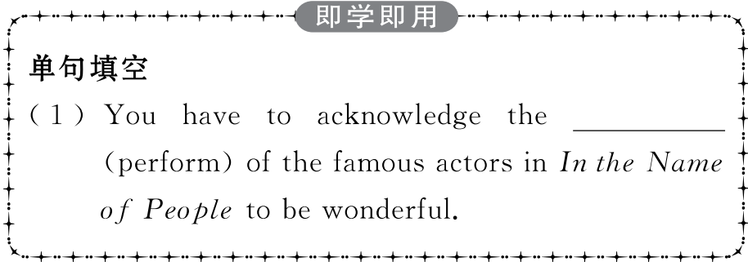
重点词汇
重点句式
随堂练习

Slide 14
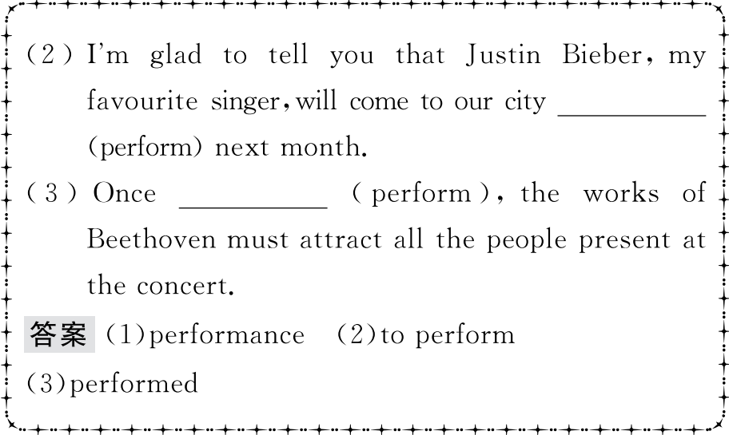
重点词汇
重点句式
随堂练习

Slide 15
重点词汇
重点句式
随堂练习
3.enable vt.使能够;使可能
【课文原句】A virtual choir enables them to add their voices to those of other individuals and become part of the global community.
虚拟合唱团能使他们把自己的声音和其他人的合在一起,成为全球社区的一部分。
【词汇精讲】enable是及物动词,意为“使能够;使可能”,可用于enable sb to do sth结构,意为“能使某人做某事”。
This dictionary will enable better international understanding.
这部词典将促进国际间更好地理解。
The software enables you to access the Internet in seconds.
这种软件使你在几秒钟内便可访问互联网。
The new programme enables older people to study at college.
这个新计划能使老年人有机会在大学学习。

Slide 16
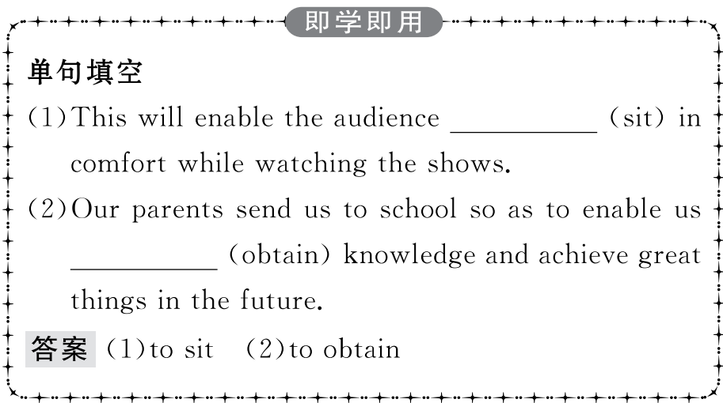
重点词汇
重点句式
随堂练习

Slide 17
重点词汇
重点句式
随堂练习
4.prove vt.证明;展现
【课文原句】It has proved to be a positive influence on the lives of many people.
事实证明,这对许多人的生活产生了积极影响。
【词汇精讲】prove是及物动词,意为“证明;展现”。
Just give me a chance and I’ll prove the theory to you.
只要给我一个机会,我就会向你证明这个理论。
The strength of China’s economy will be further proved.
中国的经济实力将被进一步证实。

Slide 18
重点词汇
重点句式
随堂练习
【词汇拓展】
You’re wrong,and I can prove it.你错了,我能证明。
The task proved (to be) more difficult than we’d thought.
这项任务比我们预想的难得多。
The doctor’s tests proved that Black was in good health.
医生的检查证明了布莱克身体健康。
【温馨提示】prove表示“证明是,结果是”时是系动词,无被动语态,用主动形式表示被动意义。
Using mobile phones proves (to be) harmful to our health.
使用手机证明对我们的身体有害。

Slide 19
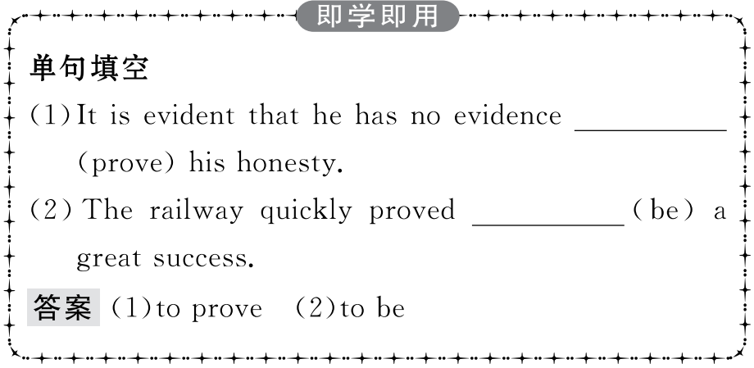
重点词汇
重点句式
随堂练习

Slide 20
重点词汇
重点句式
随堂练习
5.award vt.授予 n.奖品
【课文原句】The virtual choir was the idea of award-winning composer and conductor Eric Whitacre.
虚拟合唱团是获奖作曲家兼指挥家埃里克·惠特克的想法。
【词汇精讲】Have you heard the good news about his award?
你听到他获奖的好消息了吗?
The best students are awarded special scholarship.
优秀学生会被颁发特别奖学金。
She has been awarded first prize four years in succession.
她已连续四年获得一等奖。

Slide 21
重点词汇
重点句式
随堂练习
【词汇拓展】
【易混辨析】

Slide 22
重点词汇
重点句式
随堂练习
How many gold medals did he get in the games?
他在比赛中获得了多少枚金牌?
We will offer a reward of ten thousand dollars for information about the case.
如果有人提供有关案件的情报,我们愿意出一万美元赏金。
He hopes to get the first prize in the English competition.
他希望在英语竞赛中获得一等奖。

Slide 23
重点词汇
重点句式
随堂练习

Slide 24
重点词汇
重点句式
随堂练习
Imagine having the opportunity to sing together with hundreds of other people while you are at home alone.
想象一下,当你独自在家的时候,有机会和数百人一起唱歌。
【句式剖析】本句是一个复合句。主句是一个祈使句,imagine doing意为“想象做某事”,while引导的是时间状语从句。
while引导时间状语从句时,从句中的谓语动词必须是连系动词或延续性动词。
The mother didn’t know who to blame for the broken glass as it happened while she was out.
妈妈不知道该责备谁打碎了玻璃,因为这发生在她外出的时候。
While they were building a tunnel through the mountain,the workers discovered an underground lake.
当工人们在修建一条穿山隧道时,他们发现了一个地下湖。

Slide 25
重点词汇
重点句式
随堂练习
【句式拓展】
While I enjoy the book with some nice pictures,I don’t have enough money to buy it.
虽然我喜欢这本有一些漂亮图画的书,但是我没有足够的钱买它。
Generally,sweet apples are eaten fresh while tart apples are used to make applesauce.
一般说来,甜苹果生吃,而酸苹果则用来制作苹果酱。

Slide 26
重点词汇
重点句式
随堂练习
【温馨提示】当while从句中的主语与主句主语一致,且从句含be动词时,可省略从句的主语和be动词。
While waiting for the bus,he caught sight of an old friend.
等公共汽车时他看到了一位老朋友。
While reading in bed,she fell asleep.
躺在床上看书时她睡着了。

Slide 27
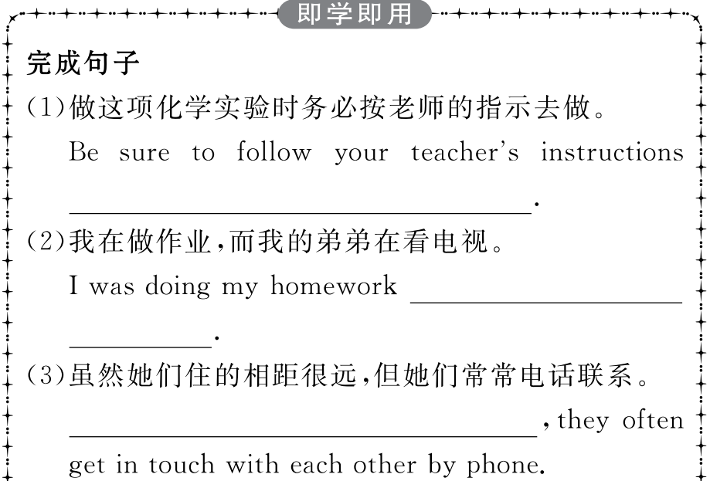
重点词汇
重点句式
随堂练习

Slide 28
重点词汇
重点句式
随堂练习

Slide 29
重点词汇
重点句式
随堂练习
Ⅰ.单词拼写
1.New technology has (使可能) the development of an online “virtual library”.
答案:enabled
2.I’d like to take this (机会) to thank my colleagues for their support.
答案:opportunity
3.My sister prefers (表演) the instrument live to playing in a recording studio.
答案:performing

Slide 30
重点词汇
重点句式
随堂练习
4.It has been (证明) that eating vegetables does good to children.
答案:proved
5.There are (总共) 3,000 students in our school,most of whom are girls.
答案:altogether

Slide 31
重点词汇
重点句式
随堂练习
Ⅱ.概要写作
根据P52课文内容,写一篇60词左右的内容概要。
参考范文
The idea of the virtual choir was put forward by composer and conductor Eric Whitacre.(要点1) Virtual choir members record their performances separately on videos and upload them onto the Internet(要点2),where they are put together to form a virtual choir.(要点3) The virtual choir turns out to have a positive influence on people and make the world a better place.(要点4)

