Slide 1
Unit 2
How often do you exercise?
Section B 1a-1e
WWW.PPT818.COM

Slide 2
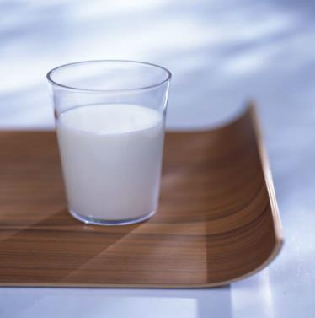
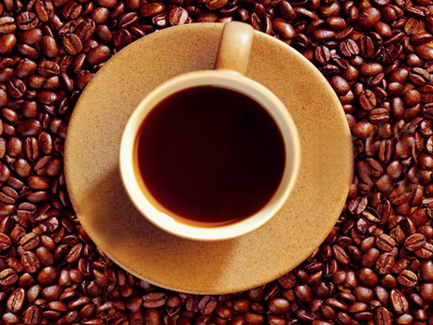
New words
milk
coffee

Slide 3
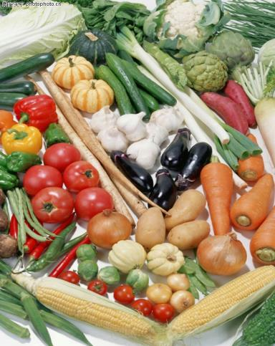
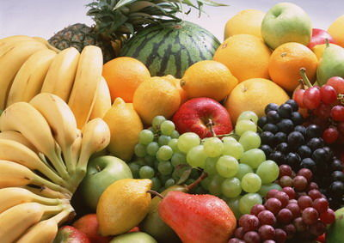
vegetables
fruit

Slide 4

We sleep every day.

Slide 5
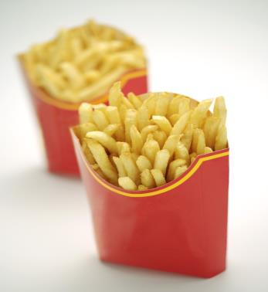
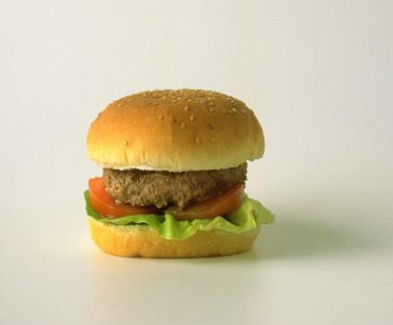
Junk food
chips
hamburger

Slide 6


cola
chocolate

Slide 7

Words review
junk
junk food
coffee
health
n. 无用的东西；
无价值的东西
垃圾食品
n. 咖啡
n. 健康；人的身体(或精神)状态

Slide 8
Free talk: Talk about your habits.
How often do you eat vegetable?
How often do you eat fruits?
How often do you drink milk?
How often do you eat junk food?
How often do you eat meat?
How often do you exercise?
What sports do you play?
How many hours do you sleep
every night?

Slide 9





is good for our health.
Junk food is bad for our health.

Slide 10
be good for 对……有好处
e.g. Milk is good for our health.
牛奶对我们的健康有好处。
be bad for 对……有坏处
e.g. Hot dog is bad for our health.
热狗对我们的健康有坏处。

Slide 11
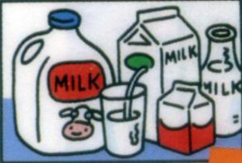
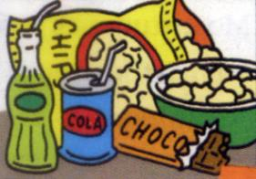
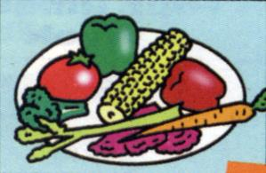
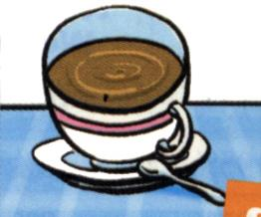
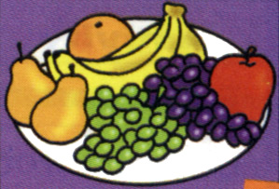

1a. Match the words with the pictures.
a
b
c
d
e
f

Slide 12
Check the answers!
____ junk food 4. _____ vegetables
2. _____ milk 5. _____ sleep
3. _____ fruit 6. _____ coffee
b
c
a
f
e
d

Slide 13
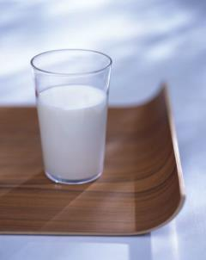
1b. Ask and answer questions.
Use the words from 1a.
A: How often do you drink milk, Liu Fang?
B: I drink milk everyday.
A: Do you like it?
B: No. But my mother wants
me to drink it. She says it’s
good for my health.

Slide 14
Find
cola, salad, soup, hot dog, mushroom,
broccoli, milk , hamburger, dumpling, potato chips, fried chicken, onion, junk food, milk, coffee, chips, cola, chocolate, fruit, vegetables
healthy:
unhealthy:

Slide 15
healthy:
unhealthy:
salad, soup, broccoli, milk , dumpling, onion, mushroom, milk, fruit, vegetables
cola, hot dog, potato chips, fried chicken, hamburger, junk food, coffee, chocolate

Slide 16
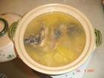
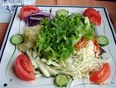

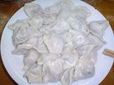
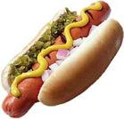

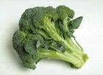

soup
salad
cola
dumpling
healthy or unhealthy?
hot dog
tomato
broccoli
onion

Slide 17
Listen to an interview about two people’s daily habits. Circle your answers to each question.
Listening
1c
Does Tina have good habits?
Yes. No. I don’t know.
Does Bill have good habits?
Yes. No. I don’t know.

Slide 18
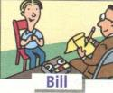
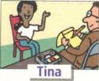
1d Listen again. Fill in the blanks in
the survey.
Questions | Tina | Bill
1.How often do you exercise?
2.How often do you eat fruit?
3.How many hours do you sleep every night?
4.How often do you drink milk?
5.How often do you eat junk food?
6.How often do you drink coffee?
every day
hardly ever
every day
never
nine
nine
every day
never
2 or 3 times a week
3 or 4 times a week
never
4 times a day

Slide 19
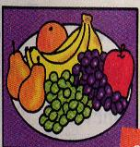
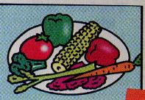
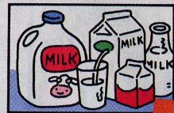
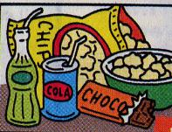

I think Tina has better
eating habits. Because she
every day.
She
two or three times a week.
She never

Slide 20
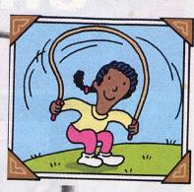

Her lifestyle is better.
She
She
nine hours every night.
She looks after her health.
She is very healthy.

Slide 21
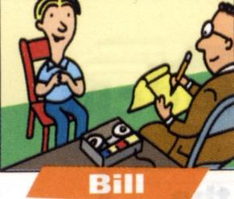
Bill sleeps nine hours every night,
too. Is he healthy?
Although Bill sleeps nine hours
every night, he is unhealthy.

Slide 22
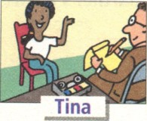

Who can get better grades?
Her healthy lifestyle helps her get
good grades.
Good food and exercise help her to
study better.

Slide 23
1e Student A is the reporter. Student
B is Tina or Bill. Ask and answer
questions. Then change roles.
A: How often do you exercise?
B: I exercise every day.
A: And how often do you …?

Slide 24
Let’s do a survey:
1.How often do you drink milk?
2.How often do you eat fruit?
3.How often do you eat junk food?
4.How many hours do you sleep
every day?
5.How often do you exercise?

