Slide 1
Unit 7 I Have A Headache
第三课时
WWW.PPT818.COM

Slide 2
1
Be able to read!
Objectives:
2
Be able to listen!
3
Be able to understand!
4
Be able to communicate!

Slide 3
Warm-up
What did you learn in part A?
Discuss with your partner.

Slide 4
Let's Learn More!

Slide 5
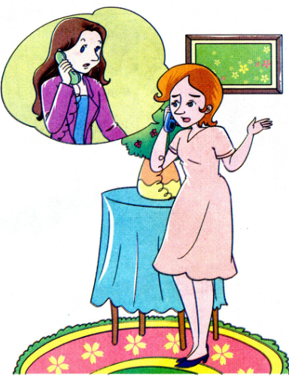
Let's Learn！
Mom: Hello, Miss White. This is Helen. Colin's mother. Colin doesn't feel well this morning. He can't go to school today.

Slide 6
Let's Learn！
Miss White: What's wrong with him?
Mom: He has a fever and a bad headache.
Miss White: I'm sorry to hear that. You'd better take him to see a doctor.

Slide 7
Let's Learn！
Mom: We'll go to the hospital.
Miss White: OK. Please tell him not to worry about his lessons and have a good rest.
Mom: Thank you. Good-bye!

Slide 8
Let's Read!

Slide 9
Try to read more
Read the words
th those brother weather
th think third Thursday

Slide 10
Try to read more
th then though other
th earth healthy thirsty

Slide 11
Let's Practice!

Slide 12
Try to read more
1.Make____English,math,and science on
Thursdays.
A has B have C had
2. What do you have____supper
A for B of C in
3.--- I like bananas.
---______
A Me too B I too C Too me

Slide 13
Try to read more
4. We have dumplings____Monday.
A in B at C on
5. They are healthy_____me
A to B with C for
6. ---____day is it today
---It’s Tuesday
A Where B What C How

Slide 14
Answers:
1.A 2.A
3.A 4.C
5.C 6.B

Slide 15
Let's Chant!

Slide 16
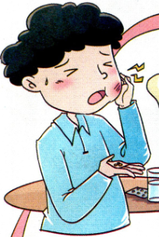
Try to read more
Little Tom has a headache
Has a headache, has a headache
Little Tom has a headache
He has a rest this morning

Slide 17
Try to read more
Little Tom has a stomachache
Has a stomachache, has a stomachache
Little Tom has a stomachache
He goes to see a doctor this morning

Slide 18
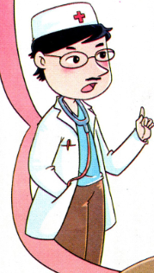
Try to read more
Little Tom has a toothache
Has a toothache, has a toothache
Little Tom has a toothache
Little Tom has a toothache
He takes some medicine this morning

Slide 19
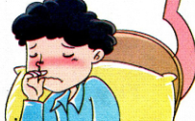
Try to read more
Little Tom has a cold
Has a cold, has a clod
Little Tom has a cold
He stays in bed this morning

Slide 20
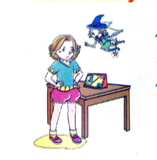
Try to read more
Can you chant the song by yourself !

Slide 21
请课后认真朗读单词课文，在记忆的基础上运用词句进行对话！

