Slide 1
Unit 4
Road safety
WWW.PPT818.COM

Slide 2
After the lesson, I will be able to…
listen, read, say and write the words and phrases：
pavement, zebra crossing, green man, red man,
traffic lights.
2. read and use the sentences：
How can you cross the road safely?
What must you (not) do on the road?
You must/mustn’t…
3. use ‘must’ and ‘mustn’t’ correctly.
4. obey traffic rules better in our daily life.

Slide 3
Play a game
如果你认为是不安全的 ，大声说 Red man, stop!

Slide 4
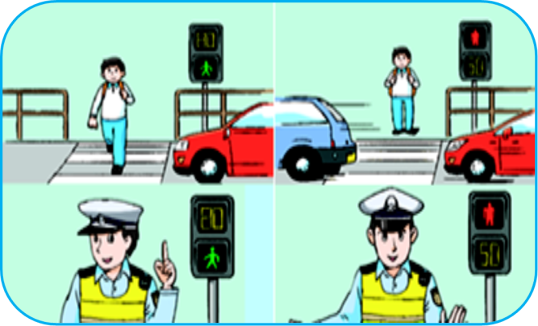
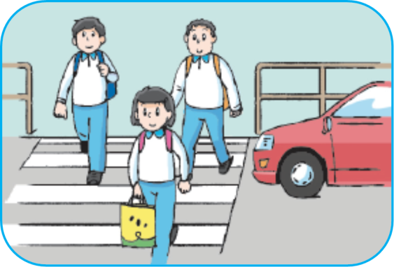
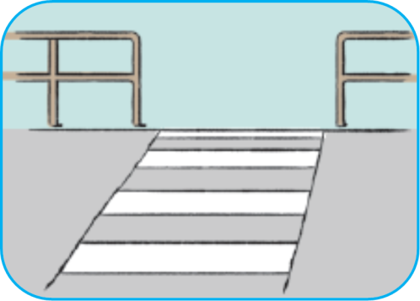
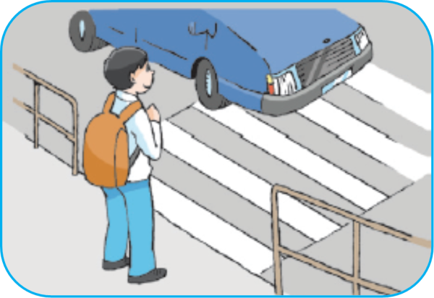
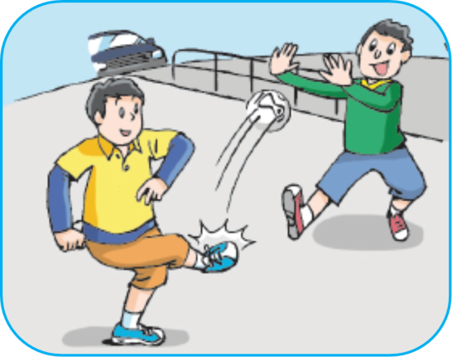
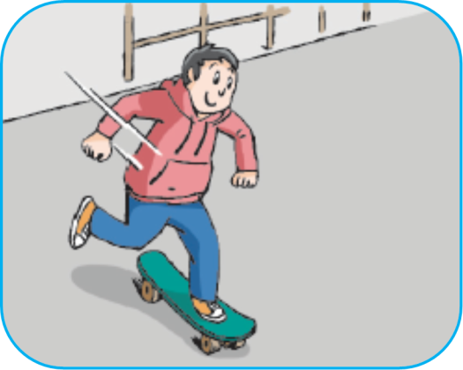
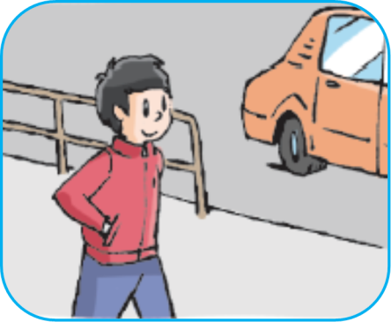
Look, listen and judge
look for a zebra crossing
cross the road with other people
look at the traffic lights
wait on the pavement
skate on the road
walk on the pavement
play football on the road

Slide 5
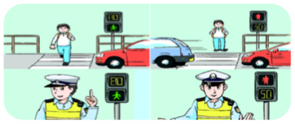
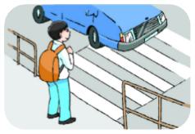
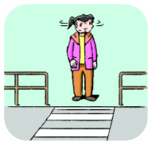
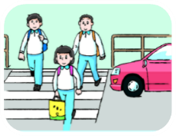
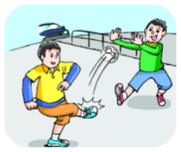
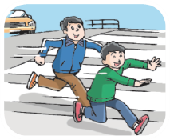
Look and say
60’
How can you cross the road safely?
两人一组，比一比谁在1分钟内说出更多的答案。
1
2
3
4
5
6
……

Slide 6
Read and learn
自读例句， 感知句型结构。
How
can
you
cross the road safely
？
What
must
(not) do on the road
疑问词
情态动词
+
+
主语
+
动词词组 ?

Slide 7
Read and learn
自读例句，感知can和must的区别。
You
must
look for a zebra crossing
.
important
look at the traffic lights
mustn’t
play football on the road
dangerous
run on the road
can
wait on the pavement
.
alternative
可选择的
cross the road with other people
You
can’t
cross the road here
can not
find a zebra crossing

Slide 8
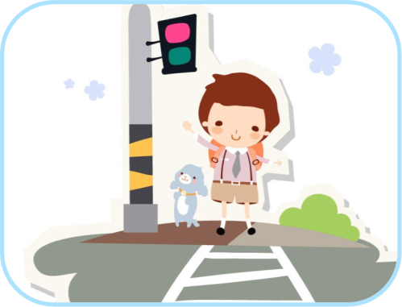
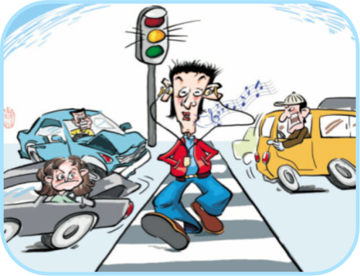
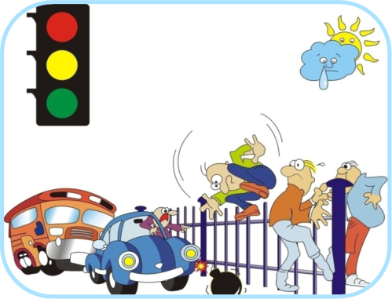
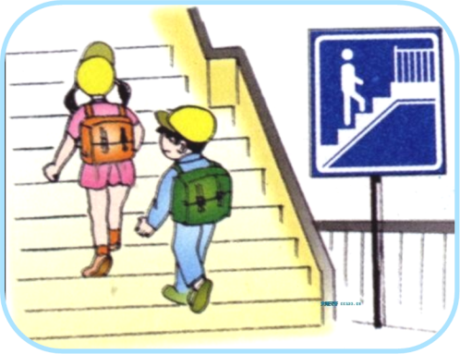
Look and read
试着读一读!
push the button
listen to the music
get over the fence
cross the over-bridge

Slide 9
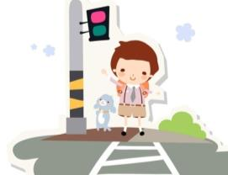
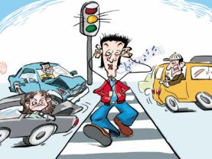
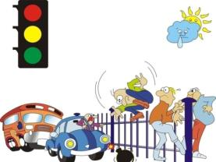
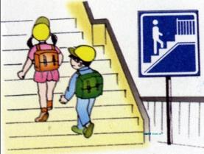
Look and say
选用合适的情态动词描述图片。
When we cross the road , we must /mustn’t …
push the button
listen to the music
get over the fence
cross the over-bridge

Slide 10
Play a game
自读Fun time，了解游戏规则。
Rules：
1. 选出一人做交通灯，交通灯提问，被提问同学迅速回答。
2. 其他人认真倾听判断对错，对的说right，错的及时改正。
3. 尽量用到黑板上的句型，必须问到每位同学哦。

Slide 11
Make a proposal
六人一组，每人写至少一句交通规则，
不要重复。
2. 快速贴在纸上，稍做装饰，做成小组倡
议书，小组齐读倡议书。

Slide 12
Show time
集体展示，选择一种喜欢的方式展示你们的海报。
Read together.(齐读)
Read and act.
(边读边演)
Read one
by one.
(轮流读)
…

Slide 13
Homework
Look, read and check the proposals in groups.
在小组内阅读、欣赏并批阅倡议书。
Preview Sound time, Culture time and Cartoon time.
预习Sound time, Culture time and Cartoon time。

