Slide 1
Is there a post office near here?
Section A 第1课时
WWW.PPT818.COM

Slide 2
地点名词
post 邮政 office办公室 post office邮局 police 警察 police station警察局 hotel 旅馆;酒店 restaurant 餐馆 bank 银行 hospital 医院 street大街 town 镇;市镇
pay 付费 pay phone付费电话 north 北方
介词&其它
near 在……附近 behind 在……后面
across过;穿过 across from 在……对面
front 前面 in front of 在……前面 around 到处;大约

Slide 3
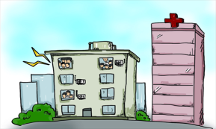
Where is the hospital?
It’s near the post office.
/'hɒspɪtl/ n.医院
post office 邮局
/pəʊst/ n.邮政
/'ɒfɪs/ n.办公室
/nɪə/ prep. 在……附近

Slide 4
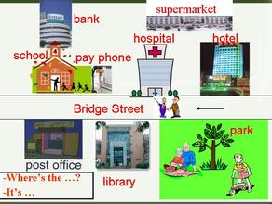
Let’s see this town.
town /taʊn/ n.镇;市镇
hotel /həʊ'tel/ n.旅馆;酒店
pay phone付费电话
pay /peɪ/ v.&n.付费
Please pay me 10 dollars.
street /stri:t/ n.大街

Slide 5
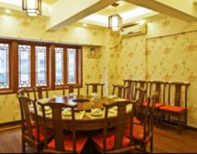
police station警察局
police /pə'li:s/ n.警察
restaurant /'restərɑ:nt/
n. 餐馆
bank /bæŋk/n.银行

Slide 6
north /nɔ:(r)θ/ n.北;北方; adj.北方的
in front of the box
front /frʌnt/ n.前面
in front of 在…前面：指在某物的前方。
in the front of 在…前面：指在某物的内部
靠前的地方。
behind the box
behind /bɪ'haɪnd/ prep.在……后面

Slide 7
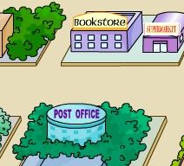
The bookstore is across from the post office.
across from在……对面
across /ə'krɒs/ adv.&prep.过;穿过
Go across the road to the bank.
around /ə'raʊnd/ adv.& prep. 到处;大约
go around the lake
There are around 100 students in the classroom.

Slide 8
根据句意和首字母提示填空
1. The post o______ is ______________(在…对面) the bank.
2. Where is the p_________ s_______?
3. I’m hungry, do you know where the __________ is?
4. There is a ____________ on the street, you can call police
for help.
ffice
across from
olice
tation
restaurant
pay phone

Slide 9
单项选择
Go ________this street and then turn right.
A. from B. cross C. across D. on
2. There is a tree _________ the house.
A. in front B. in the front C. in front of D. in the front of
C
C

Slide 10
地点名词及介词
post 邮政 office办公室 post office邮局 police 警察 across过;穿过……；
词及短语的用法
around和across的用法；
in front of和in the front of的区别。
across from 在……对面 near 附近……

