Slide 1
Unit 5 I Love Learning English！
How Do I Learn English?
WWW.PPT818.COM

Slide 2
Lead in
Do you like English?
How do you learn English?
Do you have any good tips to learn English well?

Slide 3
Presentation
PPT模板：www.1ppt.com/moban/ PPT素材：www.1ppt.com/sucai/
PPT背景：www.1ppt.com/beijing/ PPT图表：www.1ppt.com/tubiao/
PPT下载：www.1ppt.com/xiazai/ PPT教程： www.1ppt.com/powerpoint/
资料下载：www.1ppt.com/ziliao/ 范文下载：www.1ppt.com/fanwen/
试卷下载：www.1ppt.com/shiti/ 教案下载：www.1ppt.com/jiaoan/
PPT论坛：www.1ppt.cn PPT课件：www.1ppt.com/kejian/
语文课件：www.1ppt.com/kejian/yuwen/ 数学课件：www.1ppt.com/kejian/shuxue/
英语课件：www.1ppt.com/kejian/yingyu/ 美术课件：www.1ppt.com/kejian/meishu/
科学课件：www.1ppt.com/kejian/kexue/ 物理课件：www.1ppt.com/kejian/wuli/
化学课件：www.1ppt.com/kejian/huaxue/ 生物课件：www.1ppt.com/kejian/shengwu/
地理课件：www.1ppt.com/kejian/dili/ 历史课件：www.1ppt.com/kejian/lishi/
English dictionary

Slide 4
English storybooks

Slide 5
English magazine

Slide 6
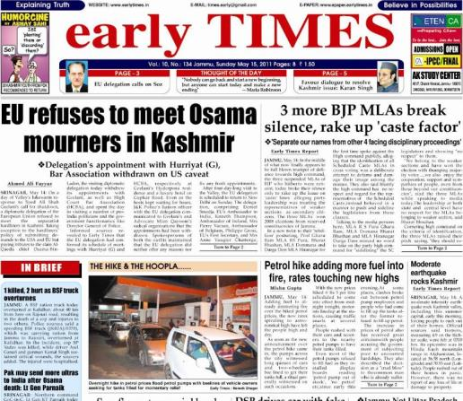
English newspaper

Slide 7
Words and expressions
Hong Kong
storybook
magazine
newspaper
mistake
silly
oops
香港(地名)
n. 故事书
n. 杂志
n. 报纸
n. 错误
adj. 愚蠢的；傻的
int. 哎哟；啊呀(摔倒或出
小差错时的用语)

Slide 8
Phrases
1. look up sth. in a dictionary 在词典上查单词
2. at the same time 同时
3. write down 写下
4. sing along with the music
跟着音乐唱歌

Slide 9
5. be afraid to do sth. 害怕做某事
6. make a （silly）mistake 犯(愚蠢的)错误
7. laugh at 嘲笑
8. right now 立刻；马上

Slide 10
Language points
1. So I look them up in a dictionary.
所以我在词典中查阅它们。
look up（从词典、电话本中）查阅。如果跟代词，代词要放在中间。look up还可表示“向上看”。
look的其他短语：
look after 照顾，照料; look as if 看上去好像;
look around/round 四处看看

Slide 11
2. Don’t be afraid to make mistakes!
别害怕犯错误！
be afraid to do sth. 害怕（恐怕）去做某事。
She is afraid to have exams. 她害怕考试。
make a mistake/mistakes 犯错误
Everyone can make mistakes.
每个人都会犯错误。
I took his dictionary by mistake.
我误拿了他的词典。
Xi’an—the Walled City

Slide 12
【探究总结】mistake的两种词性
mistake作名词意为“错误”，常用于以下短语中：make a mistake/make mistakes犯错；by mistake错误地
【学以致用】
别人出错时不要嘲笑他们。
Don’t laugh at others when they .
make mistakes

Slide 13
3. Sometimes I make silly mistakes and I laugh at myself. 有时我会因犯一些愚蠢的错误而自嘲。
silly adj. 愚蠢的；傻的
You were silly to believe his words.
你相信他所说的，真是愚蠢。
Xi’an—the Walled City

Slide 14
【探究总结】silly的用法
(1)silly用作形容词，意为“愚蠢的；傻的”，既可以指人，也可以指物，如言行、决定等。
(2)silly也可以用作名词，意为“傻孩子，淘气鬼；笨蛋”，常用于向孩子指出其愚蠢行为。
Xi’an—the Walled City

Slide 15
【学以致用】
别再问如此愚蠢的问题了。
Don’t ask such ______ questions.
silly

Slide 16
Exercises
Ⅰ. 用所给词的适当形式填空。
1. Here ________ (be) some answers to your questions.
2. I can enjoy _____ (me) by listening to Beijing Opera.
are
myself

Slide 17
3. If he meets a new word, he can look it up in a dictionary ________ (he).
4. I practice ________ (speak) English after class every day.
5. —Can you ask her to come here _______ (late)?
—Sure. I’ll tell her.
himself
speaking
later

Slide 18
Ⅱ. 单项选择
1. My father reads _______ because he likes reading news.
A. storybooks B. magazines
C. newspapers D. dictionaries
2. When you don’t understand some words, you can _______ in a dictionary.
A. look for them B. look them for
C. look up them D. look them up
C
D

Slide 19
A
3. It is _______ of you to make the same mistake again and again.
A. silly B. kind C. fun D. excited
4 . Do you speak English or Chinese _______?
A. on school B. at the home
C. after the class D. in class
D

Slide 20
Ⅲ.翻译下列句子，每空一词。
1. 你能帮我查个电话号码吗？
Can you help me _____ _____ a phone number?
2. 课后我们常说英语。
We often speak English ____ _____.
3. 不要嘲笑别人。
Don’t _____ _____ others.
look up
after class
laugh at

Slide 21
Homework
Do you have any other good ideas of learning English?
Discuss them with your classmates.

Slide 22
Thank you!

