Slide 1
外研小学起点 九年级(下) Module 3
Unit 3 Language in use
WWW.PPT818.COM

Slide 2
Language practice
Is life today better or worse than it was 50 years ago?
The most important difference is that
people are healthier today, and they
live longer.
But people don’t take as much exercise as they did.

Slide 3
People walk or use their bikes less,
and they’re lazier.
And that makes life more dangerous
and less healthy.
I really want to do my best.

Slide 4
Complete the passage with the correct form of the words.
People live longer (long) and stay (1) ________ (healthy) today than they did 50 years ago. People are (2) ____ (tall) and (3) _______ (strong) because
healthier
taller
stronger

Slide 5
they have a (4) _____ (good) diet. Athletes can run (5) _____ (fast), jump (6) ______ (high) and throw (7) ______ (far) than ever before. Playing sports is one of the (8) ____________ (popular) leisure activities. People also work
better
faster
higher
further
most popular

Slide 6
(9) ______ (hard) and lead (10) ______
(busy) lives. Big cities are (11) ___________ (pleasant) places to live than before because they are (12) ______ (dirty) and (13) _____________ (crowded). They are also (14) ______________ (dangerous). Traveling is (15) _____ (easy) than before,
harder
busier
less pleasant
dirtier
more crowded
more dangerous
easier

Slide 7
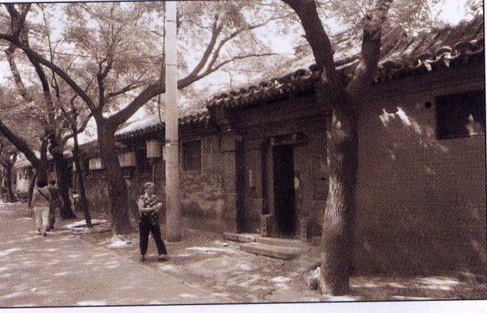
and air travel is the (16) _______________ (comfortable) way to travel long distances.
most comfortable

Slide 8
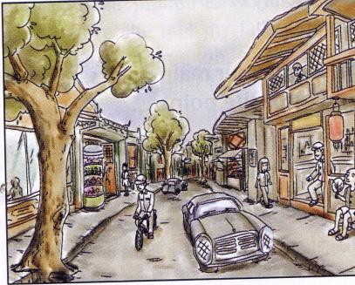
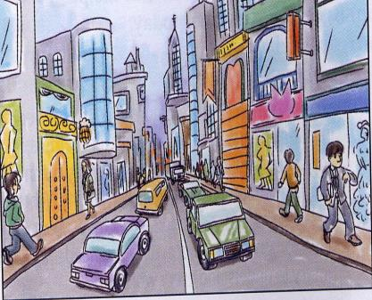
Look at the two pictures and talk about how the town has changed. Use the word to help you.

Slide 9
big building busy houses
modern more narrow shops
streets tall traffic trees

Slide 10
The sample answers
There are more cars in the street today than it was 50 years ago.
2. The buildings are much taller, much more beautiful and much newer.
3. The streets are much wider.

Slide 11
4. The environment is much better.
5. I can see people are much busier than before.
6. The life is much better than before.
7. There are more shops than before.

Slide 12
Write the words in the correct column.
composition diet education
fitness homework illness
medicine nature pollution
revision traffic weather

Slide 13
Environment | Personal health | Study
nature pollution traffic weather
diet
fitness
illness
medicine
composition
education
homework
revision

Slide 14
Read the passage on Page 23 and find three examples of things that made life harder in the past than it is today.

Slide 15
People lived in very small houses,
very close to each other, with no
space for children to play. Families
in those days were quite big. A whole
street had to share one outside toilet.

Slide 16
2. The pollution from factories covered
the streets. People put their rubbish
outside in the streets. As a result,
there were many diseases.

Slide 17
3. Children didn’t always go to school,
because they had to work. They did
dangerous and unhealthy jobs for little
money. Many were hurt in accidents
from the machines.

Slide 18
Read the passage again. How do we know that… Write reasons.
____________________________
________, so families were big in Victorian times.
There were five children in one
family

Slide 19
They lived very close to each other, with no space for children to play and they had to sleep in houses of just two rooms
2.______________________________
______________________________
______________________________
______________, so many houses
were small.

Slide 20
3. ______________________________ ____________, so there was no indoor toilet for each house.
4. _______________________________ _______________________________
________, so people weren’t healthy.
A whole street had to share one outside toile
Most of the big cities were dirty and unhealthy and there were many diseases

Slide 21
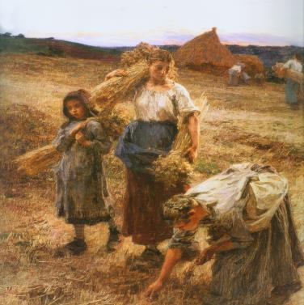
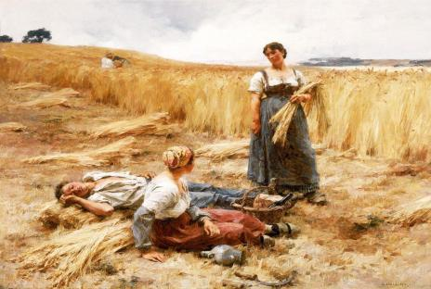
5. ________________________, so they didn’t go to school.
6. __________________________________
________________, so factory work was dangerous?
Children had to work hard
Many children were hurt in accidents from the machines

Slide 22
Some difficult points:
1. be interested to do sth.
2. hear about/of 听说
3. grow up 成长
4. thousands of 成千上万的
5. half the population of the country
6. instead of 代替, 而不是
7. as a result 结果是

Slide 23
8. no space for children to play
没有空间给孩子玩耍
9. share one outside toilet
共用一个外面的厕所
10. many diseases 许多疾病
11. very little money 非常少的钱
12. be very pleased to see
很高兴的看到……

Slide 24
Listen and complete the table.
 | Grandmother | Mother
Started school
Left school
University
Started work
8
6
14
18
no
yes
14
22

Slide 25
 | Grandmother | Mother
Got married
Children
Finished /Finish work
18
24
4 children, first at 19
1 child,
at 25
50
55

Slide 26
Write a passage comparing their lives.
The grandmother had eight brothers
and sisters so she had a bigger family.
She started school when she was older,
but she left school earlier…

Slide 27
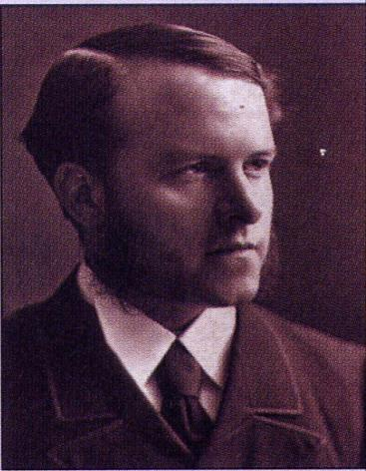
Around the w rld
1. Do you know
Dr Barnardo?
2. What do you
know about him?

Slide 28
Read the text and write down the things which happened in the following years:
1) in 1870:
2) in 1905:
Thomas Barnardo opened his first homes for children without parents.
Thomas Barnardo died.

Slide 29
Fill in the blanks.
In 1870, Thomas Barnardo studied ________ and he lived near the ________. While he was studying, he taught at a school for ____ children. He found out that many children
medicine
hospital
poor

Slide 30
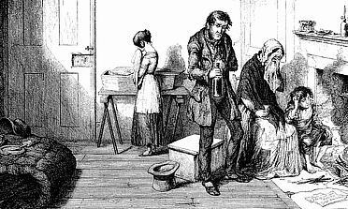
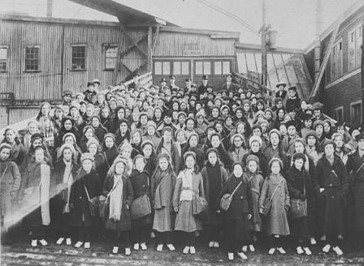
parents
at the school had no _______ and no ______, so he ______ money and ______ a house for them as a school and home.
homes
raised
bought

Slide 31
Choose the best answer.
1. Thomas Barnardo opened his first home for children ____ in 1870. A. with parents
B. without grandparents
C. without parents
C

Slide 32
D
2. He was then studying ___ in London in 1870.
A. teaching B. science C. transport D. medicine
3. He lived ____. A. beside the hospital B. in the hospital C. far away from the hospital
A

Slide 33
B
4. He taught for ___ children at a school.
A. rich B. poor C. beautiful D. ugly
5. ___ raised money and bought a house to use a school and home for poor children.
A. Mr Ronardo B. Dr Barnardo
B

Slide 34
6. There were about ___ Barnardo’s homes, caring for more than ____ children in ____. A. 1905, 100, 800 B. 8000, 100, 1095
C. 100, 8000, 1905 D. 100, 800, 1509
7. Are there any Barnardo’s homes? ___
A. Yes. B. No. C. I don’t know.
C
B

Slide 35
Module task
Organising a debate about life in the past.
1. Work in groups. Read the subject of
the debate.
Children should never work.

Slide 36
For:
extra money for the family
stop children from being bored
teach children the value of work
help children to become independent

Slide 37
Against:
Work is for adults, not children
Children need to concentrate on learning.
Conditions of work are not suitable for
young people.
Families and employers may not treat
children fairly.

Slide 38
2. Prepare your opinions for or against
the subject of the debate.
3. Have a debate. Take turns to say what
do you think and give your opinions
for or against the subject.

Slide 39
Write down a summary of the opinions for and against. Have a vote. Are most people for or against the subject?

Slide 40
Exercise: choose the best answer.
( )1. — How _____the boy is! He doesn’t work hard.
— Oh, his brother is even______. He never works hard.
A. lazy; lazier B. lazily; lazier
C. lazy; lazy D. lazily; lazy
A

Slide 41
( )2. ____ you are, ____ mistakes you’ll make.
A. More careless; the less
B. The more careless; the fewer
C. The more careful; the fewer
D. More careful; less
C

Slide 42
( ) 3. I did my _______ to prepare for the exam, but I still failed it.
A. worst B. best
C. least D. most
( ) 4. How many students in your class wear the same clothes ____ you do?
A. that B. which
C. as D. what
B
C

Slide 43
用所给词的正确形式填空。
1. _______ (million) of people will see that film.
2.He never ____ (get) angry.
3.He starts ________ (train) when he was very young.
Millions
gets
training

Slide 44
Homework
Write a short passage comparing the
life in the past and today.
2. Revise the usage of the positive degree, the comparative degree and the superlative degree of adjectives and adverbs.

