Slide 1
Unit 12
Life is full of the unexpected.
Section B Period 4 3a-Self Check
WWW.PPT818.COM
Notes:
1
1

Slide 2
过去完成时的判断依据:
由“过去的过去”来判定。
过去完成时表示“过去的过去”，先发生的动作用过去完成时，后发生的动作用一般过去时。
first
例:
When I got to the station, the train had already left.
当我到车站时，火车已经离开了。
first
After he had finished his homework, he went to bed.
完成作业后他就去睡觉了。
Notes:
2

Slide 3
Speaking
By the time…
When…
Notes:
3

Slide 4
the bus left
he ran outside
过去的过去
过去
By the time he ran outside, the bus had already left.
Notes:
4

Slide 5
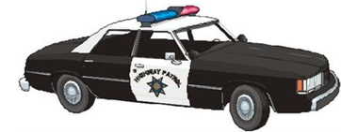
the policeman got to the shop
Tom ran away
过去的过去
过去
By the time the policeman got to the shop, Tom had run away.
Notes:
5

Slide 6
had been
1) By the end of last year, I ________ (be) to the West Hill Farm three times.
2) By the time I got up, Mom ________ (go) out for some exercise.
3) I _____________(learn) 1,000 English words by last term.
4) By 9 o’clock last night, we _________ (get) 200 pictures from the spaceship.
5) When I went into the classroom, the final bell ___________ (ring). I was happy that I wasn’t late.
had gone
had learned
had gotten
had rung

Slide 7
3a
Can you remember a lucky or an unlucky day? What happened? Make some notes about what you remember?
☺ What was the date?
☺ What happened first?
☺ Was this lucky or unlucky? Why?
☺ What happened next?
☺ How did the day end?
☺ How did you feel about this day?
P95

Slide 8
写作指导：
常见的表达句型：
I will always remember the date…
This was the luckiest /unluckiest day of my life…
When I woke up that morning…
Later that day…
I couldn’t believe …
Then/After that…
Finally…
I think….
What a lucky/an unlucky day!

Slide 9
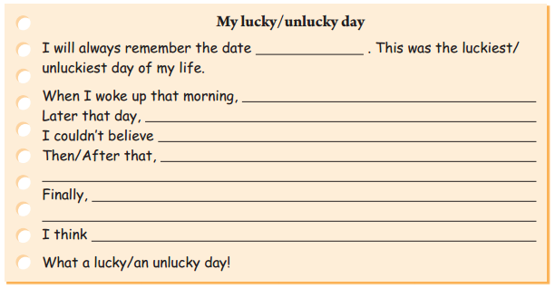
3b
Write a story about your lucky or unlucky day and tell your story to a partner or the class.
P96

Slide 10
Sample writing:
My lucky day
I will always remember the date February 28, 2014. This was the luckiest day of my life.
When I woke up that morning, the sky was very dark. I took the early bus as usual. As soon as I arrived at school, it started to rain very heavily. Many students were late and were all wet when they got to school.

Slide 11
But I wasn’t because I caught the early bus, I would have been late and wet as well!
Later that day, I realized that I had forgotten my wallet and couldn’t buy lunch. I couldn’t believe it. Then my friend Lisa said that she could share her lunch with me.
Finally, my older brother told me that night that he could take me to the concert that I’d been dying to attend that weekend. I was so happy!
I think that was the best day I’d had in a long time.
What a lucky day!

Slide 12
Self Check
1 Complete the passage with the correct
forms of the words in the box.
cancel miss west accident
lady officer market unexpected
Last Saturday after my French course , I decided to drive to the ________ to buy a meat pie for dinner. As I was heading _____ , I saw a huge truck in the middle of the road. There had been a(n) ________
market
west
accident
Notes:
12

Slide 13
and there were many police _________ around. I turned around and decided to go to a nearby mall. However, I ________ the road that led to the mall. Then I saw a restaurant that sold chicken noodles. I went inside and the _____, who was the owner, served me the most delicious bowl of chicken noodles ever. I had made a(n) _________ discovery! I’m so glad that I _________ my plan to go to the market.
officers
missed
lady
unexpected
cancelled
Notes:
13

Slide 14
2 Think of ways to finish the answers.
A: Why didn’t you hand in your science
homework?
B: Before I could start working on it,
______________________________________
______________________________________
2. A: Why didn’t you take a shower this
morning?
B: By the time I got up,
______________________________________
______________________________________
my baby brother started crying and I had to look after him as my mother was sick.
my sister had already gone into the bathroom and the bus was honking for me to hurry up.
Notes:
14

Slide 15
3. A: Why did you have to walk home from
school?
B: By the time I left my school,
_________________________________________
the school bus had already left.
Notes:
15

Slide 16
HOMEWORK
1. 复习本单元内容。
2. 对同学进行调查， 看他们在生活或工作中有没有被人愚弄或是否愚弄过别人，写篇短文，和大家分享。
Notes:
16
16

Slide 17
Thank you
Notes:
17

