Slide 1
Unit 2 Let’s play sports! Grammar
WWW.PPT818.COM

Slide 2
Guessing game:
Who is he/she?
1. Is he/she a man/woman?
2. Is he/she a teacher/student/singer/football player/basketball player/tennis player?
3. Is he/she Chinese?
4. Is he/she famous (著名的)?
5. Is he/she …?
Notes:
2

Slide 3
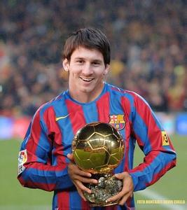
Do you know anything about him?
Simple present tense of the verb to do
Messi is a football player.
He is not Chinese.
He looks strong.
He plays football very well.
He wants to play in the next
World Cup.
Many students like him.
He looks strong.
He plays football very well.
He wants to play in the next
World Cup.
Many students like him.

Slide 4
We use this tense when we talk about:
1. things that we often do
Millie gets up at 6:30 every morning.
2. things that are always true
Cats eat fish.
3. things that are true now
Simon likes playing football.

Slide 5
Match
things that we
often do
things that are
always true
things that are
true now
Fish live in water.
I go to school by bike
every day.
I live in Wuxi.
I go to the Reading
Club every Tuesday.
Daniel enjoys swimming.
The Earth travels around the Sun.

Slide 6
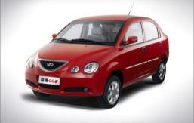
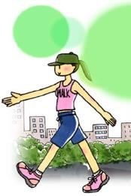
Answer the questions using the simple present tense
How do you go to school?
We/I go to school by car.
How do they go to school?
They go to school by bus.
How does she go to school?
She goes to school on foot.

Slide 7
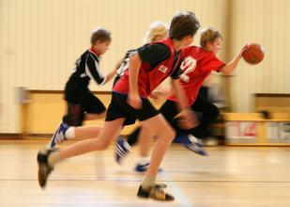
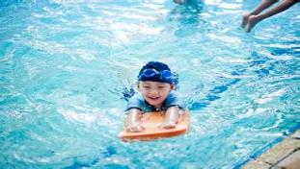
What do you do after school?
We play basketball after
school.
What does he do after school?
He goes swimming after school.
What does she do after school?
She reads books in the reading room after school.

Slide 8
Summary: how to make positive sentences
I/You/We/They | like | sports.
He/She/It | likes

Slide 9
More examples?
Speak out the third person singular form of given words
Rules
Most verbs: + -s
likes
plays
studies
flies
watches
washes
dresses
fixes
goes
does
like
play
study
fly
watch
wash
dress
fix
go
do
Verbs ending with a “consonant + -y”: -y + -ies
Verbs ending with -ch, -sh, -ss or -x: + -es
Some verbs ending with -o: + -es
Notes:
9

Slide 10
Let’s play a game!
Speak out the third person singular form of given words as fast as you can
put
puts
go
goes
enjoy
enjoys
study
studies
teach
teaches
carry
carries
fly
flies
worry
worries
guess
guesses
have
has
match
matches
stay
stays

Slide 11
Read the dialogue
Simon and Millie are talking about sports.
Simon: I like basketball very much. How about
you?
Millie: Yes, I do. But I don’t like football.
Simon: Does your sister like football?
Millie: No, she doesn’t like football. She likes
basketball too.
Simon: Do your family often watch basketball
games on TV?
Millie: Yes, we do.

Slide 12
Summary How to make negative sentences
do not
= don’t
I/You/We/They | do not | like | sports.
He/She/It | does not
does not = doesn’t

Slide 13
Sentence making
Eg: I like playing tennis, but my partner doesn’t like playing it.
My partner likes watching ball games, but his/her mum doesn’t like watching ball games.

Slide 14
Summary How to ask and answer questions
Do | I/you/we/they | like | sports?
Does | he/she/it
Yes, | I/you/we/they | do.
 | he/she/it | does.
No, | I/you/we/they | do not/don’t.
 | he/she/it | does not/ doesn’t.

Slide 15
Interview your partner
A: I like playing … Do you like it?
B: …
A: Does your father play … in his free time?
B: …
A: Does your mum like doing sports?
B: …
A: Do your family watch ball games on TV?
B: …
A: …
B: …

Slide 16
Introduce the hobby of your partner and his/her family
My partner’s name is …
He/She enjoys … in his/her free time.
He/She doesn’t like …
His/Her father enjoys … at weekends.
He often … at weekends.
His/Her mother likes … after work.
She sometimes …
They like …
They don’t like …
…

Slide 17
Millie and her classmates
Help her complete the sentences with the
correct forms of the verbs in the box.
dance go like play watch
I _____ playing volleyball.
Kitty ________ very well.
Amy ______ swimming every week.
Simon often ______ football with his friends.
Daniel sometimes _________ ball games on TV.
like
dances
goes
plays
watches

Slide 18
B. Complete the questions and then use the
information to answer them.
1. Do Sandy and Kitty enjoy listening to music?
Yes, they do.
2. _____ Millie like swimming? ______________.
3. _____ Amy enjoy reading? ____________.
4. _____ Simon like walking? _____________.
5. _____ Simon and Daniel love dancing?
______________.
Does
No, she doesn’t
Does
Yes, she does
Does
No, he doesn’t
Do
No, they don’t
Notes:
18

Slide 19
C. Complete their conversation with the correct forms of the verbs in brackets.
Daniel: Hi, Simon. _____ you ______ (play)
football at weekends?
Simon: Of course. I often ______ (play) football
with my cousins.
Daniel: _____ your parents _____ (go) with you?
Do
play
play
Do
go

Slide 20
Simon: No, they don’t. But my dad sometimes
_______ (watch) our games. Sometimes
he ______ (read) at home. My mum
often ______ (shop) at weekends. What
about you, Daniel?
Daniel: I often _____ (stay) at home.
Sometimes I ____ (go) swimming
with my dad.
watches
reads
shops
stay
go

Slide 21
Homework
Write a passage to introduce the
hobby of your partner and his/her family.
2. Finish the exercises on the exercise book.
Notes:
21

