Slide 1
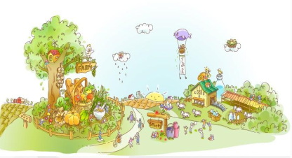
Unit4 He Lives in a Village
陕旅版
五年级下册
第三课时
WWW.PPT818.COM

Slide 2
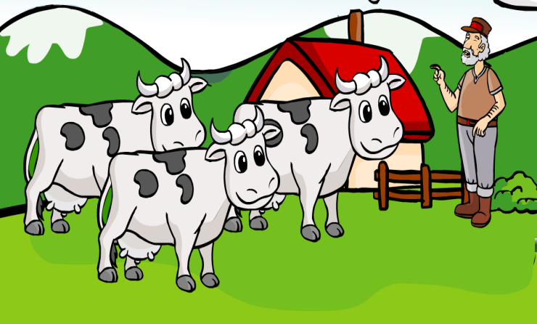
>>Warm-up
Sing a song

Slide 3
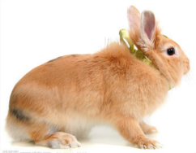
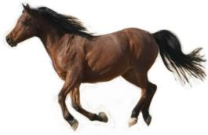
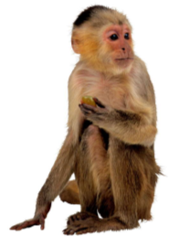
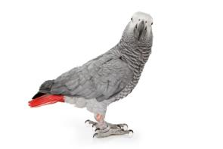
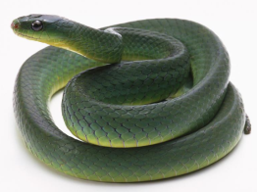
>>Review
What animals on the farm?

Slide 4
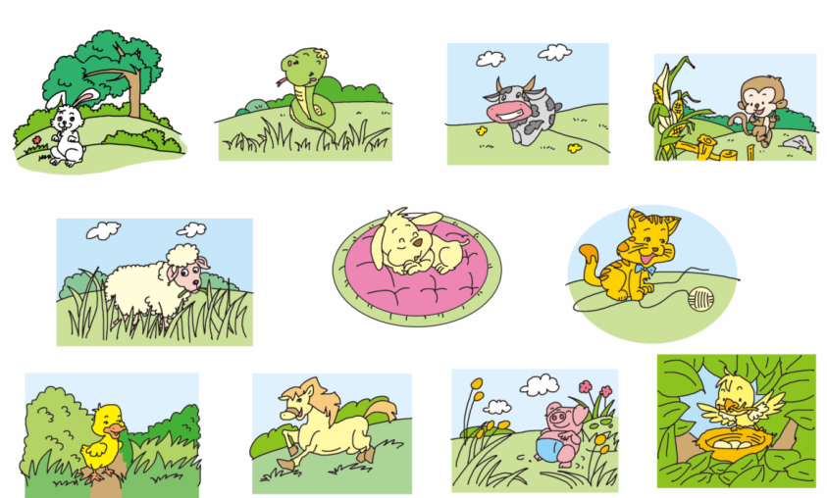
>>Lead-in
Circle the animals you love

Slide 5
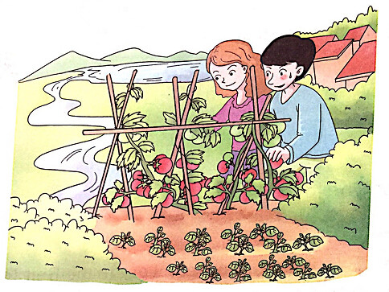
>>Presentation
Ask and answer
What can you see in the picture?
Do you like vegetables/tomatoes/ …?

Slide 6
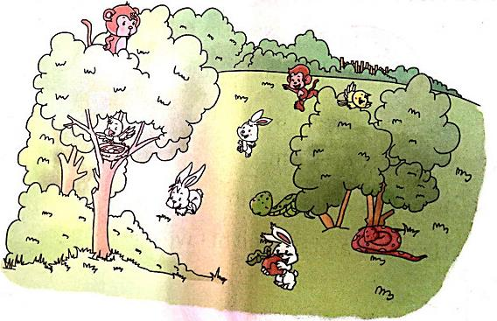
>>Presentation
Ask and answer
What can you see in this picture?
Where do they live?
Do you like animals?

Slide 7
>>Presentation
Listen, then ask and answer
Q1: Where do Lele and his parents live?
They live in a village near a lake.
Q2: Do they have a big house?
Yes, they have.

Slide 8
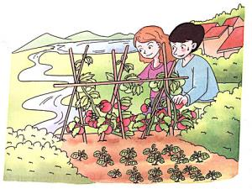
>>Presentation
Let’s learn more
Read and imitate
Lele and his parents live in a village near a lake.
They have a big house there.
A river runs by.
His parents work on a farm.
In spring, they grow tomatoes, potatoes and other vegetables.
从……旁边(过去)
种植，栽种

Slide 9
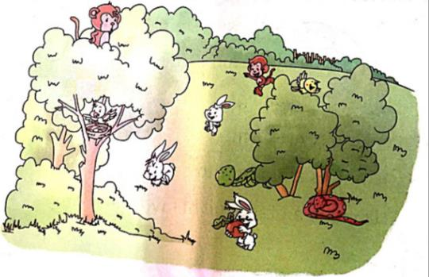
>>Presentation
Listen, then ask and answer
Q1: What can Lele see in spring, summer and autumn?
Lele can see rabbits, snakes and even monkeys.
Q2: Does Lele love his home?
Yes, he does.

Slide 10
>>Presentation
Let’s learn more
Read and imitate
They plants many trees, too.
The trees are homes for birds and some wild animals.
In spring, summer and autumn, Lele can see rabbits, snakes and even monkeys.
They live happily together year after year.
Lele loves his home.
He loves the animals, too.

Slide 11
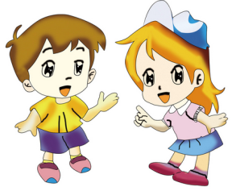
>>Practice
根据自己的情况，选择来做吧！
Role play
Level1:分角色朗读对话，注意模仿语音语调。
Level2: 2人一组，试着表演出来吧。

Slide 12
>>Practice
Read again and answer the questions
1. Where does Lele live?
He lives in a village.
2. What do they grow on the farm?
They grow tomatoes, potatoes and other vegetables.
3. What animals can Lele see?
He can see rabbits, snakes and even monkeys.
4. Does he love his village?
Yes, he does.

Slide 13
>>Practice
Read and complete
Mr. Smith has a _____ near a _____ .
He grows ________ , _______ and other
vegetables.
farm
river
tomatoes
potatoes
He plants trees and _______ on the farm, too.
The trees are homes for ______ and some wild
animals.
flowers
birds

Slide 14
>>Practice
Read and complete
In ______ , summer and ______ , he
can see rabbits, ______ and even ______
In the ______ , he can catch fish. Mr. Smith
lives happily there.
spring
autumn
snakes
monkeys
river

Slide 15
>>Summary
本课所学的重点句型：
… live in … They …
In …, they …
e.g.
They live in a village near a lake. They have a big house there. In spring, they grow tomatoes, potatoes and other vegetables.

Slide 16
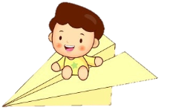
>>Homework
1.听课文录音并跟读，按照正确的语音、语调朗读并表演课文对话。 2.仿照课文Let’s learn more，创编课文内容。
3.预习 Unit4 B Let’s learn more。
close

