Slide 1
Unit 8 Save Our World!
Environment Clubs
WWW.PPT818.COM

Slide 2
Learning Targets
1. Be able to use the words and phrases: reduce, reusable, least, pollute, skip, packaging, leaky, waste, litre, sink, electricity, shut, throw away, encourage sb. to do sth. , neither... nor... , turn off, shut down
2. Learn the environment club and learn to protect the environment

Slide 3
3. Learn some key sentences:
· In an environment club, students work
together to reduce pollution and protect the
environment.
· How much garbage do you throw away after lunch？
· Environment clubs encourage students to bring
their lunches in reusable bags and dishes.

Slide 4
· The class with the least garbage gets a prize.
· It's a good way to reduce packaging.
· Did you know that a leaky toilet can waste 20
to 40 litres of water an hour？
· Turn off the television and shut down the
computer when you are not using them.

Slide 5
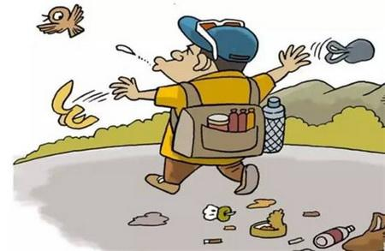
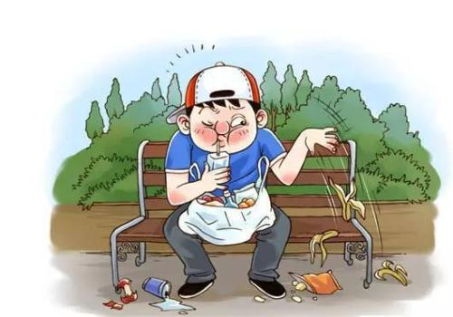
Lead in
What are they doing?

Slide 6
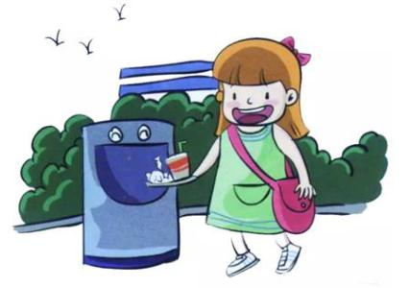
Do you think the characters in the pictures are correct? Why or why not? What should we do?

Slide 7
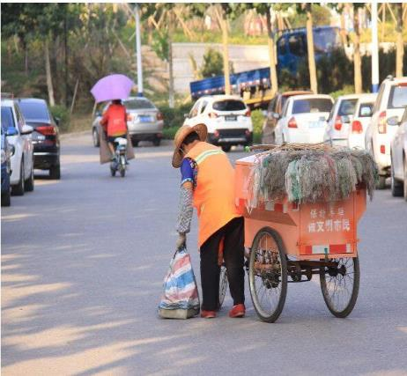
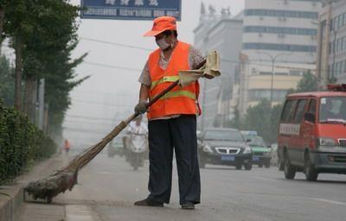
Do you know them? And what are they doing?

Slide 8
Words and expressions
reduce
reusable
least
pollute
skip
v. 减少
adj. 可重复使用的
adj. & adv. 最少的(地)；最小的(地)
n. 最少量；最小物
v. 污染；弄脏
v. 跳跃；跳绳

Slide 9
packaging
leaky
waste
litre
sink
electricity
shut
n. 包装
adj. 渗漏的
v. & n. 浪费
n. 公升
n. 水槽；水池
n. 电
v. 关上；合上

Slide 10
throw away
encourage sb. to do sth. neither... nor...
turn off
shut down
扔掉
鼓励某人做某事
既不……也不……
关掉；关闭
关闭；停下

Slide 11
THINK ABOUT IT
What do you do when you see somebody throwing garbage on the ground?
Does your school have an environment club?

Slide 12
Presentation
Listen and read the passage.
In North America, many students join environment clubs. In an environment club, students work together to reduce pollution and protect the environment. The following is a list of their activities and advice.
·No­garbage lunches: How much garbage do you throw away after lunch？Environment clubs

Slide 13
encourage students to bring their lunches in reusable bags and dishes. The class with the least garbage gets a prize.
·No­car days: On a no­car day, nobody comes to school in a car—neither the students nor the teachers！Cars pollute our air, so remember:
Walk, skip, bike or run.
Use your legs！It's lots of fun!
·Bring your own shopping bag！Bring your own

Slide 14
bag when you go shopping. It's a good way to reduce packaging.
·Save water！Did you know that a leaky toilet can waste 20 to 40 litres of water an hour？In a year, that would fill a large swimming pool！In environment clubs, students fix leaky toilets and sinks.
·Save electricity！Turn off the lights when you leave a room. Turn off the television and shut down the computer when you are not using them.

Slide 15
Let’s Do It!
Read the lesson and answer the questions.
1
1. Why do many students join environment clubs in North America？
Because they want to reduce pollution and protect the environment.
2. Why do the students take their own bags when they go shopping？
Because it's a good way to reduce packaging.

Slide 16
3. How do the students in an environment club save water？How do they save electricity？
They fix leaky toilets and sinks. Turn off the lights when they leave a room. Turn off televisions and shut down computers when they are not using them.

Slide 17
Fill in the blanks with the correct forms of the words in the box.
2
waste least nobody shut pollute
The soap factory _______ the drinking water in this area.
Students should not _____ paper.
_______ knows when life on the earth started.
He who talks the most knows the _____.
I couldn’t ____ the window because it was stuck.
polluted
waste
Nobody
least
shut

Slide 18
3
Read the passage and fill in the blanks.
In some countries of the world, people have started to reduce the amount of garbage they make. How? First, they buy ______ things. They try to buy only what they really need. When you buy fewer things, you _____ away fewer things. Second, they reuse things.
fewer
throw

Slide 19
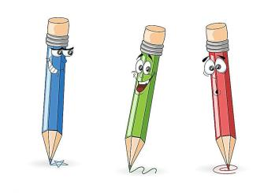
They use things, and then they use them again! Third, they recycle things. They
make old things into new things. People call these the “three Rs”: reduce, _____ and ______. The three Rs help us remember that _________ is a problem.
reuse
recycle
pollution

Slide 20
Suppose your school's environment club wants to make a poster about littering and recycling. Can you make one？Here's an example.
4
Stop Pollution！
We have a nice, clean schoolyard. Let's keep it this way.
Don't litter！

Slide 21
Always put your garbage in a garbage can.
Never throw it on the ground.
Recycle！
Stop and think before you throw something out：
Can I use this again？
Can this be recycled？
Together，we can help keep our world clean！

Slide 22
Language points
1. In an environment club，students work together to reduce pollution and protect the environment.
reduce v．减少。其反义词为increase(增加)。常用短语：reduce to减少到……；reduce by减少了……
例：The number of the students has reduced to 200 this year.
今年的学生数量已减少到了两百人。

Slide 23
2.How much garbage do you throw away after lunch？
throw away丢掉，扔掉。它相当于throw out/throw off。该短语是动副型短语，当宾语是代词时，要放在throw与away之间；当宾语是名词时，置于throw与away之间或away之后均可。
例：Don't throw away the old bottles. They are still useful.
不要扔掉这些旧瓶子。它们还有用。

Slide 24
3.Environment clubs encourage students to bring their lunches in reusable bags and dishes.
encourage sb.to do sth.鼓励某人做某事。其中，动词不定式作宾语补足语。
例：My teacher always encourages me to work hard.
我的老师总是鼓励我努力学习。

Slide 25
4. The class with the least garbage gets a prize.
least是little的最高级形式，意为“最少”，修饰不可数名词。最高级前面通常要用定冠词the。
例：Tom drank the least milk among the three boys. 这三个男孩中，汤姆喝的牛奶最少。

Slide 26
5．It's a good way to reduce packaging.
该句中to reduce packaging是动词不定式短语作后置定语，修饰way。此句可转化为一个含定语从句的复合句：It's a good way (that) you reduce packaging.
way在此作 “方式、方法” 讲，其后可接动词不定式(短语)、of短语及that/in which引导的从句作定语，that可省略。

Slide 27
例：It's a good way to practice spoken English.＝It's a good way of practicing spoken English.＝It's a good way(that)you practice spoken English.那是一个练习英语口语的好方法。

Slide 28
6．Did you know that a leaky toilet can waste 20 to 40 litres of water an hour？
waste v．浪费。常构成固定搭配 waste water/electricity/oil等。其反义词为save(节约，节省)。
例：The naughty boy wasted much money.
那个淘气的男孩浪费了很多钱。

Slide 29
7．Turn off the television and shut down the computer when you are not using them.
(1)【辨析】turn off、turn on、turn up与turn down
turn off | 意为“关掉，关闭”，一般指关闭电源、水等，后面常接电器、仪器等。
turn on | 意为“打开”，一般指打开电源、水等，后面常接电器、仪器等。
turn up | 调大电器等的频率、音量等。
turn down | 调小电器等的频率、音量等。

Slide 30
例：Please turn off the radio. My grandma is sleeping.请关掉收音机，我的奶奶正在睡觉。
Could you please help me turn on the TV？
你能帮我打开电视吗？
I can't hear clearly.Please turn up the MP3.
我听不清楚。请调大MP3的音量。
He turned down the radio.
他调小了收音机的音量。

Slide 31
(2)shut down也可意为“关闭;停下”。它强调机器等停止运转、关闭窗户等，也可指关闭公司、工厂、店铺等。
例：The restaurant shut down last year.
这家饭店去年倒闭了。
But the company shut down in 1995.
但这家公司在1995年关闭了。

Slide 32
Exercises
根据句意和首字母及汉语提示完成句子。
School should be surrounded by a pure and healthy e__________.
Chemical wastes p______ the rivers and streams.
The ship was l______ badly.
You should not w____ food when many people are hungry.
nvironment
ollute
eaking
aste

Slide 33
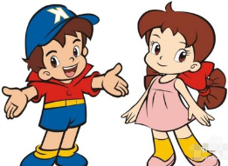
5. I have to __________ (关闭) my blog.
6. The glass from bottles can be r_______.
7. We should take ________ (可重复利用的) bags for shopping.
8. Mr. Smith can drink five ______ (公升) of beer.
9. The firm has ___(更少的) money and fewer staff than last year.
shut down
ecycled
reusable
litres
less

Slide 34
Summary
1. Learn some new words and expressions.
2. Be able to understand this text.
3. Call in people to work together to make our environment clean.

Slide 35
Homework
1. Finish the exercises of Lesson 44.
2. Preview next lesson.
3. According to the text, think about the measures to protect the environment and write down your answer.

