Slide 1
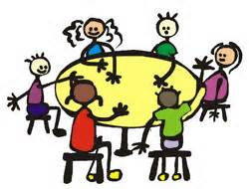
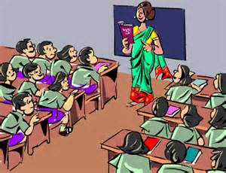
Module 2 Education
Unit 1 They don’t sit in rows.
WWW.PPT818.COM

Slide 2
Words Review
ours
tie
row
pool
pron. 我们的
n. 领带
n. 一排；一行；一列
n. 水池；游泳池

Slide 3


Objectives
1. To understand the conversation
about school
2. To learn to compare different schools using “both / one…but the other…”
3. To learn the words and expressions

Slide 4

Focus on
Words:
ours tie row pool
Phrases:
enjoy yourself in a row one day
Patterns:
1. What are English schools like?
2. We have more students here. This means more people to play with.
3. So ours is a bit bigger.
4. Let’s have a look.

Slide 5
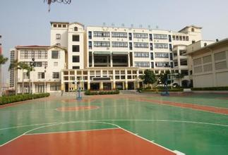


Education
a process of teaching, training and learning, especially in schools or colleges, to improve knowledge and develop skills 教育(尤指学校教育)
What can you think of when you see this word?
school

Slide 6

What words can you think of when talking about your school?
many trees
large
buildings
strict
happy
honest
campus
kind
teacher
friend
serious
school
subject
school
exam
pressure
club
homework
too much
boring
interesting

Slide 7
What do you like about our school?
What do you dislike about our school?

Slide 8
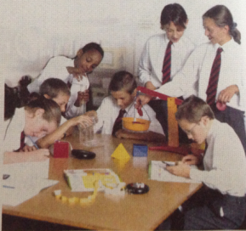


P10
1
Work in pairs and talk about your school. For example:
I like laboratory best because I can do physics experiments there.
What do you like best about our school?
I like the reading room best because I can read a lot of books there.

Slide 9


P10
2
Listen and complete the sentences.
1. The weather was _______ when Tony was in London.
2. Tony played football with _________________.
3. Daming is surprised to hear that Tony _________________________.
4. Tony didn’t go to lessons. He was ___________.
nice
Now we are going to hear about Tony’s trip to London.
What did he do when he was there?
Let’s read the sentences in Activity 2 first.
Susie’s classmates
went to school on his holiday
just visiting

Slide 10
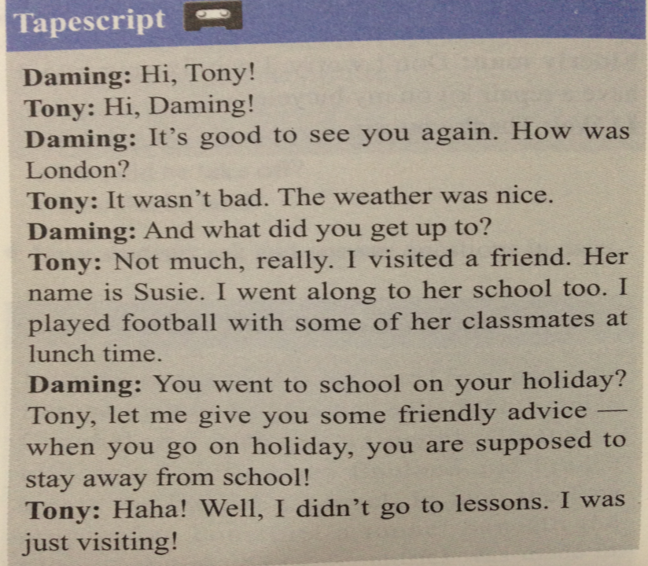

Slide 11


Do you think Susie’s school in London is the same with or different from ours?
Can you guess what the differences are between Susie’s school and ours?
It’s totally different from ours. There are, in fact, many differences between schools internationally and even within the same country.

Slide 12
Tony and his friends are talking about something. Listen and read. Finish the following tasks.

Slide 13
Task 1
Listen to the conversation and answer the following questions.
1. What are they talking about?
2. Do they think Susie’s school is greater than theirs?
They are talking about Susie’s school.
No, they think their school is great, too.

Slide 14


Task 2
1. Tony enjoyed himself in London.
2. Students in London sit in rows in the classroom.
3. Susie’s school has a swimming pool which Tony’s school doesn’t have.
4. Everyone in Tony’s school wears a jacket and tie.
around tables
also has.
Susie’s

Slide 15
P11
Task 3
3
Look through the conversation and complete Susie’s column in the table.
 | Susie’s school
Number of pupils in the school
Number of pupils in a class
Arrangement of seats in the classroom
Sports areas
about 700 pupils
about 30 pupils
Pupils sit around tables.
Sports grounds

Slide 16
P11
Task 4
4
Read the passage and answer the questions.
1. Who did Tony visit in London?
2. How did Tony get the photos of Susie’s school?
3. Which class is a bit bigger, Susie’s or Daming’s?
4. What does Betty hope to do one day?
Tony visited his friend Susie in London.
He took the photos of Susie’s school himself.
Daming’s class is a bit bigger than Susie’s class.
Betty hopes to visit Susie’s school one day.

Slide 17
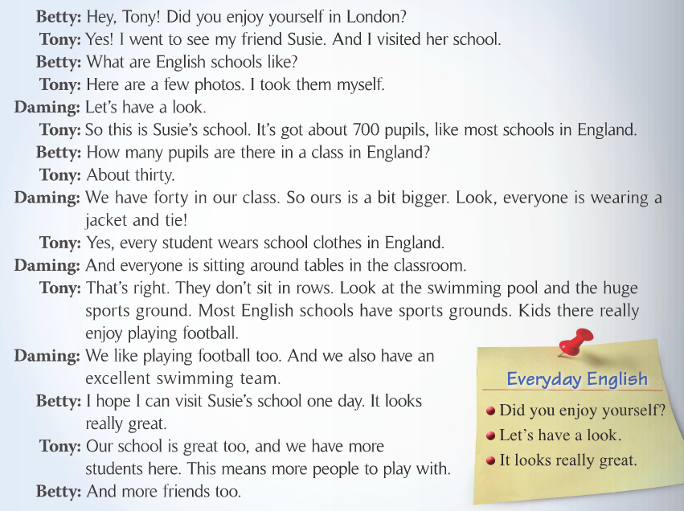

Slide 18
Read and try to recite the conversations in 5-10 minutes.

Slide 19
Role-play
1. Read the dialogue aloud for a few minutes by yourself;
2. Role play in groups;
3. Role play in front of the class.
We’ll see which group does the best.

Slide 20
P11
Task 5
5
Complete the passage with the correct form of the words in the box.
enjoy pool row tie wear
Pupils in England do not sit in (1) _______ in the classroom. They sit around tables. Everyone (2) _______ a jacket and (3) _______. Most schools have sports grounds, and English children (4) _______ playing football, just as pupils in China do. Some English schools have swimming (5) _______, but not all of them do.
rows
wears
tie
enjoy
pools

Slide 21
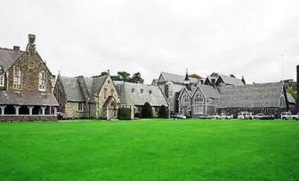
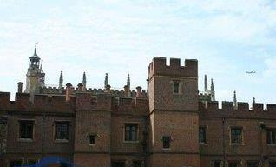
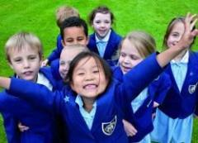
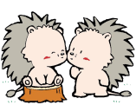

Now let’s watch a piece of video about an English school.
Can you list some differences between the English school and our school?

Slide 22

Did you notice?
在比较学校或班级大小时，英语的思维主要指的是人数多少而不是面积大小。托尼喜欢哪所学校的原因，不在于学校的设备有多先进，而在于哪个学校的学生人数多，因为人多就意味着朋友也更多。
我们初三快毕业了，要多多珍惜身边的朋友哦！

Slide 23
Language points
1. What are English schools like?
“What + be动词 + sth + like?”意为“……怎么样？”，用来询问事物的性质、质量、特征等。
“What + be动词 + sb + like?”既可用来询问人的性格、能力等，也可用来询问外表。
— What’s your new neighbour like?
— He’s friendly and he often wears a pair of
glasses.

Slide 24
2. I took myself.
我自己拍的。
这里的反身代词myself 在句中作同位语，起加强语气的作用。反身代词在句中还可以作宾语。如：
Did they enjoy themselves last Sunday?
他们上个星期天玩得高兴吗？
We should take care of ourselves.
我们应该照顾自己。

Slide 25
3. It’s got about 700 pupils.
have / has got在形式上是现在完成
时，但在内容上却是现在时，在口语中常用来代替have / has。
4. So ours is a bit bigger.
名词性物主代词具有名词的特征，相当于“形容词性物主代词+名词”。
我的词典丢了。请把你的借我用一下。
I have lost my dictionary. Please lend me yours.

Slide 26
5. I hope I can visit Susie’s school one day.
希望我有一天可以去苏西的学校。
one day意为“某一天”、“有一天”，既可用于过去时中，也可用于将来时中。如：
One day we’ll both get to see New York.
总有一天我俩都有机会看看纽约。
One day the temperature was 30℃.
有一天温度达到三十摄氏度。

Slide 27
some day(或someday)也有“某一天”之意，但它指的是“将来的某一天”，要用将来时。如：
If you drive so fast, you’ll run down someone some day.
你要是开得这么快，总有一天会撞伤人的。

Slide 28
Pronunciation
and speaking

Slide 29

Stress 重读
英语句子一般由多个单词构成，这些单词的重读一般遵循以下规律：名词、形容词、数词、实义动词、副词、代词和表达强烈思想感情的感叹词需要重读；人称代词、连词、冠词、介词、以及少数系动词和助动词等主要起语法作用的单词一般不重读（当然有少数例外）。

Slide 30

在具体的语境中，句子中重读的单词不同，所表达的意思也会不同。如：
What’s wrong with you? (Are you ill?)
What’s wrong with you? (Everybody else is OK.)
What’s wrong with you? (Are you feeling happy or sad?)
对于语音的学习，听读模仿是最常见、最有效的方法之一。同学们可以在准确朗读句子的基础上，反复地听、跟读、模仿，慢慢提高语音水平。

Slide 31

P11
6
Read and predict which words the speaker is likely to stress.
7
Work in pairs. Read the conversation aloud.
Betty: Hey, Tony! Did you enjoy
yourself in London?
Tony: Yes! I went to see my friend Susie.
And I visited her school.
Betty: What are English schools like?
Tony: Here are a few photos. I took
them myself.
Now listen and check.

Slide 32
P11
8
Complete the Your school column in the table.
 | Susie’s school | Your school
Number of pupils in the school | about 700 pupils
Number of pupils in a class | about 30 pupils
Arrangement of seats in the classroom | Pupils sit around tables.
Sports areas | Sports grounds

Slide 33

Now work in pairs and compare your school with Susie’s school. Say:
possible answers:
☺ what both schools have
Both schools have sports grounds.
☺ what one school has but the other does not
Our school has a big library ,
but Susie’s school doesn’t.

Slide 34
More samples:
Both schools are very nice. Both schools have a few science laboratories, a music room, a swimming pool and a huge sports ground.
Our school has a big library, but Susie’s school doesn’t. Susie’s school has a hall for concerts, but our school doesn’t. There are 64 pupils in a class in our school, but there are only 30 pupils in a class in Susie’s school.

Slide 35

总结回顾
本课时主要短语和句型
1. Did you enjoy yourself?
2. sit in rows/ sit around tables
3. one day
4. I took them myself.
5. let’s have a look.
6. How many pupils are there in a class in England?
7. Our school is great too, and we have more students here.
8. It looks really great.

Slide 36

Spelling Bee
Now 2 minutes to test your spelling.
1. English-Chinese
swimming pool tie ours row
2. Chinese-English
校服 玩得开心 有朝一日 自己拍照
When finishing, exchange your papers to see who does the best.

Slide 37


注: 另附word文档。
点击此处链接

Slide 38
Ⅰ.从方框内选择适当的单词填空。
really in a row the other swimming pool
swimming pool
1. There is a large ____________ in their school.
2. I have a happy family and I _________ love my family.
3. Susan has got two skirts. One is yellow,
_________ is blue.
4. We sat _________ at the back of the room.
really
the other
in a row

Slide 39
Ⅱ. 选择正确的一项完成句子。
— Does your mother often wash
clothes for you?
— No. I always wash them _______
(I / myself).
2. Your room is as big as _______ (me / mine).
3. Only ________ (few / a few) of the children can work out the problem.

Slide 40
Ⅲ. 翻译句子。
1. 莉莉的那本书虽然有趣，但我这本更有趣。
_________________________________
______________________________
2. 没有人教他画画。他是自学的。
_________________________________
______________________________
3. 将来有一天我们能去火星旅行。
__________________________________
Lily’s book is interesting, but mine is more interesting.
Nobody taught him drawing. He learned it himself.
We’ll be able to travel to Mars one day.

Slide 41
Homework
Search for the information about the education system in Britain.
Finish the exercises in Learning English.
3. Preview the passage My school life on page 12.

