Slide 1
Module 8 Unit 1
Why do you have cups on your heads?
WWW.PPT818.COM

Slide 2
Learning goals
能够掌握单词: cup, planned, baseball, more, smile, mistake, with, said。
能够掌握句子：
Why do you have cups on your heads?
Why are you laughing?
能用“Why …?”对不理解的事情进行询问并回答。

Slide 3
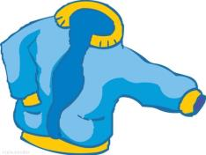
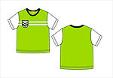
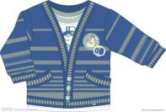
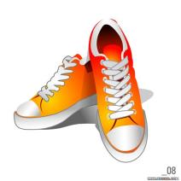
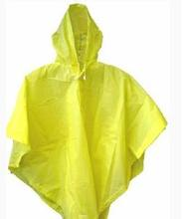
Lead-in
T-shirt
coat
dress
sweater
shoes
raincoat
cap

Slide 4
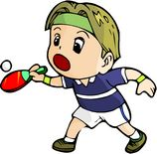
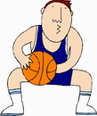
table tennis
football
baseball
basketball

Slide 5
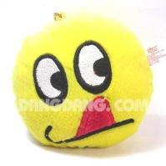
happy
sad
bored
hungry
angry
afraid

Slide 6
课文学习
1 Look, listen and say.
Where's my bag?
I put it on your bed.
Why can't I see it?
Oh, it's under my bed.

Slide 7
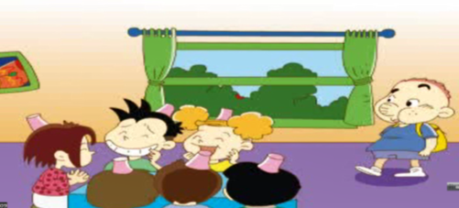
2 Listen and read.
Sam came into the classroom and saw some friends there . They had cups on their heads. “Why do you have cups on your heads ?Why are you laughing?”

Slide 8
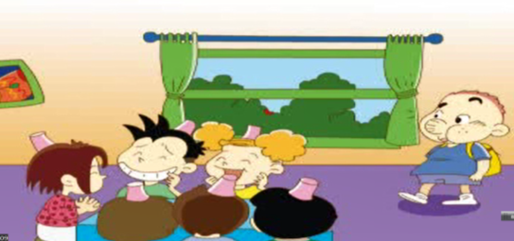
Daming told him the story. They planned to play a baseball game. Amy asked Lingling to bring some caps for the game. But Lingling brought some cups. They all laughed. Then they put the cups on their heads and laughed more.

Slide 9
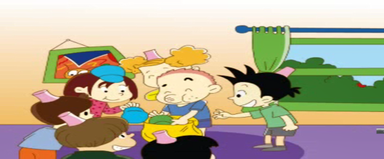
Sam smiled. “It’s easy to make mistakes with English words,”he said. “I make lots of mistakes with Chinese words too. Now look what’s in my bag!” Sam opened his bag .There were baseball caps!“Hooray!” everyone shouted . They put the caps on. Then they went to the playground and played baseball together.

Slide 10
New words
baseball

Slide 11
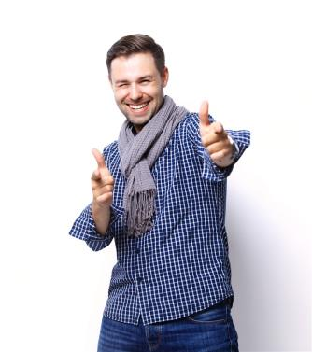
smile

Slide 12
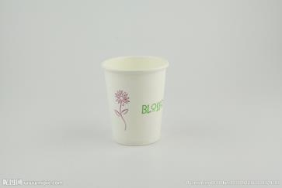
a cap
a cup
not
/ ʌ /
/æ/

Slide 13
课文理解
课文理解
1. Why are they laughing?
Because Lingling made a mistake.
2. What did they plan to do?
They planned to play a baseball game.
3. What was in Sam’s bag?
There were baseball caps.
4. What did they do at last?
They went to the playground and played baseball.

Slide 14
课文理解
重要句型
why表示“为什么”，用来询问原因，一般要用because…来回答。
—Why are you laughing?
—Because I’m happy.
—Why are you late?
—Because I get up late.

Slide 15
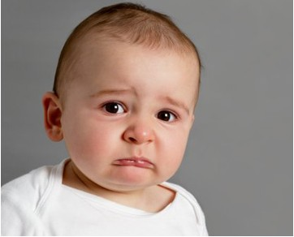
crying----sad
—Why is he crying?
— Because he is sad.

Slide 16
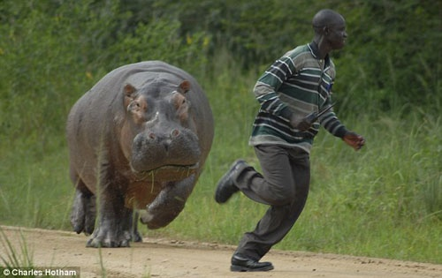
running---afraid
—Why is he running?
—Because he is afraid.

Slide 17
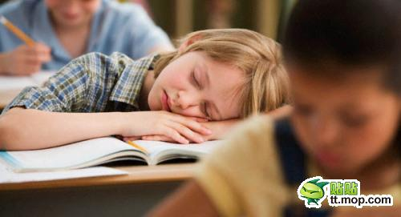
sleeping--tired
—Why is she sleeping?
—Because she is tired.

Slide 18
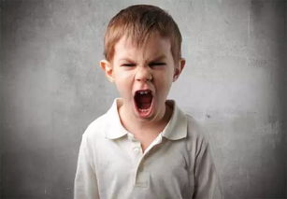
shout--angry
—Why are you shouting?
—Because I’m angry.

Slide 19
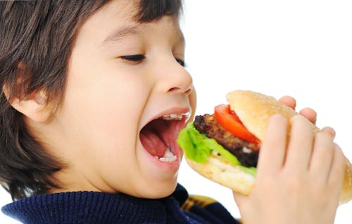
eat--hungry
—Why are you eating?
—Because I’m hungry.

Slide 20
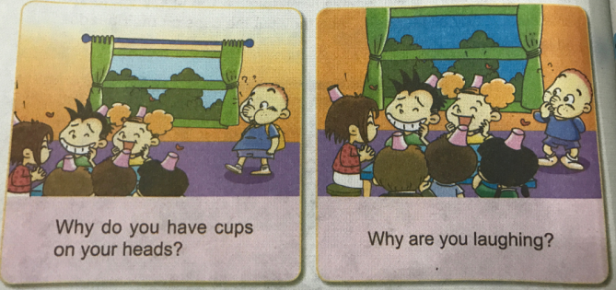
课文学习
3. Listen and say.

Slide 21
Homework
1. Recite the text.
2. Try to make a poster talk about your hero.

