Slide 1
Unit 4
January is the first month.
WWW.PPT818.COM

Slide 2
March is the third month of the year.People can see green trees and green grass everywhere.In China, Tree Planting Day is on 12th.People plant trees on that day.They wan to stop sand on windy days and make the air clean.They want to make the country greener.

Slide 3
April is the thirdfourth month of the year.Easter is in March or April. It is always on a sunday.For American students,The Easter holiday are aw long.During Easter,children get colorful Easter eggs.

Slide 4
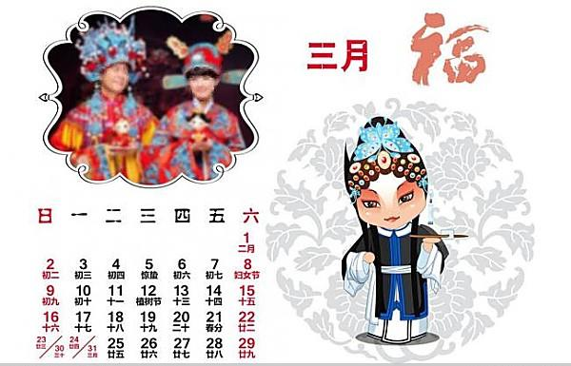
March is the third month of the year.

Slide 5
草，不可数名词，无复数
People can see green trees and green grass everywhere.

Slide 6
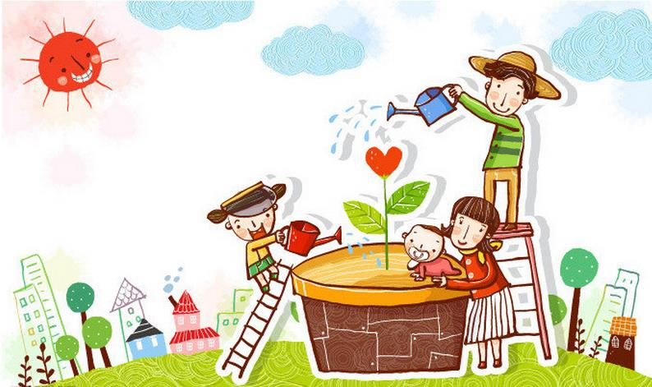
具体几号前加介词on.
Tree-Planting Day is on March 12th. People plant trees on that day.

Slide 7
stop the sand on windy days 风天阻沙
make the air clean. 净化空气
make the country greener 让国家更绿

Slide 8
want to的用法
They want to stop the sand on windy days and make the air clean.
They want to make the country greener.
构成：want to+动词原形
意义：想要做某事

Slide 9
April is the fourth month of the year.

Slide 10
单纯月份前加介词in, 具体几号前加介词on.
Easter is in March or April.
例如：in March on March 12th.

Slide 11
stop third greener clean on everywhere
third
March is the ______month of the year. People can see green trees and green grass________. They want to _____the sand ____windy days and make the air______. They want to make the country_______.
everywhere
stop
on
clean
greener

Slide 12
eggs Sunday fourth week.
April is the _______month of the year. Easter is ___March or April. It’s always on a _______.Easter holidays are a _____long. During Easter, children get colourful ____.
fourth
in
Sunday
week
eggs

Slide 13
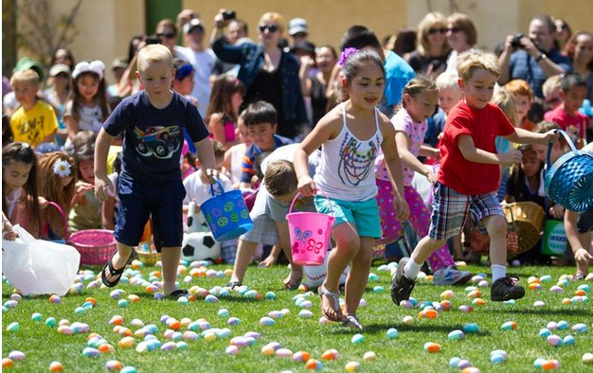
about Easter
复活节（主复活日）是一个西方的重要节日，在每年春分月圆之后第一个星期日。基督徒认为，复活节象征着重生与希望，为纪念耶稣基督于公元30到33年之间被钉死在十字架之后第三天复活的日子。

Slide 14
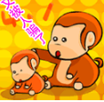
about April Fool’s Day
四月一日愚人节，人们之间可以相互开玩笑，被骗到的人就要被称为四月傻瓜。

