Slide 1
Unit 1 Lesson 1
What did you do in the holidays?
WWW.PPT818.COM

Slide 2
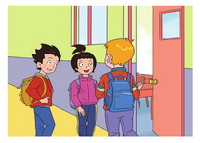
Watch and find:
They are talking about winter holidays.
What did they do in the holidays?

Slide 3
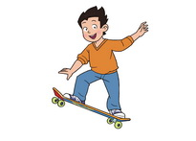
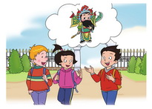
Watch and find
What did you do
in the holidays?
I learned Beijing Opera.

Slide 4
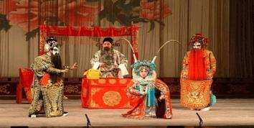
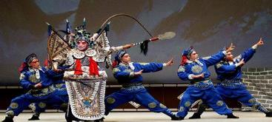
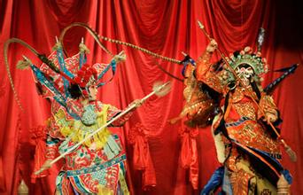
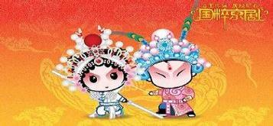
Beijing Opera

Slide 5
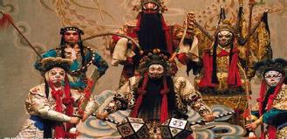
Beijing Opera
Was it fun?
Yes, but a little difficult.
有点 难

Slide 6
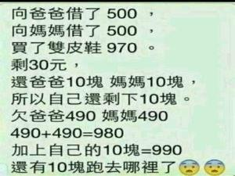
difficult ----- diffi cult
different ----- diffe rent
difficult
It's a little ___________.

Slide 7
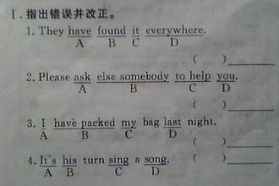
difficult
It's a little ___________.

Slide 8
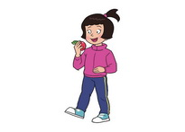
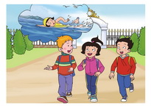
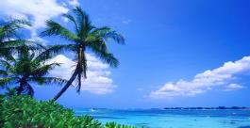
Watch and find
What did you do
in the holidays?
I went to Hainan.
（go 的过去式）
It's a beautiful place.
(地方)

Slide 9
What did Wang Hong do in Hainan?
She went swimming in the sea.
went swimming
She had a good time there.

Slide 10
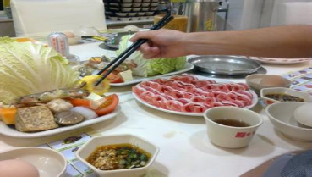
Watch and find
Did you enjoy your holidays?
(喜欢，享受……的乐趣）
enjoy
________nice food

Slide 11
Watch and find
Did you enjoy your holidays?
(喜欢，享受……的乐趣）
enjoy
________ the sun

Slide 12
Watch and find
Did you enjoy your holidays?
(喜欢，享受……的乐趣）
enjoy
________ summer

Slide 13
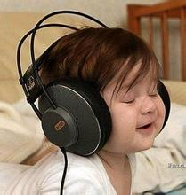
Watch and find
Did you enjoy your holidays?
(喜欢，享受……的乐趣）
enjoy
________ the music

Slide 14
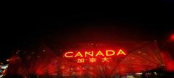
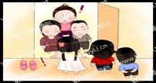
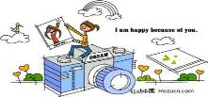
Watch and find
Did you enjoy your holidays?
喜欢，享受……的乐趣）
Yes. I went back to Canada.
I visited my friends and
took many pictures.
（take 的过去式）

Slide 15
Holiday, holiday,
What did you do in the holidays?
Opera, opera,
I learned Beijing Opera.
It was fun.

Slide 16
Holiday, holiday,
What did you do in the holidays?
Hainan, Hainan,
I went to Hainan.
I went swimming in the sea.

Slide 17
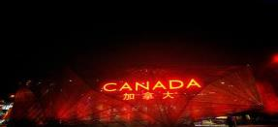
Holiday, holiday,
What did you do in the holidays?
Canada, Canada,
I went back to Canada.
I enjoyed my holidays.

Slide 18
Listen and imitate .
Listen , point and repeat !
(看看谁模仿的发音最像！)

Slide 19
Fill in the words.
Beijing Opera
1. Li Ming learned _______________.
2. Wang Hong _______ to Hainan.
3. Did Wang Hong _______ in the sea?
Yes, she did. She______ a good time.
4. Peter _______ back to Canada.
He _______ his friends and
_______ many pictures.
5. Peter_________ his holidays.
went
swim
had
went
visited
took
enjoyed

Slide 20
Read and show.
Read the text in groups .(小组内表演课文)
2. Show Time . (展示一下你们的风采吧)

