Slide 1
Unit 2 Feelings
Was he happy?
WWW.PPT818.COM

Slide 2
Magic eyes

Slide 3
happy

Slide 4
sad

Slide 5
angry

Slide 6
excited

Slide 7
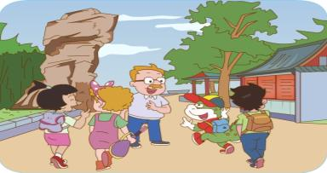
We’re going to the park.

Slide 8
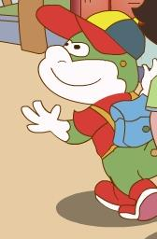
Danny is happy.

Slide 9
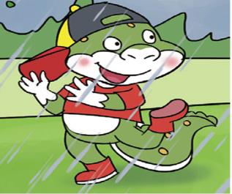
Danny is dancing in the rain.

Slide 10
He is excited.

Slide 11
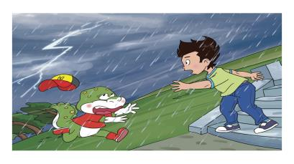
Oh, the sky is angry.

Slide 12
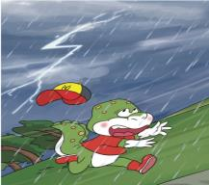
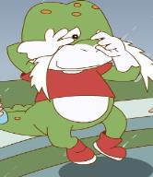
Danny lost his cap. He’s sad.

Slide 14
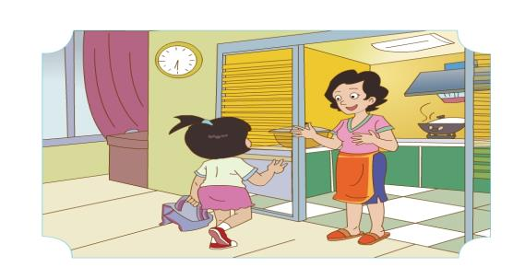
Wang Hong is late.

Slide 15
What does mum say?

Slide 16
A: I’m sad you’re back.
I was worried.
B: I’m glad you’re back.
I was worried.

Slide 17
Was Wang Hong happy
Yes, she was.
She played games with
Jenny and Li Ming.

Slide 18
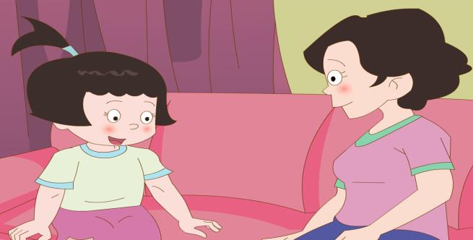
No, he wasn’t.
He was sad.
He lost his cap.
Was Danny happy?

Slide 19
Read and fill.
Wang Hong was____. Her mother was ________. She ______ games with Jenny and Li Ming. She was very ______. But Danny _______ happy. He ______ his cap.
late
worried
played
happy
wasn’t
lost

Slide 20
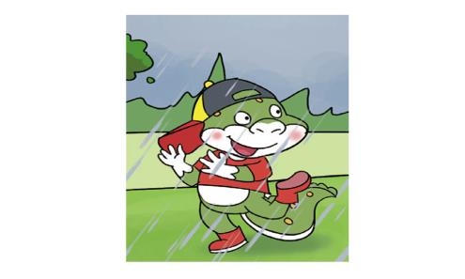
Ask and answer.
A: Was Danny angry?
B: No, he wasn’t.
He was excited.
angry
×

Slide 21
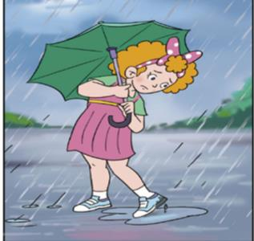
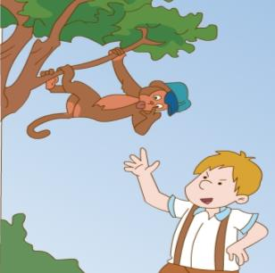
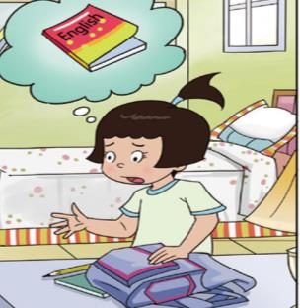
sad
√
excited
×
worried
√
A: Was she/ he …?
B: Yes, she/ he was.
No, she/ he wasn’t.

Slide 22
Let’s talk.

Slide 23
My feeling diary
Saturday
Sunday, Monday, Tuesday, Wednesday, Thursday, Friday, Saturday…
It was__________.
It was__________.
cloudy
cloudy, windy, sunny, rainy…
I_______________.
played basketball, played football, played computer games, played the piano, played the erhu, played
games, cleaned the floor…
lost my English book
worried
I was__________.
excited, sad, angry, happy, worried…

Slide 24
The wolf is coming.

Slide 25
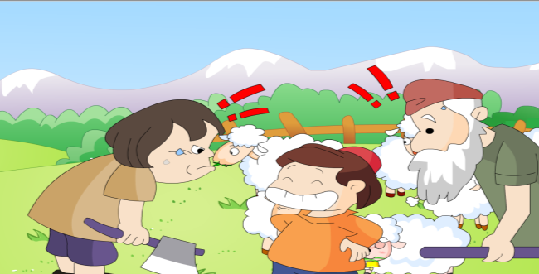
Was the boy happy?
Yes, he was.

Slide 26
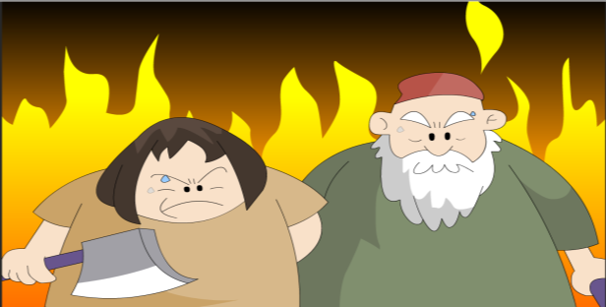
Were they angry?
Yes, they were.

Slide 27
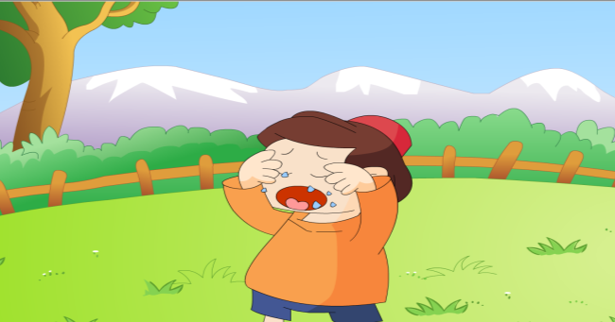
Was he worried?
No, he wasn’t. He was sad.

Slide 28
Don’t tell lies.
不要说谎！

Slide 29
Homework：
1. Read the text ______ times. （读课文___遍。）
2. 和朋友或家长谈论你的心情日记。

