Slide 1
Section D Reading for Writing & Assessing Your Progress
人教版高中英语必修二
UNIT 4 History and traditions
WWW.PPT818.COM

Slide 2
Ⅰ
Ⅱ
Ⅲ
Ⅰ.知识体系图解
poet
county
roll
cattle
ocean
greet
pub
wine
beer
custom
crowd

Slide 3
Ⅰ
Ⅱ
Ⅲ
对……有很大的影响
有……的历史
构成;编造
用……迎接
有……的机会
向……介绍
使……情绪激昂
对……进行研究
获得一等奖
事实上

Slide 4
Ⅰ
Ⅱ
Ⅲ
Ⅱ.释义匹配
1.poet A.a very large area of sea
2.ocean B.something that is done by people in a particular society because it is traditional
3.greet C.a large group of people who have gathered together
4.custom D.to say hello to someone or welcome them
5.crowd E.a person who writes poems
答案:1.E 2.A 3.D 4.B 5.C

Slide 5
Ⅰ
Ⅱ
Ⅲ
Ⅲ.介词填空
1.Van Gogh had a major influence the development of modern painting.
2.We came to a river green grass and beautiful flowers on both sides.
3.People in our country usually greet the New Year_____________ fireworks.
4.His inspiring speech set the students fire.
5.May I introduce you the other members of the delegation?
on
with
with
on
to

Slide 6
重点词汇
重点句式
高分写作
随堂练习
1.greet vt.问候;迎接
【课文原句】On a quiet morning in the mountains,feel the sun on your skin,and breathe in the sweet scent of fresh flowers while birds greet the new day with their morning song.
在宁静的早晨,在山上,感受阳光照射在你的皮肤上,呼吸鲜花的芬芳,鸟儿用清晨的歌声迎接新的一天。
【词汇精讲】greet是及物动词,意为“问候;迎接”。
He looked at Livy and Mark,who had risen to greet him.
他看着莉薇和马克,他们站起来跟他打招呼。
He greeted all the guests warmly as they arrived.
所有客人到达时他都热情接待。

Slide 7
重点词汇
重点句式
高分写作
随堂练习
【词汇拓展】
She greeted the guests with a warm smile.
她热情地微笑着迎接客人。
My mother sends her greetings to you all.
我母亲向你们大家问好。

Slide 8
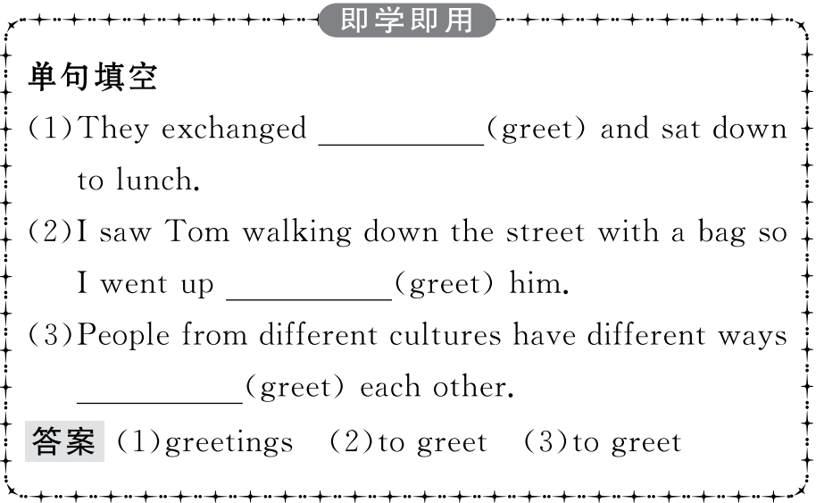
重点词汇
重点句式
高分写作
随堂练习

Slide 9
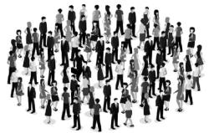
重点词汇
重点句式
高分写作
随堂练习
2.crowd n.人群;一群人;民众 vt.挤满;使……拥挤
【课文原句】Dave could not find a seat in the room.It was very crowded.
戴维在房间里找不到座位,太拥挤了。
【词汇精讲】crowd作名词,意为“人群;一群人;民众”,作动词,意为“挤满;使……拥挤”。
A cry of horror burst forth from the crowd.
人群中突然发出恐惧的叫喊声。
A crowd gathered to see what had happened.
一群人聚拢起来看发生了什么事。
Many passengers crowded the platform.许多乘客挤满了站台。
He crowded more books onto the shelf.
他又在书架上塞进了一些书。

Slide 10
重点词汇
重点句式
高分写作
随堂练习
【词汇拓展】
The man tried his best to get into the crowded bus.
那个人尽力上了拥挤的公交车。
In winter the place is crowded with skiers.
冬季这地方满是滑雪的人。

Slide 11
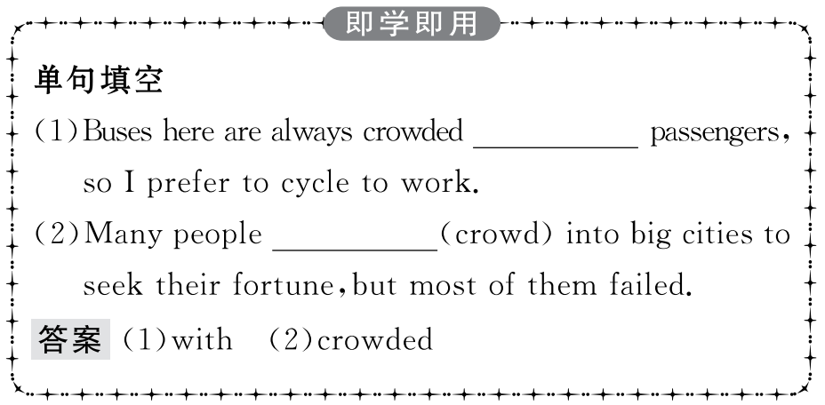
重点词汇
重点句式
高分写作
随堂练习

Slide 12
重点词汇
重点句式
高分写作
随堂练习
The peaceful landscape of the “Emerald Isle” and its many green counties is a true feast for the eyes,with its rolling green hills dotted with sheep and cattle.
“绿宝石(爱尔兰岛)”风光宁静秀美,郡县草木葱茏,青山连绵起伏,牛羊点缀其中,堪称一场名副其实的视觉盛宴。
【句式剖析】with its rolling green hills dotted with sheep and cattle为“with+宾语+宾补”结构,dotted with...是动词-ed形式作宾语补足语,其中dot和green hill有逻辑上的动宾关系。
With all the work finished,they hurried back home for lunch.
所有的工作都做完了,他们匆忙回家吃午饭。
You have no idea how she finished the relay race with her foot hurt so much.
你不知道她脚伤那么厉害是怎么完成接力赛的。

Slide 13
重点词汇
重点句式
高分写作
随堂练习
【句式拓展】
With the boy leading the way,we had no trouble in getting to the station.
由这个男孩带路,我们毫不费力地到达了车站。
With many things to deal with,I have to stop listening to the light music.
有许多事情要处理,我只好停止听轻音乐。

Slide 14
重点词汇
重点句式
高分写作
随堂练习

Slide 15
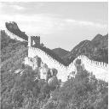
重点词汇
重点句式
高分写作
随堂练习
介绍名胜古迹
假如你是李华,你的澳大利亚笔友Mary来信说打算暑期到长城旅游,请你根据以下信息给她写一封回信。要点如下:
1.长城是世界奇迹之一;
2.长城有2,000多年的历史,城墙建于春秋时期、战国及秦朝;
3.现在长城已成为著名景点。
注意:1.词数不少于80;
2.可适当增加细节,以使文章连贯;
3.开头和结尾已给出,不计入总词数。

Slide 16
重点词汇
重点句式
高分写作
随堂练习
Dear Mary,
I am very delighted to hear you are paying a visit to the Great Wall during the summer holiday.__________________________________
________________________________________________________________________________________________________________
Hope you will have a good time.
Yours,
Li Hua

Slide 17
重点词汇
重点句式
高分写作
随堂练习
一、审题定调
1.确定体裁:本单元的写作是写一封信,内容为介绍长城的相关内容,根据写作要点来看,该类短文可按照时间顺序进行介绍。
2.确定人称:由于是介绍长城的历史,所以主要人称为第三人称。
3.确定时态:由于介绍的是过去发生的事情,所以主要时态用一般过去时。
二、谋篇布局
本文可以按照逻辑顺序来写作,分为三个段落。
第一段:表达自己的心情(已给出),然后用过渡句引出下文。
第二段:具体介绍长城的历史:(1)初建于春秋时期;(2)战国时期建了更多的城墙;(3)秦始皇把城墙连接在了一起。
第三段:长城的影响。

Slide 18
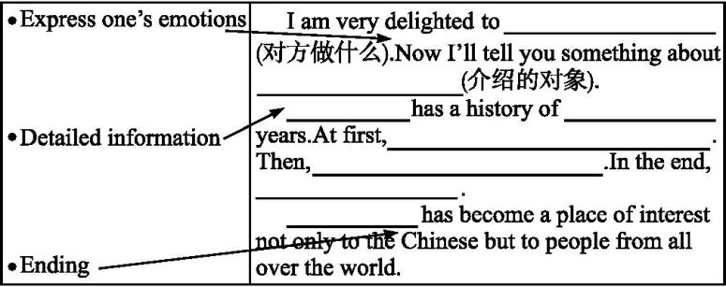
重点词汇
重点句式
高分写作
随堂练习
三、短文模板

Slide 19
重点词汇
重点句式
高分写作
随堂练习
四、组织语言
1.常用语块

Slide 20
重点词汇
重点句式
高分写作
随堂练习
2.遣词造句

Slide 21
重点词汇
重点句式
高分写作
随堂练习
五、连句成文
参考范文
Dear Mary,
I am very delighted to hear you are paying a visit to the Great Wall during the summer holiday.Now I’ll tell you something about it.
The Great Wall,which has a history of over twenty centuries,is one of the wonders of the world.The first part of it was built during the Spring and Autumn Period.During the Warring States Period,more walls were put up to defend the borders of different kingdoms.It was during the Qin Dynasty that Emperor Qinshihuang had all the walls joined up.Thus,the Great Wall came into being.
Today the Great Wall has become a place of interest not only to the Chinese but to people from all over the world.
Hope you will have a good time.
Yours,
Li Hua

Slide 22
重点词汇
重点句式
高分写作
随堂练习
Ⅰ.单词拼写
1.Ms Smith is not only a musician,but also a (诗人).
答案:poet
2.There were few sights as beautiful as the calm (海洋)on a warm night.
答案:ocean
3.When she opened the door she was (迎接)by smiling faces.
答案:greeted
4.The c of lighting the Olympic flame goes back centuries.
答案:custom
5.A huge c gathered in the street,waiting for the famous singer.
答案:crowd

Slide 23
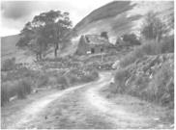
重点词汇
重点句式
高分写作
随堂练习
Ⅱ.语篇填空
People in Ireland and Ireland’s traditions are
1. (great) influenced by its beautiful countryside.
During its long history,many great 2. (poem) and
greatly
poets
peaceful
writers appeared.The 3. (peace) landscape of the “Emerald Isle” and its many green counties is a true feast for the eyes,with its rolling green hills 4. (dot) with sheep and cattle.The roar of the ocean waves and cries of the seabirds make 5. the music of the coast.On a quiet morning in the mountains,you can feel the sun shining on your skin,and take a 6. (breathe) of the sweet scent of fresh flowers with birds 7. (greet) the new day with their morning song.With all this beauty,it is not 8. (surprise) that Ireland has developed strong traditions that include music,dancing,and dining.
dotted
up
breath
greeting
surprising

