Slide 1
Unit 2 Good Health to You!
Lesson 7 Always Have Breakfast!
WWW.PPT818.COM

Slide 2


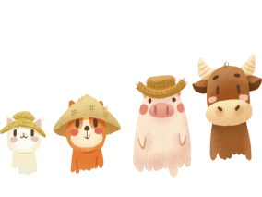
Warm-up
Greeting

Slide 3


Review

Slide 4


根据内容填表格。
(1)You always wear shoes from Monday to Sunday.
(2)You never eat dount on Sunday.
(3)You usually go to school by bus from Monday to Friday.
(4)You sometimes go to school on foot.

Slide 5
 | always | usually | sometimes | never
Sunday | √ |  |  | √
Monday | √ | √
Tuesday | √ | √
Wednesday | √ | √ | √
Thursday | √ | √
Friday | √ | √
Saturday | √

Slide 6
Presentation

Slide 7
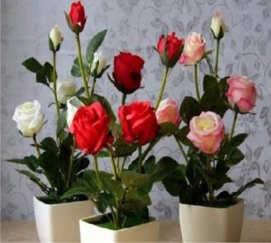


These flowers are healthy and strong.

Slide 8
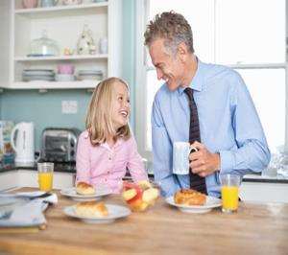
How often do you have breakfast?

Slide 9
once
twice
three times
four times
基数词+times

Slide 10
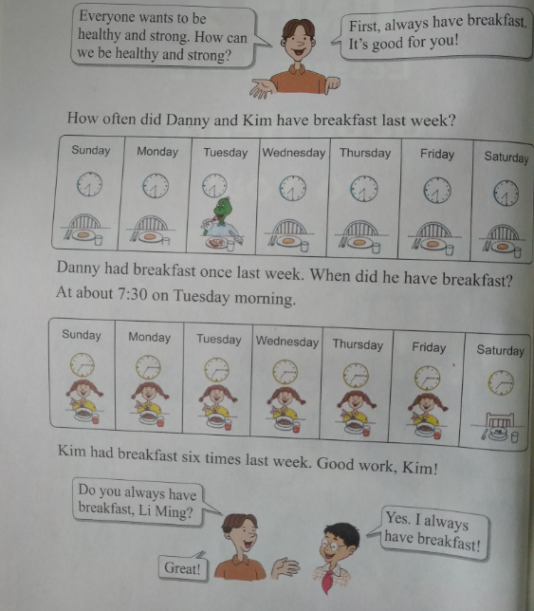
Healthy and strong

Slide 11

Practice

Slide 12


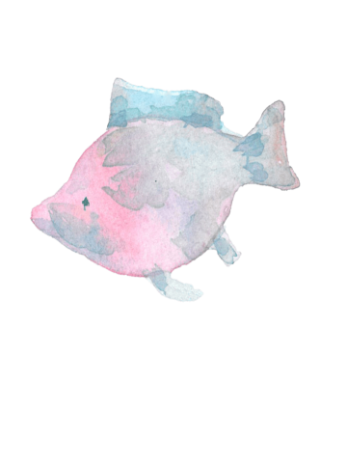
adapt the dialogue

Slide 13
编排对话:
A: I’m weak and sick.
B: I’m health and strong.
Because I always have breakfast.
A: I never have breakfast.
B: It’s bad for you. You need to
have breakfast. That’s good for
you.
…

Slide 14

Consolidation and Extension

Slide 15
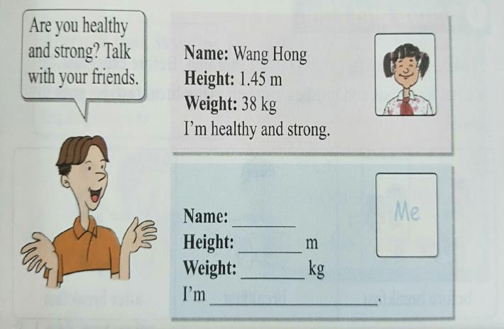
Let’s do it !

Slide 16

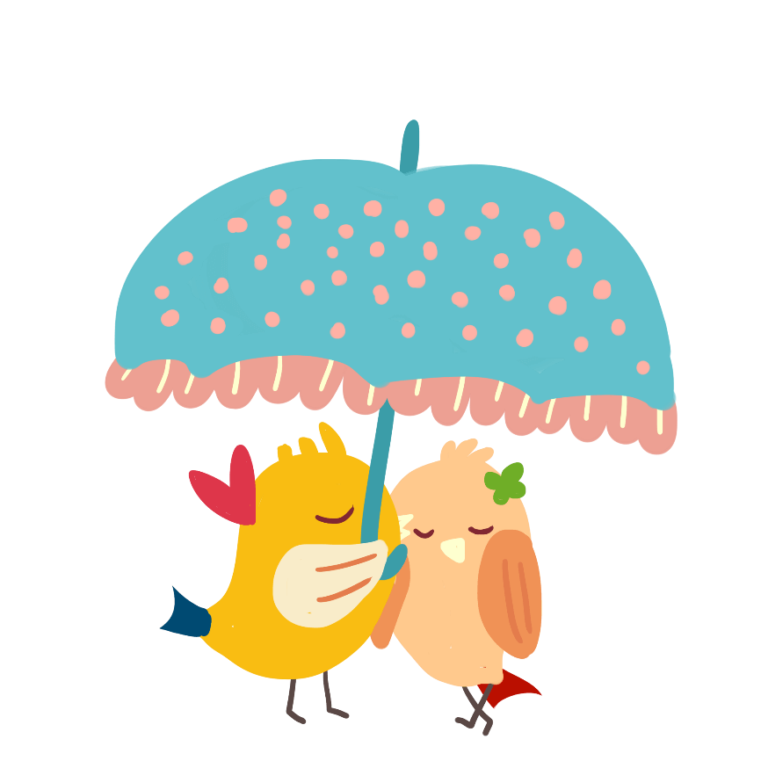
Talk and write.

Slide 17
How to be healthy and strong?
参考句式:
I want to be______.
First _______.
My favourite food ______.
I eat breakfast _______ times a ______.
Let’s ______.

Slide 18


Homework
1.做完课后的配套练习题。
2.跟随录音朗诵练习本课的单词与句型。

Slide 19
THANKS

