Slide 1
广州版三年级英语上册
Unit 5
Wash My Face.
WWW.PPT818.COM

Slide 2
Let's talk
 | What? | What time?
 | get up | at…
 | have breakfast
 | go to school
 | go home
 | go to bed

Slide 3
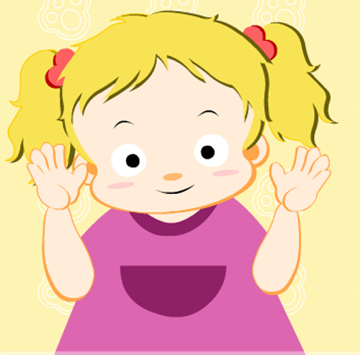
Module 2 My Body
I have…
hair
(I)-eyes
nose
ears
face
mouth
hands

Slide 4
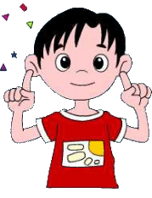
Let's chant
Nose, nose, I have a nose.
Mouth, mouth, I have a mouth.
Face, face, I have a face.
Eyes, eyes, I have two eyes.
Ears, ears, I have two ears.
Hands, hands, I have two hands.
Hair, hair, I have black hair.

Slide 5
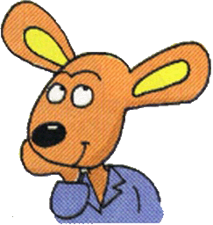
Let's think
What do you usually do after you get up?小朋友们，你起床后通常会做什么事呢？

Slide 6
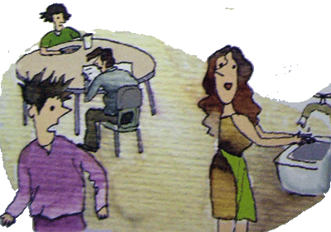
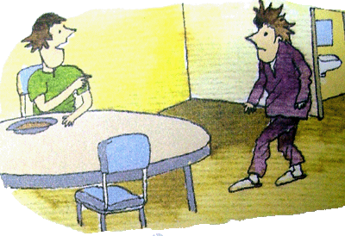
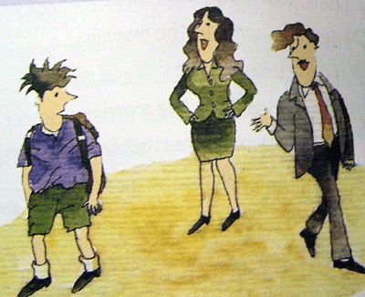
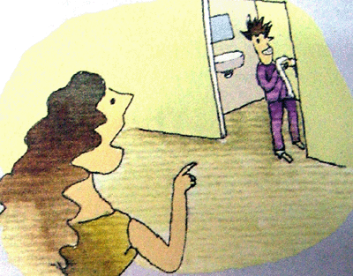
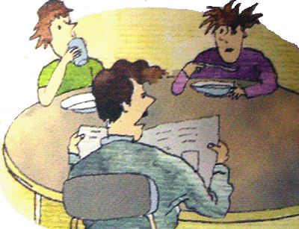
Let's talk and guess
Mrs Webb
Ben
Janet
3
1
5
Mr Webb
4
2

Slide 7
Let's act
Janet:
Ben:
Ben!
Wash your hands.
OK.

Slide 8
Let's act
Ben!
Brush your hair.
Mr Webb:
Ben:
All right. Dad.

Slide 9
Let's act
Wash your face and clean your ears!
Mrs Webb:
Ben:
OK, Mum.

Slide 10
Let's act
And clean your teeth!
Mrs Webb:
Ben:
But Mum.

Slide 11
Let's act
Mr Webb:
And wash your face and hands, and brush your hair.

Slide 12
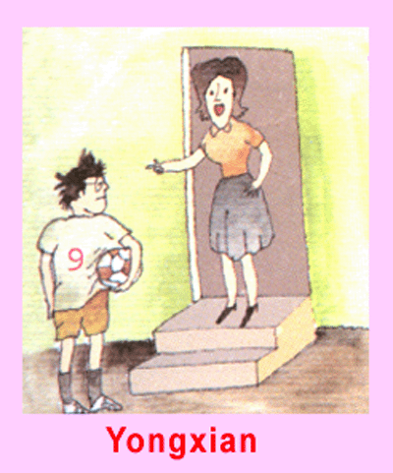
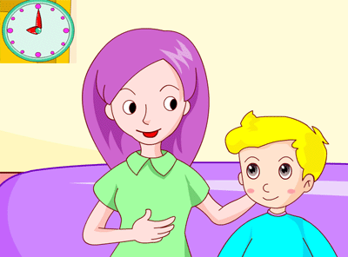
Let's make
小朋友们，你能选择下面其中一幅图片，用你所学的词句和你的伙伴创编一个对话吗？ 试试吧！你一定行的！
5:00
It’s time to go home
It’s time to go to bed.
Mum
Ben
(1)
(2)
Hello! / Hi!
What time is it?
It’s time to…
Wash your…
Brush your…
Clean your…
OK/ All right!
Key points:

Slide 13
Thank you！

