Slide 1
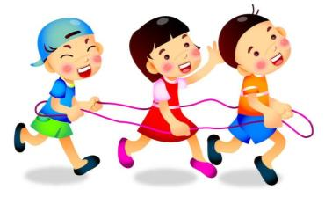
6
Unit 6 Me
About you
第二课时
WWW.PPT818.COM

Slide 2
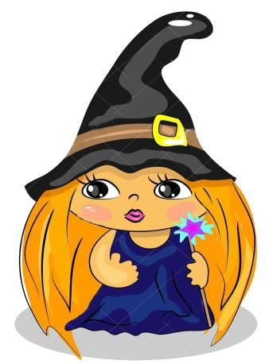
Who am I?
a witch

Slide 3
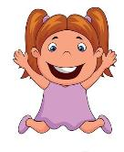
Look! This is my new face.
Wow, You’re a witch.
You’re small.
.
Your eyes are big and black. Your hair is long and yellow.
Your mouth is small and red.
I like your new face!

Slide 4
Your
eye
s
are big and black.

Slide 5
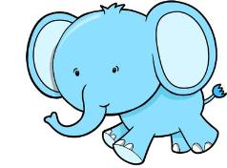
Look! This is my new face!
Your
eyes are small and black.
Look! This is my new face!
Your eyes are big and yellow.

Slide 6
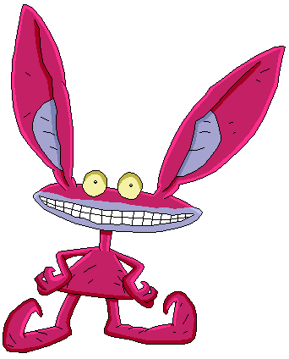
Look! This is my new face!
Your ears are long and red.
Look! This is my new face!
Your ears are short and yellow.

Slide 7
Your hair is long and yellow.
nose?
mouth?
face?

Slide 8
Look! This is my new face.
Wow, You’re a witch.
You’re small.
.
Your eyes are big and black. Your hair is long and yellow.
Your mouth is small and red.
I like your new face!

Slide 9
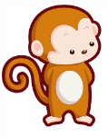
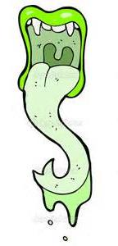
Your eyes, your eyes. Are, are, are. Your eyes are big. Your eyes are red. Your eyes are big and red!
Let's chant
Your mouth, your mouth.
Is, is, is. Your mouth is_____. Your mouth ____ ________. Your mouth ____ _______and ______!

Slide 10
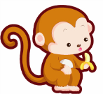
Games Time
Fun with words

Slide 11
yellow
green
yellow
hair
short
hair
Your
Your
long
and
long
and
is
is
.
are
.

Slide 12
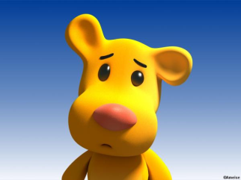
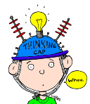
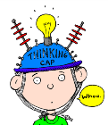
.
ears
small
and
big
red
green
Your ears are small and yellow.
Your
is
are
yellow

Slide 13
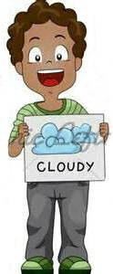
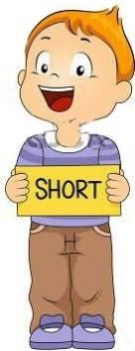
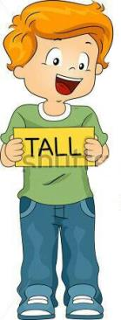
yellow
hair
is
Long
and
Your
.

Slide 14
Your
is
mouth
.
big
Your mouth is big and green.
and
green

Slide 15
Homework
Make a funny face for your parents and write down the description.
Culture research: more about Halloween

Slide 16
Funny face
给你的父母或者朋友制作一个万圣节面具，并请写一写，描述这个面具。
You’re _____.
You’re_____. (tall/short/fat/thin)
Your eyes are .

