Slide 1
Unit 9
Have you ever been to a museum?
Section A 1a—2d
WWW.PPT818.COM

Slide 2
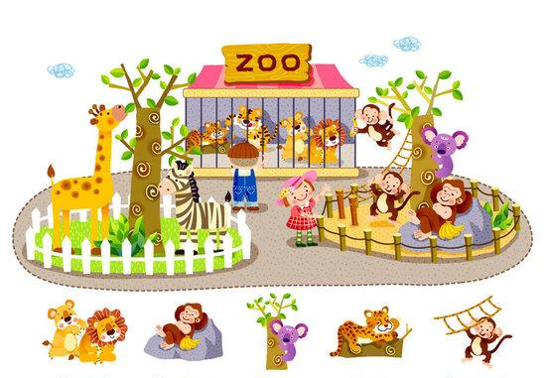
zoo

Slide 3
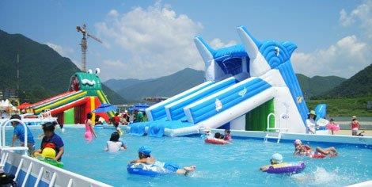
water park

Slide 4
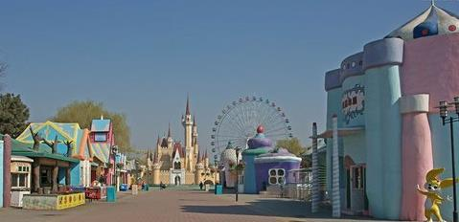
amusement park

Slide 5
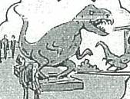
history museum

Slide 6
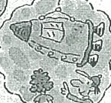
space museum

Slide 7
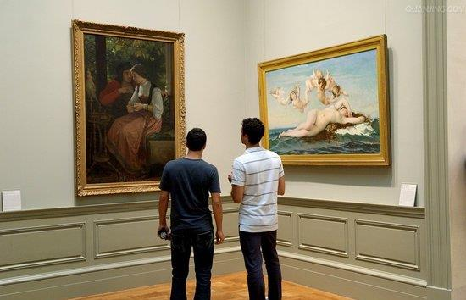
art museum

Slide 8
1a
Which of these places would you like to visit?
Rank them from 1 (most) to 6 (least).
space museum ___________
history museum __________
art museum __________
water park __________
zoo __________
amusement park __________

Slide 9
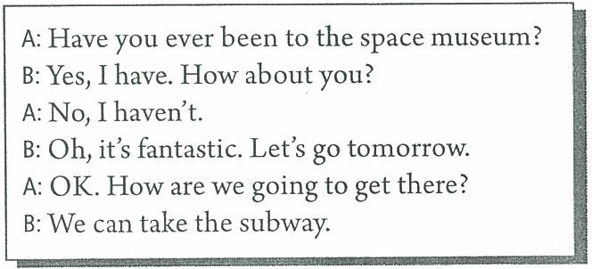
2c
Look at the map in 2a and make
conversations about the places.

Slide 10
Language points
·have been to... 意为“曾经去过某地”，现在已不在那里了，后可接次数，如once，twice，three times等，表示“去过某地几次”，也可和 just，never，ever等连用。如：
I have been to Hong Kong twice. 我去过香港两次。
She has never been to a farm. 她从没去过农场。
·It’s really interesting, isn’t it? 此句是反意疑问句，结构为肯定的陈述句+否定的附加疑问句。
另一种结构为否定的陈述句+肯定的附加疑问句。
如： You didn’t go, did you? 你没去，对吗？
·put up 搭起，张贴
We put up out tents near the lake last weekend.
上周末我们在湖边搭起了帐篷。

Slide 11
An interview
Name | Have you ever been to ...?
 | the space museum | the zoo | the water park | the art museum | ...
Report: My friend Tom has ever been to the space museum.
But he has never been to the zoo…

Slide 12
Summary
Have you ever ______（去过）the nature museum？ | Yes, I have.
 | No, I ______ .
I’ve ______（从未）been to a water park. | ______（我也没去过。）.
I’ve ______（曾经）been to the art museum. | ______ （我也去过。）.
Answers: been; haven't; never; Me neither; ever; Me,too

Slide 13
Homework
 | Have you ever been to...? | Where do you want to go? | How do you get there?
Grandfather
Grandmother
Father
Mother
Uncle
...

