Slide 1
Module 8 My future life
Unit 3 Language in use
WWW.PPT818.COM

Slide 2
How many days are left before you leave school?

Slide 3
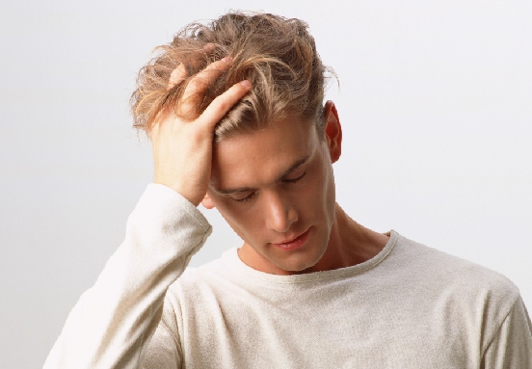
Do you feel nervous every day?

Slide 4
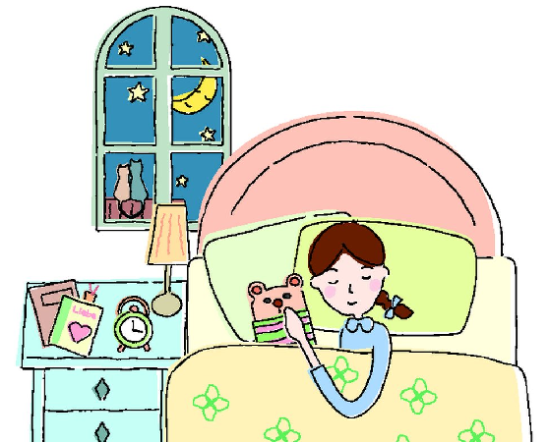
What time do you go to bed every night?

Slide 5
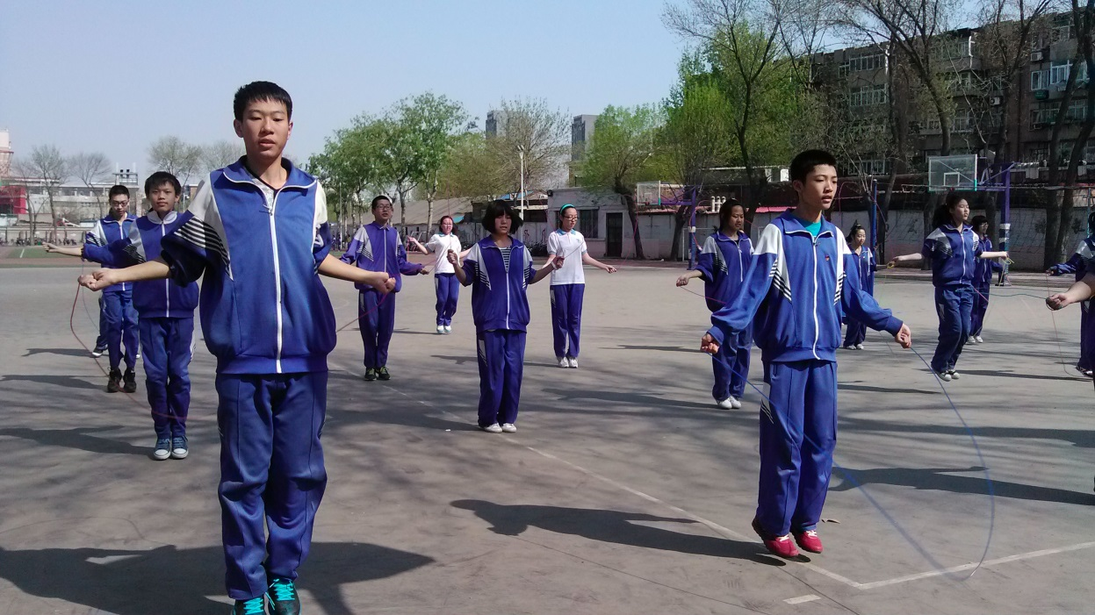
Do you have time to do exercise except studying?

Slide 6
Language practice
1. I know _____ you will be better at
maths.
2. These roses are to thank three groups
of people for the three most important things _____ I have learnt.
that
that

Slide 7
3. I give the white rose to my teachers,
_____ have taught me _____ there
is no success without effort.
4. I’m sure that you all have your own
memories about the happiness of the
last three years, and the people
_____ you want to thank for it.
who
that
whom

Slide 8
1. Complete the sentences using
which, that, who or whom. Try to
explain the meaning of the words in purple.
Finger food is the food _____________
__________________.
2. A hangbag is a small bag ___________
_________________________________.
that/which we eat with our fingers

Slide 9
3. School-leavers are young people______
_________________________________.
4. A classmate is someone _____________
_________________________________.
5. A friend is someone ________________
_________________________________.
6. A stranger is someone ______________
_________________________________.

Slide 10
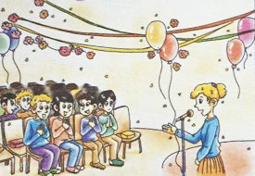
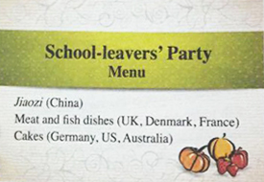
2. Work in pairs. Look at the picture
and the menu. Discuss the
questions.

Slide 11
1. How do you know that the party is
international?
2. Why are the people cheering?
3. What do you think the person making
a speech is saying?

Slide 12
3. Complete the passage with the
clauses in the box.
a) the success at school is important for
our futures
b) if you want to be an engineer
c) that we control the future
d) we can all make a wonderful future if we remember this
e) that I am a very good student

Slide 13
We will finish junior high soon. Many students are worried about the future. School is hard. We all think (1) ____.
Some of us are lucky. We are good at studying. I am very lucky. My teachers say (2) ____. I especially love studying maths. It is a very important subject.
a)
e)

Slide 14
You need it for physics, or (3) ____. I want to be an engineer. Engineers and
scientists are important for our country’s future.
My classmates and I are all a bit sad to be leaving junior high. But we are also excited about taking a new step in our lives. Our future lives and jobs get closer every day.
b)

Slide 15
The English say, “The future is what you make it!” I like this saying. It means (4) ____. It reminds us to try our best, and to never give up. I really think (5) ____.
c)
d)

Slide 16
4. Join the words in Box A with the
words in Box B to make new words.
You need to use one word more
than once.
A
after class hair hand
B
bag cut make mate noon

Slide 17
_______________________________________________
afternoon, classmate, haircut, handbag, handmade

Slide 18
Now complete the conversation with the new words.
Lingling: What are you going to wear to
the school-leavers’ party?
Betty: I’m going to wear a dress. And
I’m going to buy a new black (1)
________. Do you want to go
with me to the shopping centre
to look for one?
handbag

Slide 19
Lingling: Sorry, I can’t. I’m having a(n)
(2) _______ this (3)
_________ at three o’clock. I
want nice short hair for the
party!
haircut
afternoon

Slide 20
Tony: I’ll go with you, Betty. I’m going
to take photos, and I want to buy
a book to put the photos in. I
hope that all of us will remember
each other. I’m happy I have
been your (4) _________.
classmate

Slide 21
Betty: I’ve already bought a special
book for the photos. It’s black,
with (5) _________ paper pages.
Tony: You can carry it on the big night,
then. It’ll match your clothes.
Betty: Don’t be silly, Tony!
handmade

Slide 22
5. Complete the sentences with the
words or expressions in the box.
beat, laugh at, pardon, roses, wake…up
beat
1. Try to follow the _____ of the music.
2. Oh, ______ me. I didn’t see you there.
3. We’re going to put _____ all around
the room this year.
pardon
roses

Slide 23
4. I can’t go to school wearing that –
everyone will ________ me.
5. I’ll ______ you _____ when it’s time
to leave.
laugh at
wake up

Slide 24
6. Listen and answer the questions.
Did Adam go to Africa or America?
Africa.
2. What did Adam do there?
He built a primary school with others.
3. What does Adam like most about the
country?
The people are very friendly.

Slide 25
4. What did Adam do at weekends?
He visited the beaches.
5. What does Adam want to do in the
future?
He wants to help people. He has decided to go to college and maybe becomes a teacher in the future.

Slide 26
Read the passage and answer the
questions.
1. Was Mark Smith better at doing things
than at reading books?
Yes, he was.
2. What does he learn now?
How to repair machines.

Slide 27
7. Listen and read the passage, choose the correct answer.
1. What do students at vocational schools
do?
a) They look for jobs there.
b) They learn how to do many of the
jobs that are needed in society.
c) They study why the jobs are needed
in society.
d) They do the same as students in
secondary school.

Slide 28
2. Why did Mark choose to go to
vocational school?
a) Because he wanted to know
vocational society.
b) Because he finished secondary school.
c) Because he found that he was better
at doing things than at reading books.
d) Because he did not do well at school.

Slide 29
3. According to the passage, which of the
following is NOT the reason why Mark
made his choice?
a) Everyone needs a skill for a good life in
the future.
b) He can study the things that he likes best.
c) The society needs not just people who
work in an office, but also those who
can make things and repair things.
d) He likes physics.

Slide 30
Around the world
Junior high school dances
In the US, students often have a school dance to celebrate the end of junior high. There is usually a student committee which organizes the dance. They decorate the school gym with balloons, lights and other things so that it looks very nice.

Slide 31
They plan the music and organize the food. Sometimes the parents help make the food and sometimes it comes from a restaurant. The girls usually wear pretty dresses and the boys wear smart clothes. They eat, dance and sometimes have competitions. The dance is usually supervised by teachers and parents.

Slide 32
Read the passage and fill the blanks.
1. In the US, students often have _______
______ to celebrate the end of junior
high.
2. There is usually __________________
which organizes the dance.
3. Sometimes __________ help make the
food and sometimes it comes from
___________.
a school
dance
a student committee
the parents
a restaurant

Slide 33
4. The girls usually wear _____________
and the boys wear ____________.
5. The dance is usually __________ by
teachers and parents.
pretty dresses
smart clothes
supervised

Slide 34
8. Think about your life in the future.
Make notes about the following
things:
what you are planning to do in the next three years
what you would like to do after that
what other areas of your life you want to develop
what sort of values you think will be
important to you

Slide 35
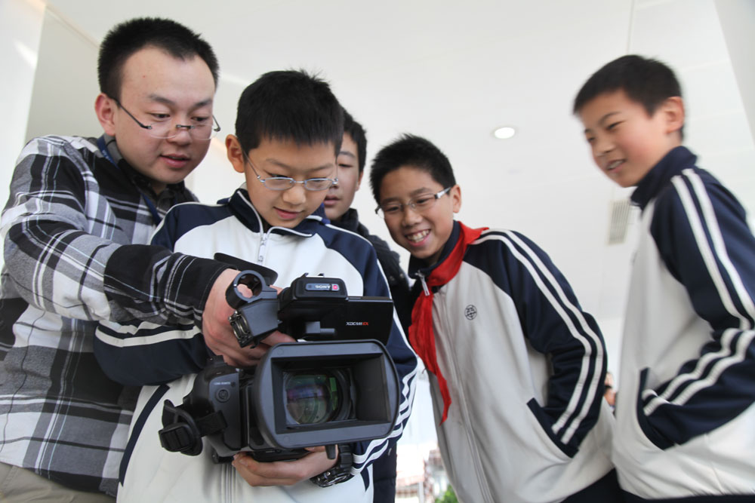
9. Use your notes to write sentences.
10. Join your sentences and write
a passage about your future
plan.

Slide 36
宾语从句
根据引导词的不同，宾语从句分为三类：that引导的宾语从句，whether/if引导的宾语从句和疑问词引导的宾语从句。在宾语从句的使用中有以下三点需要注意：

Slide 37
1. 宾语从句中引导词的选择
宾语从句的引导词包括that, whether,
if和疑问词。其中that, whether和if 在
句中不做任何成分，如下面例句(1)和
例句(2)中的that, whether,和if。而疑
问词在句中充当成分，如例句(3)中引
导词作从句中的状语。

Slide 38
e.g. I hear (that) he has passed the exam.
我听说他通过了考试。
I wonder whether/if he has passed the exam.
我想知道他通过考试了没有。
I asked when he passed the exam.
我问他何时通过了考试。

Slide 39
宾语从句中的引导词that只起连接作用，在从句中不作句子成分，也没有词汇意义，在口语中常被省略。

Slide 40
在疑问词引导的从句中，应根据从句的意思决定用什么引导词。
e.g. She asked me when he came back
home every evening.
她问我他每晚什么时候回家。
Can you tell me how he got back
home?
你能告诉我他怎么回家的吗？

Slide 41
I don’t know why he came back home.
我不知道他为什么回家了。
以上三个句子的从句都在表述同一事
件—“他回家”，但根据句子的语义选
择了不同的引导词。

Slide 42
2. 宾语从句中的时态
一般情况下，如果主句谓语动词时态
为现在时或将来时，宾语从句谓语动
词可根据句意的需要使用任何时态；
如果主句谓语动词为过去时态，宾语
从句谓语动词使用相应的过去时态。

Slide 43
试比较下面几个句子：
I don’t know where we will go for the holiday. 我不知道我们要去哪度假。
He asked where we would go for the holiday. 他问我们要去哪度假。
I always think they’re for people whose English is already quite good. 我一直以为这些俱乐部是为那些英语已经说得很好的人开办的。

Slide 44
I always thought they were for people whose English is already quite good. 我原来一直以为这些俱乐部是为那些英语已经说得很好的人开办的。

Slide 45
注意，如果宾语从句中叙述的是真理、实际情况或经常发生的事情时，即使主句的谓语动词为过去时态，从句的谓语动词仍要保留一般现在时。例如：
In the past, people didn’t know that the earth moves around the sun. 过去人们不知道地球围绕太阳转。
I didn’t know you like classical music. 我过去不知道你喜欢古典音乐。

Slide 46
3. 宾语从句的语序
不管宾语从句表示肯定还是疑问，都
用陈述语序。例如：
Can you tell me where I can get my
car repaired?
你能告诉我到哪里修车吗？
I don’t know when I can get the result
of the test.
我不知道什么时候能得知测验结果。

Slide 47
定语从句
1. 定语从句引导词的选择。
从所指来看，which只能用于先行词为
物的情况，who和whom只能用于先行
词为人的情况，其中whom用于引导词
在定语从句中作宾语的情况，在口语
中可用who代替；而that既可指人，又
可指物。例如：

Slide 48
Everyone that/ who goes to Shenzhen says it I a modern city.
每个去深圳的人都说它是一座现代化城市。
This is the song which/ that has been extremely popular for the last few months.
这就是那首近几个月十分流行的歌。

Slide 49
Mr Li is the teacher that/whom/who we like best.
李老师是我们最喜爱的老师。

Slide 50
2. 定语从句引导词的省略
当引导词在定语从句中充当宾语成分
时，可以被省略。例如：
What are the subjects (that) they are
studying this term?
他们这学期都学习哪些科目？
She is the woman (who/whom) I met
yesterday.
她就是我昨天遇到的那个女人。

Slide 51
Exercises
1. Do you know the man ___ is talking to
Miss Wu?
A. he B. whom
C. who D. which
2. I really like the photo of my family ___
my sister took in the city park last year.
A. which B. who
C. what D. whom
C
A

Slide 52
D
3. People _____ overweight need more
water than thin people.
A. who is B. which are
C. that is D. who are
4. Do you know the man ____ saved five
people in the fire?
A. who B. it
C. when D. whom
A

Slide 53
中考链接
1. –We have no idea _______.
–It’s heard that he is Mr. Green’s son.
【2014达州】
A. where he comes from
B. if does he live here
C. who he is
D. who is he
C

Slide 54
2. –Excuse me, can you tell me _____?
–Sorry, I don’t know. You can go to the
information desk. 【2014河南】
A. that there is a train
B. when the train leaves
C. which train can I take
D. where does the train go
B

Slide 55
3. I really like the photo of my family
_____ my sister took in the city park
last year. 【2014绍兴】
A. which B. who
C. what D. whom
A

