Slide 1
What can I do for you?
WWW.PPT818.COM

Slide 2
Warming-up
1

Slide 3
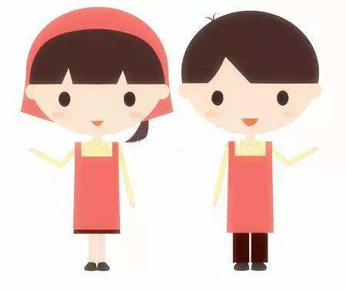
Warming-up
You're a salesman.
Today is Fruit Day in our supermarket. You should check the fruits with your manager.
Try to using “Have we got …?”

Slide 4
Warming-up
Have we got some…?
Yes, we have.
No, we haven't

Slide 5
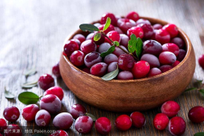
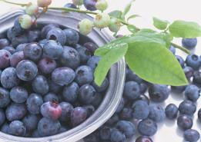
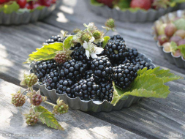
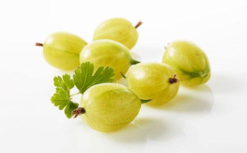
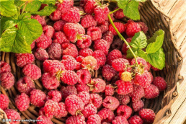
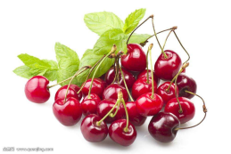
cranberry
blueberry
blackberry
gooseberry
raspberry
cherry

Slide 6
Everything is ready.
Here comes a family!

Slide 7
Part A
2

Slide 8
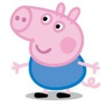
Task 1
Read part A in 3 minutes and tick the right sentences.
1.Peppa's favourite fruit is apple.( )
2.Suzy likes bananas. ( )
3.Edmond is very clever. ( )
4.George doesn't like strawberry. ( )

Slide 9
Task 1
Watch the video and check the answers.
1.Peppa's favourite fruit is apple.( )
2.Suzy likes bananas. ( )
3.Edmond is very clever. ( )
4.George doesn't like strawberry. ( )
√
√

Slide 10
Part B
3

Slide 11
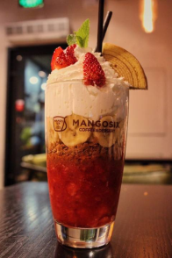
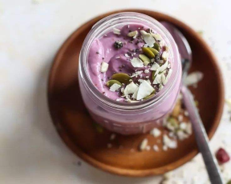
Smothie
Smothie: a drink made from fruit

Slide 12
Task 2
Read part B in 3 minutes.
Choose the right fruits for Peppa and Pedros smoothie. Write down the numbers.

Slide 13
Task 2
1 3 6
Peppa's smoothie :
Pedro's smoothie :
1.apple 2.orange 3.banana
4.pear 5.peach 6.raspberry
7.strawberry 8.blackberry
9.blueberry 10.gooseberry
6 8 9 10

Slide 14
Part C
4

Slide 15
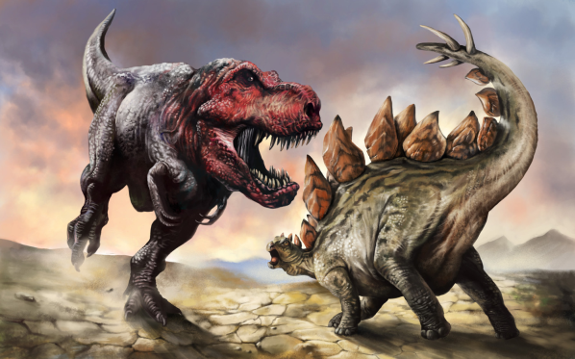
Dinosaur

Slide 16
Task 3
Read part C in 5 minutes and answer the question:
How Freddie Fox know what's in dinosaur juice?
By smelling it.

Slide 17
Task 4
Watch the video and fill the blanks.
one
Freddie Fox: Em. _____ banana.Miss Rabbit: ____ banana.Freddie Fox: Three, no, _____ strawberries. _____ strawberries. ______ cherries.Miss Rabbit: Strawberries, cherries.Freddie Fox: _____ peach. Half（一半） of a pineapple. A slice（片） of melon. And something else. What is it?
one
four
four
Five
one

Slide 18
Review
5

Slide 19
Review
1.Match the word with its Chinese meaning.
delicious 一点
blueberry 恐龙
dinosaur 芝士
cheese 美味的
a bit of 闻
smell 蓝莓
delicious 美味的
blueberry 蓝莓
dinosaur 恐龙
cheese 芝士
a bit of 一点
smell 闻

Slide 20
Review
2.Summary
On Fruit Day, Peppa goes to supermarket with her 1.f_______. She meets her friends. They’re choosing their favourite 2.f______. Peppa likes apples best. And George likes 3.s_________. Then Miss Rabbit makes smoothies for them.
amily
ruit
trawberries

Slide 21
Review
2.Summary
And George gets some dinosaur juice. Everyone wants to 4.d________ dinosaur juice. But Miss Rabbit can’t remember. Finally, Freddie helps Miss Rabbit do it by smelling. Everyone 5.l______ fruit and dinosaur juice.
rink
oves
likes

Slide 22
Homework
6

Slide 23
Homework
Play Part B with your group members. And we will do it the next lesson.

Slide 24
Mr. Potato's fruit song
“Apples, oranges, bananas. Pears and pineapples, too. Eat five pieces of fruit a day. Because it's good for you. ”

Slide 25
Thank you!

