Slide 1
unit 3 It's a pineapple
WWW.PPT818.COM

Slide 2
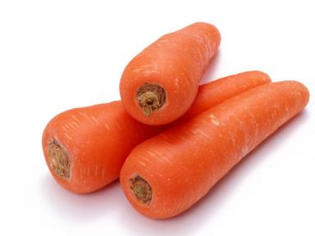
carrot

Slide 3
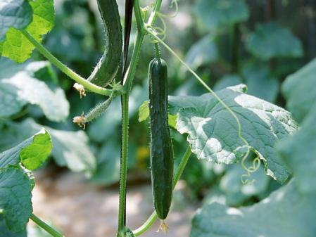
cucumber

Slide 4
重点掌握
What's that in English?
It's carrots.
What's that in English?
It's cucumber.

Slide 5
小重点
DO you like cucumber?
Yes,I do.
DO you like carrots?
No,I don't.

Slide 6
让我们一起读原文
Hi,Kate,What's that in English?
It's a carrot.
Do you like carrots?
Yes,I do ,and I like cucumbers,too.

Slide 7
说说看
carrot cucumber

Slide 8
课间作业
和小伙伴们一起谈谈自己喜欢的蔬菜水果吧！

Slide 9
复习-------------我们学了哪些单词呢？
cucumber 黄瓜
carrot 胡萝卜
tomato 土豆

Slide 10
小练习
一、选出不同类的单词。
( )1.A.carrot B．cucumber C．banana
( )2.A.driver B．boy C．doctor
( )3.A.class B．seven C．thirteen
( )4.A.pineapple B．potato C．pear
( )5.A.Canada B．England C．Chinese
一、1.C 2.B 3.A 4.B 5.C

Slide 11
小练习
二、单项选择。
( )1.—What's that in English?—It's ______．
A．an apple B．a carrots C．cucumber
( )2.—What do you like?—I like ______．
A．orange B．tomatoes C．a apple
( )3.—Does she like pears?—______
A．Yes，she do. B．Yes，she like. C．Yes，she does.
( )4.—I like watermelons.—______
A．Good idea. B．Me too. C．Thank you.
( )5.—Thank you.—______
A．OK. B．You're welcome. C．All right.
二、1.A 2.B 3.C 4.B 5.B

