Slide 1
Unit 8 A green world
task
WWW.PPT818.COM

Slide 2

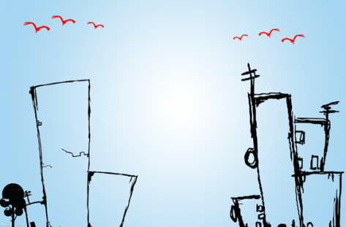
This picture is very simple.
adj. 简单的

Slide 3
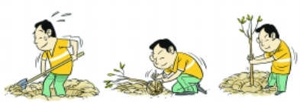
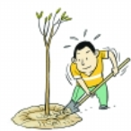

planting trees
step n. 步骤; 措施

Slide 4

power n. 电力; 力量

Slide 5

How can we go green?
protect the environment

Slide 6

1. What can we do to save water?
2. What can we do to save power?
3. What can we do to reduce pollution?

Slide 7
Going green
The Class1, Grade 8 students are going to give a presentation on how to go green. Here are Millie’s ideas. Read her notes and find out:

Slide 8
What can we do to save water?
Take shorter showers.
Turn off the tape when we brush teeth.
Reuse water if possible.

Slide 9
What can we do to save power?
Turn off the lights when we leave a room.
Turn off the power when our TV or computer is not in use.

Slide 10
What can we do to reduce pollution?
Do not use plastic bags. Take our own bags when shopping.
Separate waste into different group.

Slide 11
Which else can we do to live a green life?
Do more exercise and watch less TV.
Plant some flowers at home.

Slide 12
Millie is writing the script for the presentation. Help her complete her script. Use the information on page 118 to help you.

Slide 13
Our environment is changing for the worse, so it is time for us to (1) _________. Here are some simple steps to take.
We can save water by taking (2) _______________ and turning off (3) __________ when we brush our teeth. We should also (4) ___________ if possible. In
go green
shorter showers
the tap
reuse water

Slide 14
order to save power, we should (5)_________________ when we leave a room. We should also turn off the power when our TV or computer is (6)_________.
Some other good habits can help reduce pollution too. We should not use (7)___________. Instead, we should take
(8) _____________ when shopping.
turn off the lights
not in use
plastic bags
our own bags

Slide 15
Recycling is also a good way to help reduce pollution. We should separate (9)_______ into different groups so that it can be recycled.
Moreover, it is important for us to develop a green lifestyle. We should (10)_______________ and watch less TV and it is good to (11) _________________ at home. Follow these small steps, and you can make a big difference to the Earth!
waste
do more exercise
plant some flowers

Slide 16

1. Here are some simple steps to take.
take some steps
采取一些措施
e.g. 我们应该采取一些简单的措施来
节约用水。
We should take some simple steps
to save water.

Slide 17
We’ve read Millie’s script. Now it’s your turn to give a presentation on how to go green. Discuss this in groups of four and write down your notes.

Slide 18
Useful expressions
1. It is time for us to ….
2. We can save water by ….
3. We should use/take ….
4. … is a good way to ….
5. It is important for us to ….
6. It is good to ….
7. Moreover, ….

Slide 19


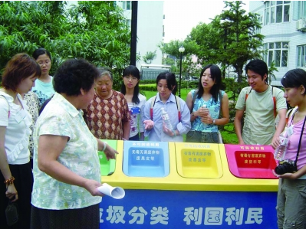

Slide 20
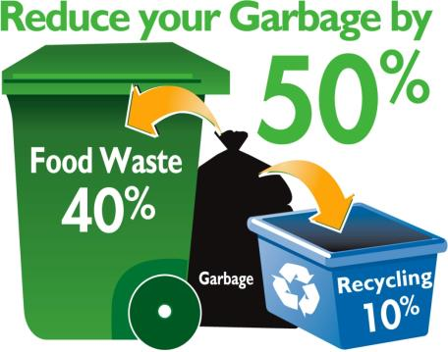


Slide 21

I. 用所给单词的适当形式填空。
1. The waste can ____________
(separate) into different groups to
recycle.
2. Take your own bags when
__________ (shop).
be separated
shopping

Slide 22
3. You should do more exercise and watch ______ (little) TV.
4. We can save water by ________ (take) shorter showers.
5. You need to check your homework after finishing _________ (write).
less
taking
writing

Slide 23
II. 汉译英。
1. 我们可以通过缩短淋浴时间来节约用水。
2. 为了节约电力，当我们离开房间时应该把灯关掉。
We can save water by taking shorter showers.
In order to save power, we should turn off the lights when we leave a room.

Slide 24
3. 好习惯能够帮助减少污染。
4. 对我们来说养成环保的生活方式很重要。
Good habits can help reduce pollution.
It’s important for us to develop a green lifestyle.

Slide 25
5. 遵循这些小步骤，你可以对地球产生大影响。
6. 当电视和电脑不用时，我们应该关掉电源。
Follow these small steps, and you can make a big difference to the Earth.
We should turn off the power when our TV or computer is not in use.

Slide 26
1. Finish your script.
2. Review all the new words and language points in this unit.

