Slide 1
In the classroom
第一课时
WWW.PPT818.COM

Slide 2
What can you see in our classroom? I can see... What colour is it/are they? It's/They are ... How many ... are there? There is/are...

Slide 3
Stationary
文具
People
Things in the classroom
New words
Other things

Slide 4
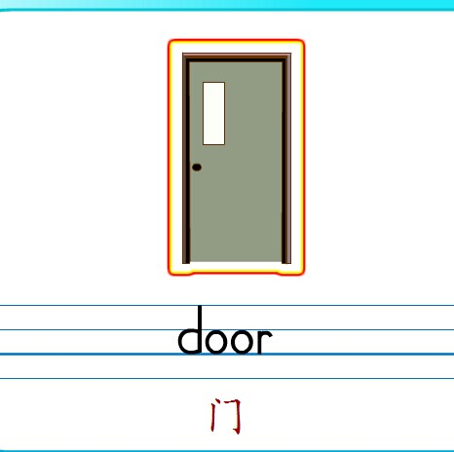
Think and say

Slide 5
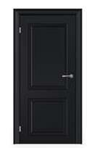
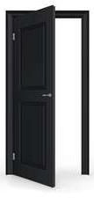
Think and say
Knock at the door.
door
Open the door.
door
Close the door.
door

Slide 6
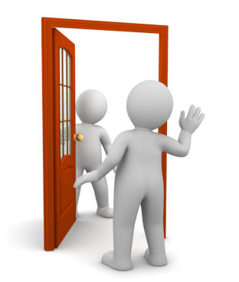
Let’s chant.
Door, door, knock at the door.
Door, door, open the door.
Door, door, close the door.

Slide 7
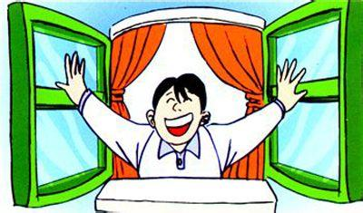
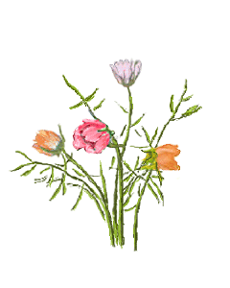
Open the door and open the window when you come to the classroom!
Because it’s good for our health!
(早晨来到学校后，请记住把门窗打开，这样对我们的身体是有好处的哦！)

Slide 8
There is a thing in our classroom.
It’s big.
It’s rectangle.(长方形)
We can write and draw on it.
It’s black.
What’s this?

Slide 9
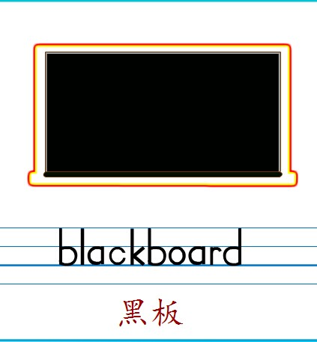
Think and say
Q: What colour is the blackboard?
A: It’s ________.

Slide 10
+ board
+ board

Slide 11
M M M for my.
My books, my pens do you like?
N N N for no.
No pens, no books, where do they go?

Slide 12
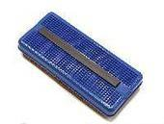
Think and say
This is Kitty.
She’s short and thin.
This is her mother.
She’s beautiful.
Look at the blackboard. It’s dirty.
Clean the blackboard.
Look at the blackboard. It’s clean.

Slide 13
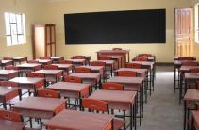
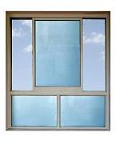
Match and say
window
classroom
blackboard
door

Slide 14
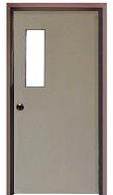
blackboard
door
window

Slide 15
一、根据左面的图片在四线格中填入相应的单词。
1、
door
2、
window
3、
blackboard

Slide 16
二、请根据图片提示及语境填入适当的单词。
.
blackboard
1、Clean the .
door
2、Please close the .
window
3、Open the , Please.

Slide 17
picture 1
OK! Open the door
/window.
It's very hot.
Open the door.
Thank you!
Open the window，please.
You are welcome.

Slide 18
picture 2
It's very...
Thank you!
Please ...
You are welcome.
OK,...

Slide 19
picture 3
This is Kitty.
She’s short and thin.
This is her mother.
She’s beautiful.

Slide 20
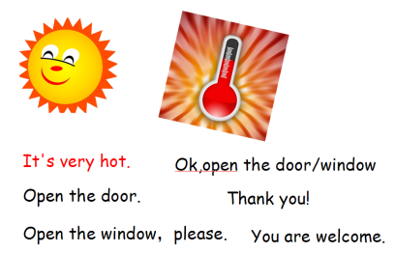
Look and say
This is Kitty.
She’s short and thin.
This is her mother.
She’s beautiful.

Slide 21
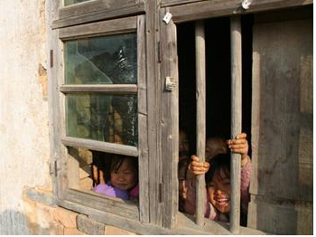
Please love your things, and give away your things to the people who needed.
爱惜你的物品，并把你闲置的物品捐赠给有需要的人！

Slide 22
Let's chant
Window, window, close the window.
Door, door, close the door.
Window, window, open the window.
Door, door, open the door.
Blackboard, blackboard, look at the blackboard.
We study hard, we are good!

Slide 23
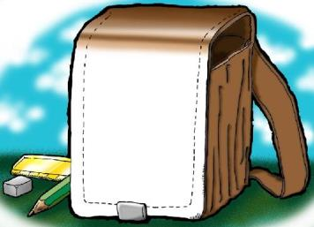
Homework
Choose one of them by yourselves:
A | Review the letters and words we learn today.
B | Make some instructions with partners and practice them.
C | Draw a picture about your classroom and describe it.

