Slide 1
Unit 7
Teenagers should be allowed to choose
their own clothes.
SectionB Period 3 1a-2e
WWW.PPT818.COM
Notes:
1

Slide 2
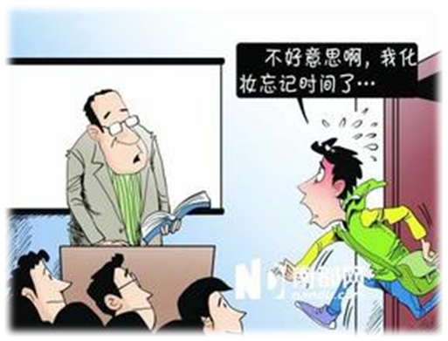
How often do you do these things?
get to class late

Slide 3
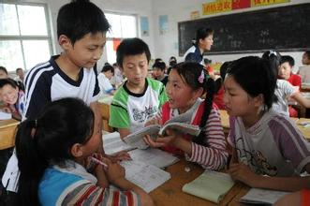
study with friends

Slide 4
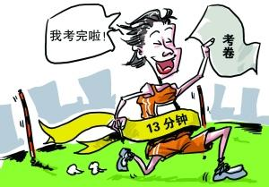
finish a test early

Slide 5
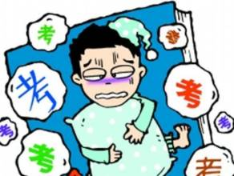
worry about failing a test

Slide 6
Pair Work
Do you ever …
get to class late? _________
study with friends? _________
finish a test early? _________
worry about failing a test? _________

Slide 7
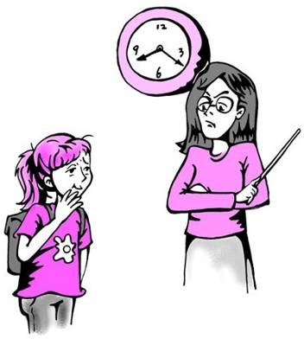
A: Do you ever get to class late? B: Yes, I sometimes get to class late.

Slide 8
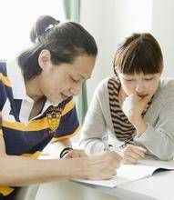
A: Do you ever study with your friends? B: ...

Slide 9
1c Listen and circle the things in 1a that Peter talks about.
Do you ever…
get to class late? __________
study with friends? __________
finish a test early? __________
worry about failing a test? __________

Slide 10
1d Listen again. Match these sentence
parts.
c
1. Peter is going to … 2. He isn’t allowed to … 3. Peter wasn’t allowed to … 4. He could … 5. He should be allowed to … | ___ a. take the test. ___ b. pass the test. ___ c. fail a math test. ___ d. take the test later. ___ e. get to class late.
e
a
b
d

Slide 11
1e Read the statements. Then discuss
them with your group.
Peter should be allowed to take the test later.
Students need strict rules.
Parents should not be too strict with teenagers.
A: I think Peter should …
B: I don’t agree.
C: I think …

Slide 12
Pair Work
About Test
Have you ever been late for a test?
Did you have a chance to take the test later?
Do you think the chance to take a test later should be given or not?

Slide 13
Pair Work
About Parents
Do you always have a talk with your parents?
What do you usually talk about?
What are you allowed to do?
What aren’t you allowed to do?

Slide 14
Free Talk

Slide 15
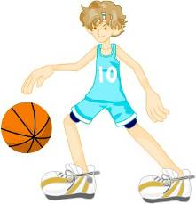
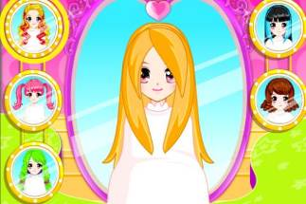
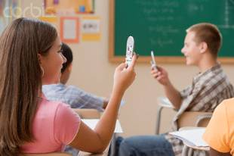
What do you like doing? Do your parents allow you to do it? What do you think of it?
Should I be allowed to make my own decisions?
Have my own hair-style.
Notes:
15

Slide 16
Read quickly and answer questions.
Is Liu Yu allowed to make his own decisions?
No, he isn’t.

Slide 17
2c Read again and answer questions.
1. What is Liu Yu’s hobby?
His hobby is running.
2. What does Liu Yu want to be when he grows up?
He wants to be a professional runner.

Slide 18
3. Why do Liu Yu’s parents not allow Liu Yu to practice his hobby at night?
4. Do you think Liu Yu should be allowed to practice his hobby as much as he wants? Why or why not?
They believe that he should study hard in the evenings.
Yes, he has the potential to be a running star. / No, his parents know best. His dream may not be realistic and he may regret it in future if he does not study hard now.

Slide 19
2d Look in the passage for the words
in bold. Then use them to complete sentences of your own.
my school results
My parents worry about ______________.
My parents have always taught me how important it is to ___________________.
I am serious about __________________.
I think it is unfair ____________________
_____________________.
be honest in all situations
my part-time job
that I get so little
pocket money.

Slide 20
5. I have always wanted to be _____________.
6. My parents have nothing against ______________.
7. I need to think about what will happen if ______________.
8. I need to spend more time on ______________.
an English teacher
makeup
I don’t get a place in the university of my choice
studies / exercise

Slide 21
Free Talk
With a partner, discuss the time you spend on schoolwork and on hobbies. Imagine you want to show your parents that you can make responsible decisions. Plan a schedule to balance the time needed for your schoolwork and your hobbies.
Notes:
21

Slide 22
2e Discuss the questions with a partner.
Use the information in the passage
to support your opinion.
What is your dream job?
Do your parents support your dream?

Slide 23
Tips
What do you want to be? Is it your dream? Are you serious about it?
Do your parents have anything against your dream? What do they worry about?
How much time do you spend working towards your dream?
What will happen if you fail in achieving your dream?

Slide 24
Thanks for listening

