Slide 1
PE lessons
第一课时
WWW.PPT818.COM

Slide 2
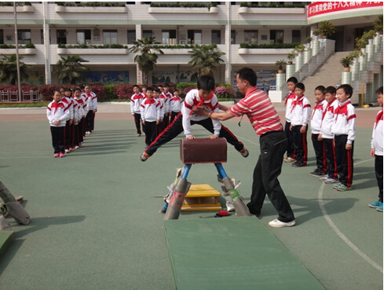
Warming
We have two PE lessons at school every week. Do you like them?

Slide 3
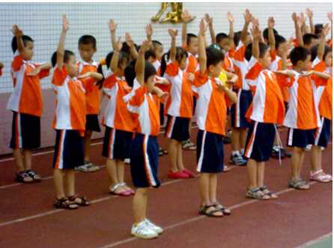
Presentation
What do we do in PE lessons?

Slide 4
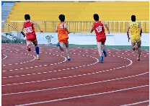
Presentation
We run long races.

Slide 5
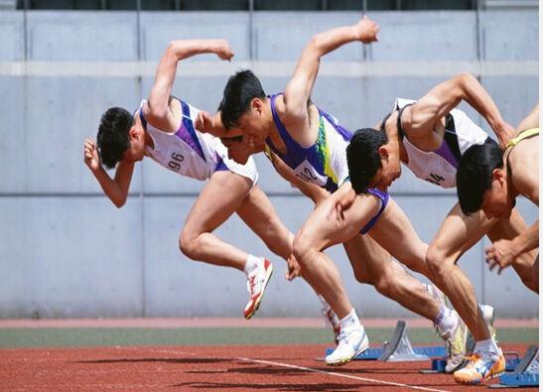
Discussion
We run short races.

Slide 6
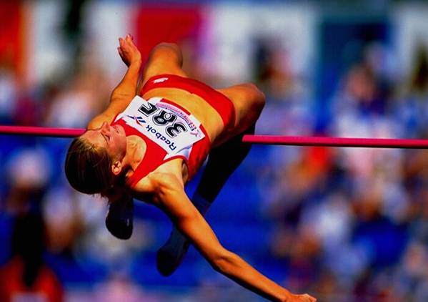
Presentation
We do the high jump.

Slide 7
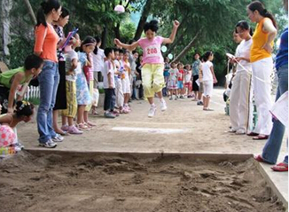
Presentation
We do the long jump.

Slide 8
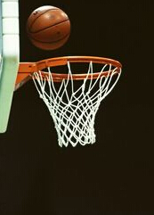
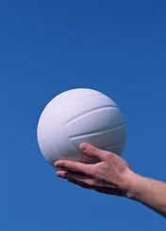
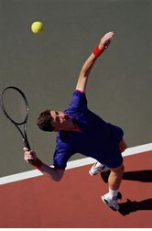
Presentation
We play ball games.

Slide 9
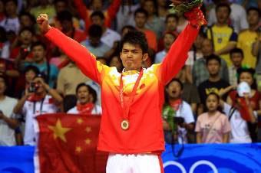
Presentation
We all want to win.

Slide 10
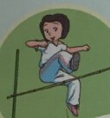
Presentation
Jill is good at the high jump.
be good at

Slide 11
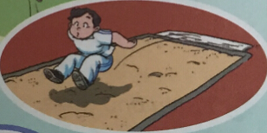
Presentation
Joe is good at the long jump.
be good at

Slide 12
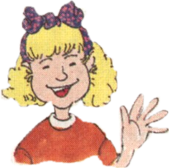
Listen and say
My friends and I like playing sport. We have a lot of fun together.
l like playing football, volleyball and basketball.

Slide 13
Exercise
Complete Peter’s notes.
In our PE lessons, we run __________ and __________ .
We do the __________ and __________ . Jill is good at the ___________. Joe is good at ___________.
We also play ball games. I like playing ________,
_________ and __________.
long races
short races
long jump
high jump
high jump
long jump
football
volleyball
basketball

Slide 14
Work in pairs.
I like… I am good at….

Slide 15
Summary
本课重点句型：
be good at 擅长于，常用短语be good at sth, be good at doing sth.
like doing sth 喜欢做某事。

Slide 16
Homework.
用英语询问同学、朋友、家长等，完成这个survey。填写表格。
Name | Sport

Slide 17
The End

