Slide 1
Unit 7 What's the highest mountain in the world?
Section A 第2课时
WWW.PPT818.COM

Slide 2
1. To learn about Qomolangma
2. To learn new words: achievement,
thick, include, condition, succeed,
achieve, force, nature…

Slide 3
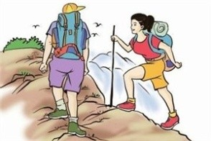
Do you like mountain climbing? Do you know the most popular places to go for it?

Slide 4
3a
Read the article and match each paragraph with the main ideas.
Paragraph 1 Spirit of climbers
Paragraph 2 Achievements of climbers
Paragraph 3 Facts and dangers

Slide 5
3b
Read the article again and complete the chart.
Paragraph 1 | Paragraphs 2 | Paragraph 1&3
List four dangers for climbers | List three achievements | List four comparisons
1. thick clouds | 1.1953-Tenzing Norgay and Edmund Hillary were the first to reach the top | 1. most dangerous sport
2. very high
2. most popular place
3. hard snow
2. 1960-the first Chinese team reached the top
3. the highest and is the
most famous.
4. freezing
weather
conditions
4. even more serious
difficulties
5. heavy
storms
3. 1975- Junko Tabei from Japan was the first woman to reach the top
5. stronger than the
forces of nature
6. hard to
breathe

Slide 6
Answer the questions using information from the article.
3c
1. Where are the Himalayas?
2. How high is Qomolangma?
They run along the southwestern part of China.
It is 8,844.43 meters high.

Slide 7
3. Why do so many people try to climb this
mountain even though it is dangerous?
4. What does the spirit of the climbers tell
us?
Because people want to challenge themselves in the face of difficulties.
The spirit of the climbers tells us that we should never give up trying to achieve our dreams.

Slide 8
形容词和副词的比较级和最高级
形容词和副词的比较级和最高级（规则变化）
单音节词和少数多音节词
一般在词尾加-er 或-est
原级 比较级 最高级
high
higher highest
slower slowest

Slide 9
原级 比较级 最高级
strong
fast
slow
stronger strongest
faster fastest
slower slowest

Slide 10
以“辅音字母+y”结尾的双音节词，先改“y”为“i”，再加-er或-est
原级 比较级 最高级
easy
lucky
early
easier easiest
luckier luckiest
earlier earliest

Slide 11
多音节词和部分双音节词在词前加more或most
原级 比较级 最高级
delicious
interesting
easily
carefully
more delicious most delicious
more interesting most interesting
more easily most easily
more carefully most carefully

Slide 12
（不规则变化）
原级 比较级 最高级
good/well
bad/badly
many/much
little
far
better best
worse worst
more most
less least
farther farthest
further furthest

Slide 13
Fill in the blanks with the correct forms of the words in the box.
4a
big much popular long old high
longest
1. The Amazon River is one of the _______ rivers in the world. It's a little _______ than the Yangtze River.
2. Qomolangma is 8,844.43 meters _____. It's one of the most ________ places for serious mountain climbers.
longer
high
popular

Slide 14
big
3. No ocean in the world is as _____ as the Pacific Ocean.
4. Although Japan is _______ than Canada, it is _______ smaller.
太平洋
n. 大海；海洋
older
much

Slide 15
4b
Write two comparisons about two topics. Write true facts.
the Yangtze River
the Amazon
Two rivers: _______________ and __________
______
________________________________________________________________________________________________________________________________________________________________
River
The Yangtze River is almost as long as the
Amazon River.
The Amazon is longer than the Yangtze, but the Yangtze River is the longest river in China.

Slide 16
Singapore Kuala Lumpur
Two cities: ___________ and ________________
1. _______________________________________
2. _______________________________________
_______________________________________
Kuala Lumpur is as modern as Singapore.
Singapore is bigger than Kuala Lumpur and has a larger population than Kuala Lumpur.
Monkey Elephant
Two animals: ___________ and ______________
1. _______________________________________
2. _______________________________________
_______________________________________
An elephant is bigger than a monkey.
A monkey is smaller than an elephant, but it climbs a tree faster than an elephant.

Slide 17
Write five questions using comparisons. Then ask your partner your questions.
4c
What is the highest building in our city?
1. _______________________________________
2. _______________________________________
3. _______________________________________
4. _______________________________________
5. _______________________________________
What is the busiest subway station in our city?
What is the largest shopping mall in our city?
Which is the biggest park in our city?
Which is the longest road in our city?

Slide 18
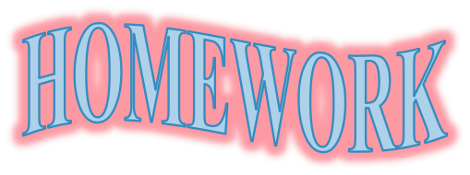
Review the new words and expressions and the passage.

