Slide 1
Starter Module 2 My English lesson
Unit 1 Open your book.
WWW.PPT818.COM

Slide 2
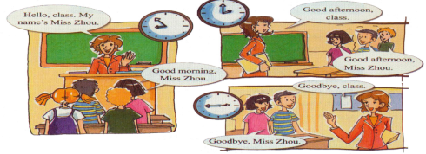
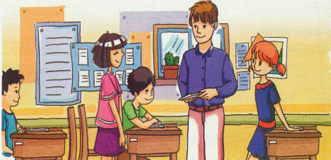
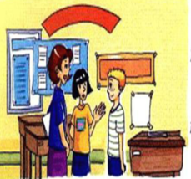
Revision time
-Good morning ,class .
-...
-What’s your name, please?
-I’m…
-Can you spell it, please?
-Yes,….
-How are you?
-Fine, thank you.
-This is…
-Nice to meet you.
-...
-It’s time to …, goodbye.

Slide 3
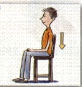
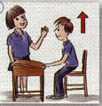
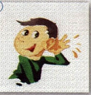
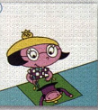
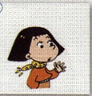
some instructions in class（课堂指令）
/ɪ/
/æ/
/ɪ/
Sit down
Stand up
listen
instructions in class
draw
Put up your hand
/ɔː/
/æ/
Close your book
Open your book
/əʊ/
/ə/

Slide 4
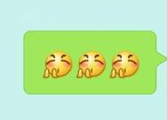
Other instructions in class
Be quiet, please!/ Ssh.
Clap your hands.
Work in pairs.
other instructions
Ready? go!
Stop !
Read after the tape.

Slide 5
Exercise time
1. When you want to ask or answer questions, you should
_____________________________.
2. When a customer(客人）come to your home, you should
say_______________________________.
3. When teachers come to the classroom, you should
____________________________.
4. When you have a dictation(听写）, you should
____________________________.
5. When you read in the morning, you should
_______________________.
put up your hand
sit down, please./Please sit down
stand up
close your book
open your book

Slide 6
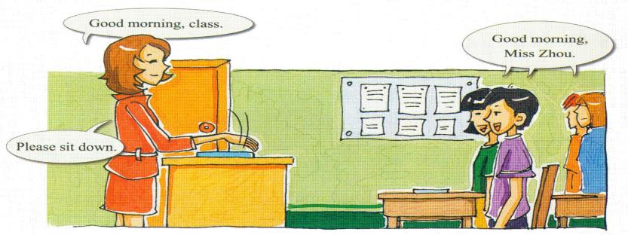
Listen and fill in the blanks
Tip1: Predict before listening(听前先预测问题的可能答案）
morning
class
A: Good________, ______.
B: ______ _________, ___________.
A: Please ______ ______.
Good
morning
Miss Zhou
sit
down

Slide 7
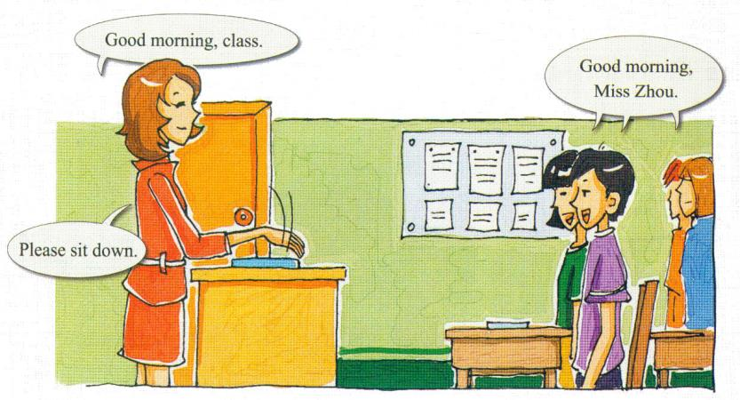
Let's read and imitate
Read the text after the tape(跟录音读课文)
Read the text with your partner(两人分角色朗读)

Slide 8
Listen and renumber
Listen
Draw
Stand up
Sit down
1
2
3
4
5
6
7
Put your hand
Open your book
Close your book
4
6
1
2
5
3
7
____→____→____→____→____→____→____

Slide 9
Work in pairs
Listen
Draw
Stand up
Sit down
1
2
3
4
5
6
7
Put your hand
Open your book
Close your book

Slide 10
Match
1. Put up … a) … your book.
2. Open … b) … down.
3. Stand … c) … up.
4. Sit … d) … your hand.

Slide 11
Listen and write
Tip2: pay attention to your writing, write the letters in the right place.（注意书写，把字母写在正确的位置）
1
2
3
4
5
6
Close your book.
Listen.
Open your book.
Put up your hand.
Sit down.
Stand up.

Slide 12
Group work
Choose the best player in your group
参考词汇
Play the game“Simon says”.
Practice like this:
Game rules: when Simon says“Simon says”, you can do the actions; if not, you don’t do.
Sit down
Stand up
Open…
Close…
Put up your hand
Put down…
listen
draw
Clap your hands
...
1位学生: Simon
其他3位: players
A: Simon says listen/…
B,C,D do the actions(做动作）
Notes:
12

Slide 13
Summary
instructions in class
Is the instructions important in English class?

Slide 14
Homework
Must-do
①Read and recite the new words on PS8.
②Make a mind-map of this lesson.
Challenge to do
③Search for more information about the instructions in English class, then try to talk about it with your friends.

