Slide 1
Unit 1 Welcome to our school!
WWW.PPT818.COM

Slide 2
Learning new words
welcome 欢迎
Welcome to our school.

Slide 3
Learning new words
nice 友好，开心。
Nice to meet you.
很开心认识你。

Slide 4
Learning new words
show 展示，表演
show sb.(某人) sth.(某物，某事)
I will show you our school.

Slide 5
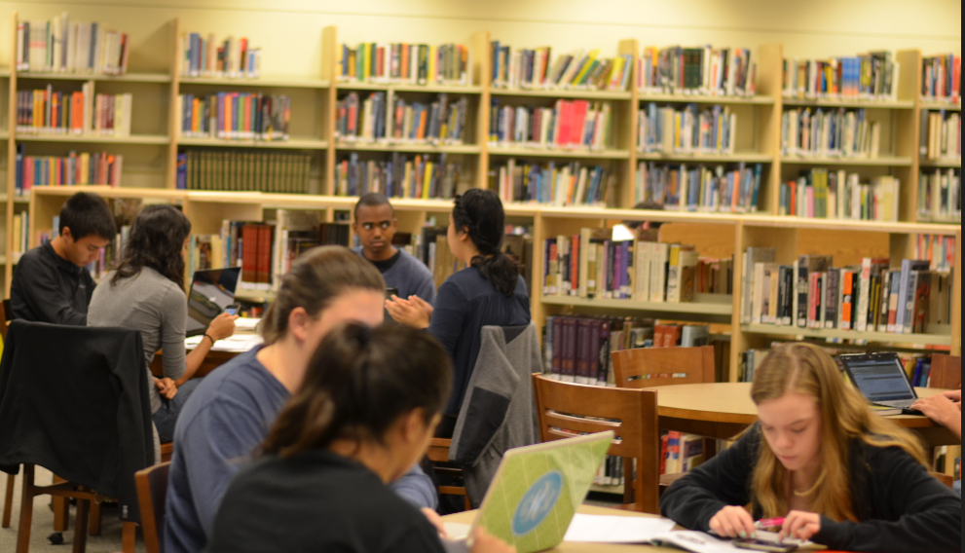
Learning new words
library 图书馆

Slide 6
Learning new words
often 经常
Do you often go to the library?
你经常去图书馆吗？

Slide 7
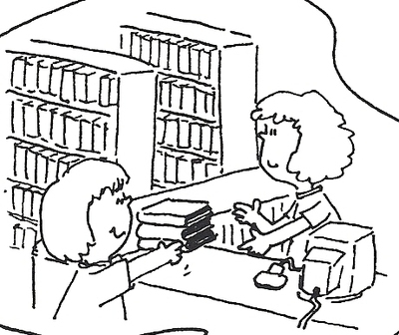
Learning new words
borrow 借
borrow books 借书

Slide 8
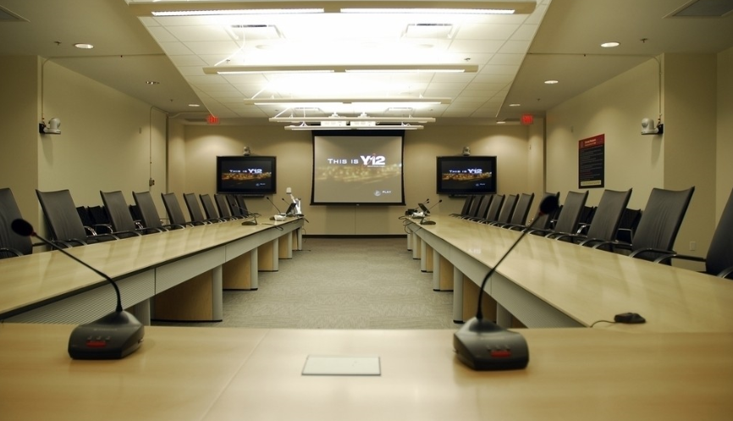
Learning new words
meeting room 会议室
meeting 会议
room 房间

Slide 9
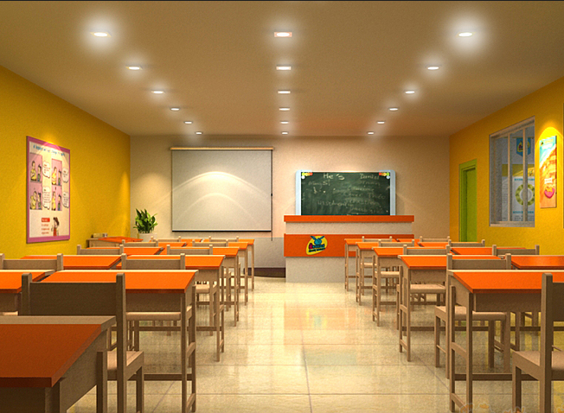
Learning new words
class room 教室

Slide 10
Game time
记忆大比拼
教师展示迅速展示图片，由学生记忆。展示完之后，要求学生写出自己看到的图片相应的英语单词。

Slide 11
Let’s talk
This is the library.
This is the classroom.
This is the meeting room
熟知 this is 的句型用法。

Slide 12
Let’s talk
Do you often come to the library?
Yes, I do. I often borrow books from the library. / No, I don’t.

Slide 13
Let’s talk
Do you often have meetings here?
Yes, we will have a meeting this afternoon.
注：这里的will表示将来发生的事情。比如说现在是上午，我说我们下去有会，那么就是未来要发生的事情。

Slide 14
Practise
运用上述学过的句型，在下列场景中进行角色扮演。

Slide 15
Practise
This is our classroom,
We are learning here.

Slide 16
Practise
This is our playground.
We are playing here.

Slide 17
Homework
造句！！
make sentences
运用学过的单词进行造句。加深新单词的记忆。

