Slide 1
Unit 2
Colour
Main task
WWW.PPT818.COM

Slide 2
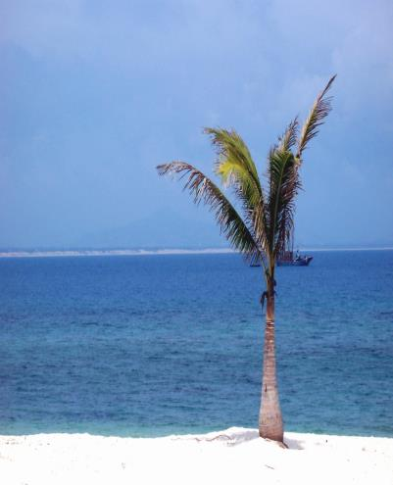
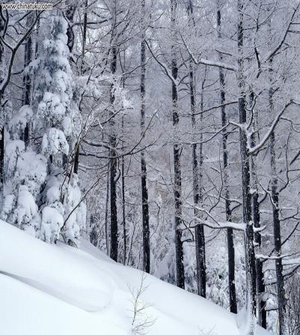
sadness or calm
calm and peace
calm colours

Slide 3
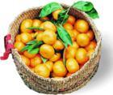
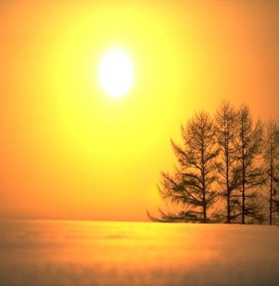
warm colours
orange yellow
success and joy
wisdom and warmth

Slide 4
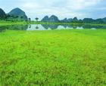
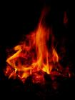
green
red
energy and nature
power and strength
energetic colours
strong colours

Slide 5
1. 将颜色和其代表的含义连线。
1. black
2. blue
3. green
4. orange
5. red
6. white
7. yellow
calm and peace
power and protection
wisdom and warmth
power and strength
energy and nature
sadness or calm
success and joy

Slide 6
Wearing blue is good for ______________________.
mind and body

Slide 7
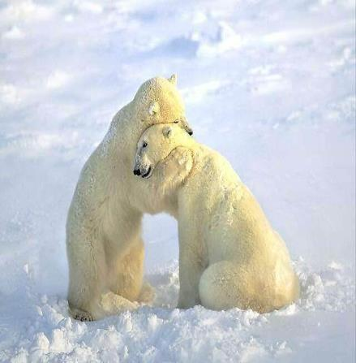
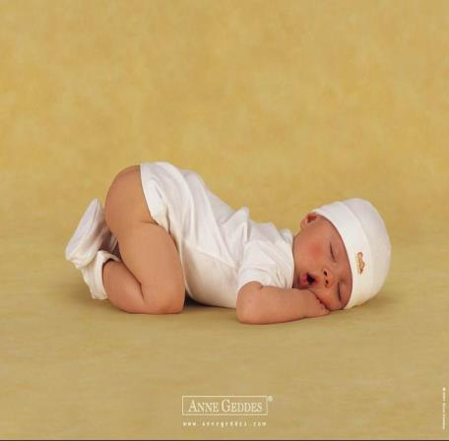
Are you feeling stressed（焦虑不安）?
Wear white like us!

Slide 8
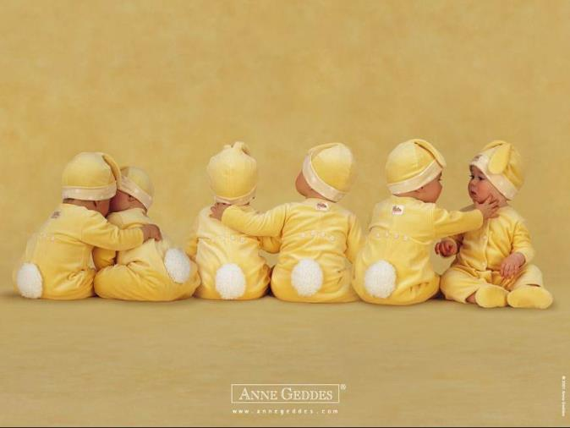
wisdom
Yellow is also the colour of_______.
Don’t you think they are clever sunny babies?

Slide 9
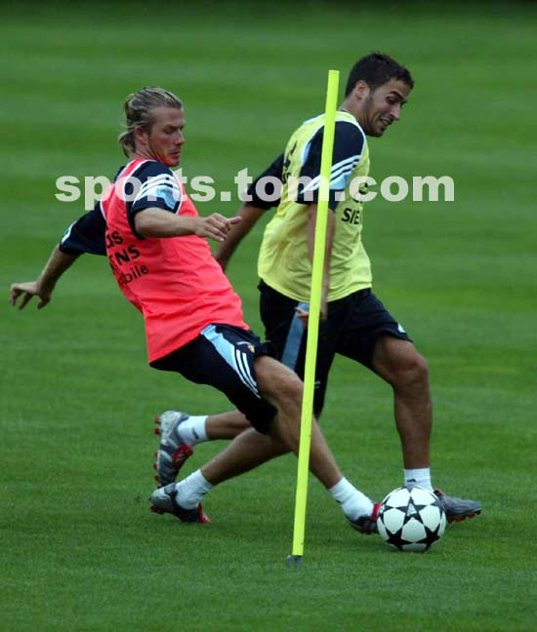
Wearing red makes it easier for you to
________.
take action

Slide 10
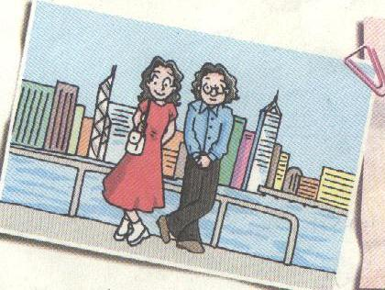
What is the colour of the woman’s …?
2. What does … represent ?
3. Why does she wear …?

Slide 11
Colours and what they represent.
Millie Wang
The woman in this picture is wearing a ________ dress and a pair of _______ shoes. This is interesting because red and white are very different colours.
Red represents ________ and ________.Maybe she feels weak and that is why she is wearing red—she just wants to make herself look more powerful.
red
white
power
strength

Slide 12
shoes
Her handbag and ________ are white. The colour white represents ________ and ________. She could be ________ and the colour white helps her feel peaceful.
I think the woman is feeling weak and a little bit stressed, but she is wearing the right colours to change that. Red and white are a good match, as the powerful ________ balances the calm _________.
calm
peace
stressed
red
white

Slide 13
Introduction
Describing the colours that the person is wearing
the first paragraph
Main body
Explaining the moods that the colours represent
the second and the third paragraph
Conclusion
Judging whether the person is wearing the right colours
the fourth paragraph
Notes:
13

Slide 14
The important language points.
1. That is why she is wearing red.
2. make herself look more powerful
3. feel a little bit stressed
4. She is wearing the right colours to change that.
5. Red and white are a good match.
6. The powerful red balances the calm white.

Slide 15
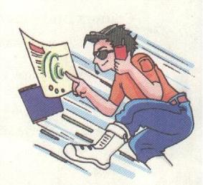
Colour of shirt: __________
Represents: _____________
Colour of trousers: _______
Represents: _____________
Colour of glasses: ________
Represents: ___________________
Colour of shoes: ____________________
Represents: ________________________
Moods: ____________________________
Reasons: __________________________
Is it a good mobile phone advertisement?
__________Why? _____________________________
orange
success and joy
blue
sadness or calm
black
power and protection
white
calm and peace
fast, powerful
He is running fast…

Slide 16
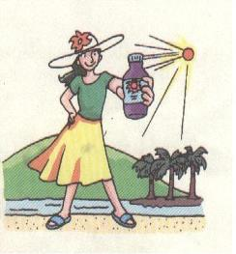
Colour of T-shirt: ____________
Represents: ________________
Colour of skirt: _____________
Represents: ________________
Colour of hat: __________________
Represents: ________________________
Colour of shoes: ____________________
Represents: ________________________
Moods: ____________________________
Reasons: ______________________
Is it a good fruit juice advertisement?
___________________Why? ________
green
energy and nature
yellow
wisdom and warmth
white
calm and peace
blue
sadness or calm
relaxed, peaceful, cheerful
He is standing near the sea…

Slide 17
Introduction
The man (woman) is wearing…
Green /Red… represents…
Maybe he/ she feels…
I think …
Main body
Conclusion

Slide 18
Sample article about the man: P 39
black
The man is wearing a _______shirt and_____ trousers. He looks very fashionable. Blue ____________ sadness and _____ . Black is the color of power and protection. However, the man doesn’t look very sad. The blue should make him feel calm but he does not look calm, either. In fact ,he looks worried or afraid.
blue
represents
calm

Slide 19
I think the man is wearing those colors because he is afraid . He needs ________for protection, and blue to make him feel _________. He is also wearing __________shoes. He is wearing them to make himself feel __________ and __________.
black
calm
brown
powerful
strong

Slide 20
Sample writing
The woman in this advertisement is wearing a green T-shirt and a yellow skirt.This is interesting because yellow and green are both positive colours.Yellow represents warmth and wisdom and can also remind you of a warm,sunny day.Her T-shirt is green.Green represents engery and nature.Maybe the woman feel tired and decided to wear green because this colour can make her feel more energetic.
The woman’s shoes are blue.Blue represents trust and it can also make us feel calm.
Maybe the woman is a bit stressed and that is why she wears blue.
I think this woman is cheerful and friendly.She prefers warm,energetic and calm colours to strong colours.I think she must be very happy because yellow can remind you of a warm ,sunny day and green can give you lots of energy.
I like this advertisement because it makes me feel wqarm and reminds me of the summer holidays.

Slide 21
discussion
Suppose you have the chance to design school uniforms. What colours will you choose? Why?

Slide 22
Choose A B or C
1.---Red represents power and strength.
---This is ______ she is wearing red.
A .because B. why C. that
2.---Black represents power and protection.
---Oh, I see. It can make him ______powerful.
fell B. to feel C. feel
3.---Look, he is wearing white today. What do you think of him?
---Maybe he is feeling __________stressed.
a little B. a little bit C. a bit D. a bit little E. a bit of
4.---You look happy today.
---I get ________ praise(表扬).
A.a little B. a little bit C. a bit D. a bit little E. a bit of
B
C
A
B
C
A
E

Slide 23
Translation
1. 李老师穿着一件红色女服和一双白鞋子.
Miss Li is wearing a red dress and a pair of white shoes.
2. 我想使自己看上去更强壮.
I want to make myself look more powerful.

Slide 24
3. 绿色象征着活力和自然.
Green represents energy and nature.
4. 红色和白色是一个很好的颜色搭配.
Red and white is a good match.
5. 橙色代表着成功和喜悦.
Orange represents success and joy.

Slide 25
Checkout

Slide 26
represent
blue
harmony
sadness
calm
white
purity
orange
joy
success
warm
yellow
sun
wisdom
new life and growth
energetic
green
nature, money, envy
power heat
strong
red
strong feelings

Slide 27
Do exercises on P41. Finish the dialogue between Millie and Daniel and Daniel’s word list.

Slide 28
Hurry up, ____ you will miss the bus.
A. and B. but C. or D. so
2. Jack was so ____ that she fell ____ as soon as she was on the bed. A. asleep, sleepy B. sleepy, sleepy C. sleepy, asleep D. asleep, asleep

Slide 29
3. The boy ____ short hair looks lovely in black and white T-shirt. A. has B. have
C. with D. is
4. I have made a lot of friends since I ____ to China. A. have come B. came C. come D. am coming

Slide 30
5. --- Why don’t you wear that black jacket?
--- ____
A. That is a great idea. B. How about you? C. Really? D. I’m sorry to hear that.

Slide 31
6. Colours can make us ____ or sad.
feel relax
B. to feel relaxed
C. feel relaxed
D. to feel relax

Slide 32
7. --- Is there ____ in today’s newspaper?
--- I haven’t seen it. A. anything strange B. strange something C. strange anything D. something strange

Slide 33
8. They would rather ____ there by train than ____ a plane. A. go, taking B. go, take
C. going, take D. going, taking

