Slide 1

Unit2 My Family
陕旅版
三年级下册
第四课时
WWW.PPT818.COM

Slide 2
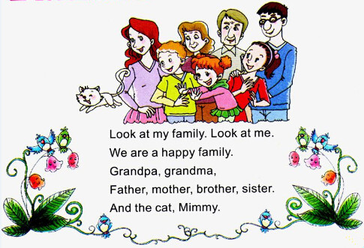

>>Warm-up
Let’s chant

Slide 3

>>Review
大转盘
Who is he/she …?
活动
He / She is …
grandpa
sister
mother
grandma
father

Slide 4
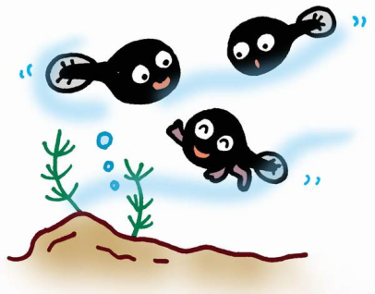
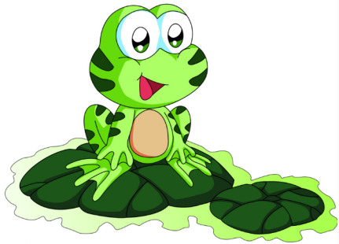
>>Lead-in
Look and say

Slide 5

>>Presentation
Ask and answer
Questions 1: Look at Picture 1. What color is the tadpole?
It’s black.
Questions 2: Look at Picture 2. What does the tadpole have?
He has two legs.

Slide 6
>>Presentation
Ask and answer
Questions 3: Look at Picture 3. How many legs does the tadpole have?
He has three legs.
Questions 4: Look at Picture 4. Does he have a tail?
No, he doesn’t.

Slide 7
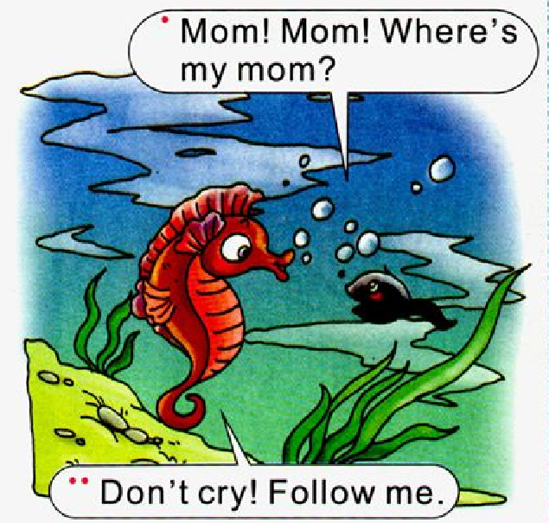
>>Presentation
Read a story

Slide 8
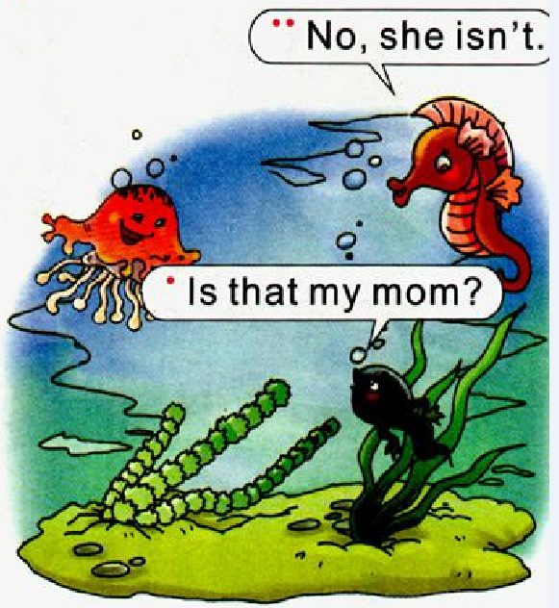
>>Presentation
Read a story

Slide 9
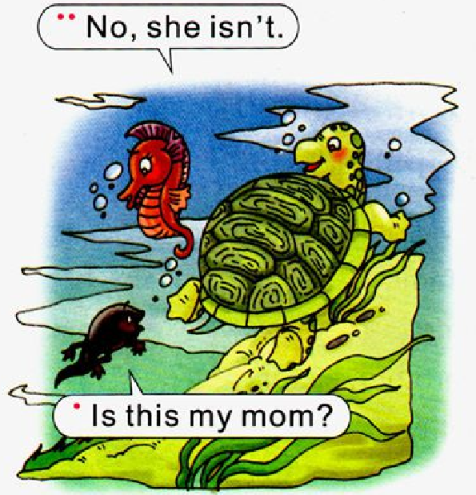
>>Presentation
Read a story

Slide 10
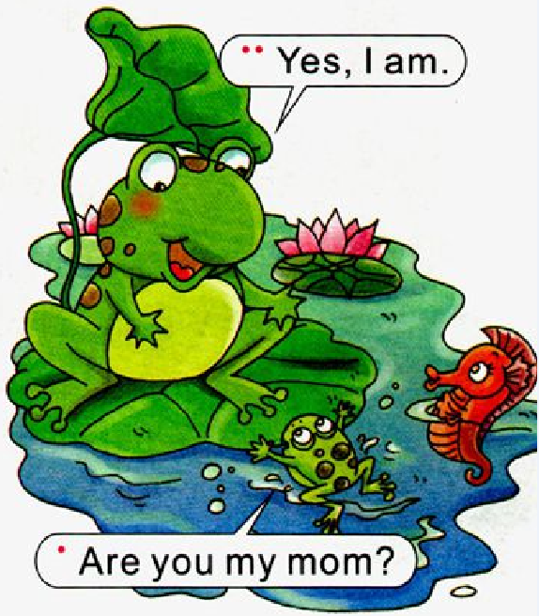
>>Presentation
Read a story

Slide 11
>>Presentation
Read a story
—Mom! Mom! Where’s my mom?
—Don’t cry! Follow me.
—Is that my mom?
—No, she isn’t.
—Is that my mom?
—No, she isn’t.
—Are you my mom?
—Yes, I am.

Slide 12
>>Practice
Read it by yourselves for one minute .
自读课文一分钟。
一分钟倒计时
60
Learning tip :
50
10
当你自己朗读时，遇到不会读或不明白意思的单词或句子，可以把它圈起来，请教同学或老师！
20
40
30
开始

Slide 13






>>Practice
Show time
Work in two, choose a way you like to read or act the story.（2人一组,选择你喜欢的方式去读或者表演故事。）
Act out the story.（表演对话）
Read in roles.（分角色朗读）
Read together.（齐读）

Slide 14

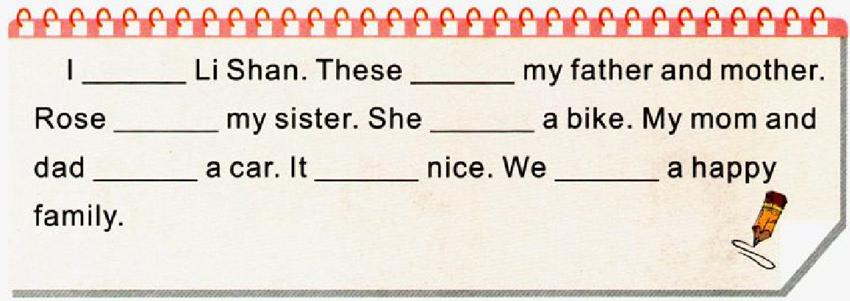
>>Practice
Choose and fill in the blanks
am
are
is
has
have
is
have

Slide 15

>>Summary
如何用一般疑问句询问？
—Are you …?
—Yes, ...
—Are you my mum?
—Yes, I am.

Slide 16
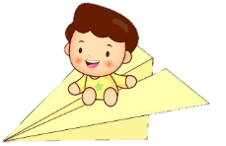

>>Homework
1.听课文录音并跟读，按照正确的语音、语调朗读并表演课文对话。
2.朗读课文Let’s learn more, 并会背诵。
3.预习Unit3 A Let’s learn.
close

