Slide 1
The user can demonstrate on a projector or computer, or print the presentation and make it into a film to be used in a wider field

Slide 2
CONTENTS
自我介绍
岗位认知
任职能力
未来规划
The user can demonstrate on a projector or computer, or print the presentation and make it into a film to be used in a wider field

Slide 3
01
自我介绍
The user can demonstrate on a projector or computer, or print the presentation and make it into a film to be used in a wider field

Slide 4
自我介绍
姓名：第一PPT
性别：男
年龄：26
籍贯：上海
学校：北京大学
专业：平面设计
我是一个爱学习，有计划，乐观向上的人。拥有较强的自制能力和适应能力，并且有较强的管理策划与组织管理协调能力

Slide 5
自我介绍
标题添加
标题添加
标题添加
The user can demonstrate on a projector or computer, or print the presentation and make it into a film to be used in a wider field
The user can demonstrate on a projector or computer, or print the presentation and make it into a film to be used in a wider field
The user can demonstrate on a projector or computer, or print the presentation and make it into a film to be used in a wider field

Slide 6
自我介绍
标题添加
标题添加
The user can demonstrate on a projector or computer, or print the presentation and make it into a film to be used in a wider field
The user can demonstrate on a projector or computer, or print the presentation and make it into a film to be used in a wider field
标题添加
标题添加
The user can demonstrate on a projector or computer, or print the presentation and make it into a film to be used in a wider field
The user can demonstrate on a projector or computer, or print the presentation and make it into a film to be used in a wider field

Slide 7
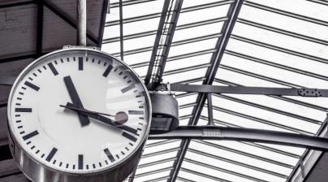
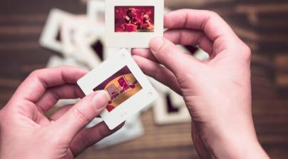
自我介绍
标题添加
标题添加
标题添加
The user can demonstrate on a projector or computer, or print the presentation and make it into a film to be used in a wider field
The user can demonstrate on a projector or computer, or print the presentation and make it into a film to be used in a wider field
The user can demonstrate on a projector or computer, or print the presentation and make it into a film to be used in a wider field

Slide 8
自我介绍
标题添加
The user can demonstrate on a projector or computer, or print the presentation and make it into a film to be used in a wider field
标题添加
标题添加
The user can demonstrate on a projector or computer, or print the presentation and make it into a film to be used in a wider field
The user can demonstrate on a projector or computer, or print the presentation and make it into a film to be used in a wider field

Slide 9
02
岗位认知
The user can demonstrate on a projector or computer, or print the presentation and make it into a film to be used in a wider field

Slide 10
岗位认知
标题添加
标题添加
Q1
Q2
The user can demonstrate on a projector or computer, or print the presentation and make it into a film to be used in a wider field
The user can demonstrate on a projector or computer, or print the presentation and make it into a film to be used in a wider field
标题添加
Q3
Q4
标题添加
The user can demonstrate on a projector or computer, or print the presentation and make it into a film to be used in a wider field
The user can demonstrate on a projector or computer, or print the presentation and make it into a film to be used in a wider field

Slide 11
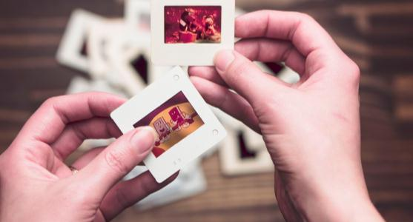
岗位认知
08 AUG
08 AUG
标题添加
标题添加
08 AUG
08 AUG
标题添加
标题添加

Slide 12
岗位认知
标题添加
标题添加
The user can demonstrate on a projector or computer, or print the presentation
The user can demonstrate on a projector or computer, or print the presentation
标题添加
标题添加
The user can demonstrate on a projector or computer, or print the presentation
The user can demonstrate on a projector or computer, or print the presentation
标题添加
标题添加
The user can demonstrate on a projector or computer, or print the presentation
The user can demonstrate on a projector or computer, or print the presentation

Slide 13
岗位认知
标题添加
标题添加
标题添加
The user can demonstrate on a projector or computer, or print the presentation and make it into a film to be used in a wider field
The user can demonstrate on a projector or computer, or print the presentation and make it into a film to be used in a wider fieldThe user can demonstrate on a projector or computer, or print the presentation and m to in a wider field
The user can demonstrate on a projector or computer, or print the presentation and make it into a film to be used in a wider field

Slide 14
岗位认知
标题添加
1
The user can demonstrate on a projector or computer, or print the presentation and make it into a film to be used in a wider field
标题
添加
标题添加
2
The user can demonstrate on a projector or computer, or print the presentation and make it into a film to be used in a wider field
3
标题添加
The user can demonstrate on a projector or computer, or print the presentation and make it into a film to be used in a wider field

Slide 15
03
任职能力
The user can demonstrate on a projector or computer, or print the presentation and make it into a film to be used in a wider field

Slide 16
任职能力
任职能力
任职能力
The user can demonstrate on a projector or computer, or print the presentation and make it into a film to be used in a wider field
The user can demonstrate on a projector or computer, or print the presentation and make it into a film to be used in a wider field
任职能力
任职能力
任职能力
The user can demonstrate on a projector or computer, or print the presentation and make it into a film to be used in a wider field
The user can demonstrate on a projector or computer, or print the presentation and make it into a film to be used in a wider field
The user can demonstrate on a projector or computer, or print the presentation and make it into a film to be used in a wider field

Slide 17
任职能力
标题添加
标题添加
The user can demonstrate on a projector or computer, or print the presentation and make it into a film to be used in a wider field
The user can demonstrate on a projector or computer, or print the presentation and make it into a film to be used in a wider field
标题添加
标题添加
The user can demonstrate on a projector or computer, or print the presentation and make it into a film to be used in a wider field
The user can demonstrate on a projector or computer, or print the presentation and make it into a film to be used in a wider field

Slide 18
任职能力
标题添加
标题添加
The user can demonstrate on a projector or computer, or print the presentation and make it into a film
The user can demonstrate on a projector or computer, or print the presentation and make it into a film
标题添加
标题添加
The user can demonstrate on a projector or computer, or print the presentation and make it into a film
The user can demonstrate on a projector or computer, or print the presentation and make it into a film
标题添加
标题添加
The user can demonstrate on a projector or computer, or print the presentation and make it into a film
The user can demonstrate on a projector or computer, or print the presentation and make it into a film

Slide 19
任职能力
标题添加
The user can demonstrate on a projector or computer, or print the presentation and make it into a film to be used in a wider field
标题添加
The user can demonstrate on a projector or computer, or print the presentation and make it into a film to be used in a wider field
标题添加
The user can demonstrate on a projector or computer, or print the presentation and make it into a film to be used in a wider field

Slide 20
04
未来规划
The user can demonstrate on a projector or computer, or print the presentation and make it into a film to be used in a wider field

Slide 21
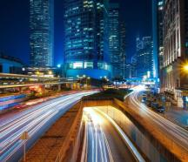
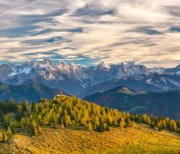
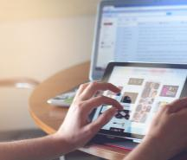
未来规划
32K
2018 Q3
18K
2018 Q1
52K
2018 Q4
26K
2018 Q2
标题添加
The user can demonstrate on a projector or computer, or print the presentation and make it into a film to be used in a wider field
The user can demonstrate on a projector or computer, or print the presentation and make it into a film to be used in a wider field

Slide 22
未来规划
2020.08.19
2020.08.19
2020.08.19
标题添加
标题添加
标题添加
The user can demonstrate on a projector or computer, or print the presentation and make it into a film to be used in a wider field
The user can demonstrate on a projector or computer, or print the presentation and make it into a film to be used in a wider field
The user can demonstrate on a projector or computer, or print the presentation and make it into a film to be used in a wider field

Slide 23
未来规划
标题添加
标题添加
The user can demonstrate on a projector or computer, or print the presentation and make it into a film to be used in a wider field
The user can demonstrate on a projector or computer, or print the presentation and make it into a film to be used in a wider field
标题添加
标题添加
The user can demonstrate on a projector or computer, or print the presentation and make it into a film to be used in a wider field
The user can demonstrate on a projector or computer, or print the presentation and make it into a film to be used in a wider field

Slide 24
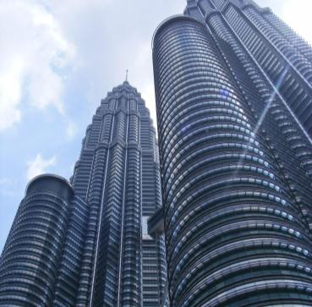
未来规划
标题添加
The user can demonstrate on a projector or computer, or print the presentation and make it into a film to be used in a wider field
标题添加
The user can demonstrate on a projector or computer, or print the presentation and make it into a film to be used in a wider field
标题添加
标题添加
The user can demonstrate on a projector or computer, or print the presentation and make it into a film to be used in a wider field
The user can demonstrate on a projector or computer, or print the presentation and make it into a film to be used in a wider field

Slide 25
谢谢观看
THANKS

