Slide 1
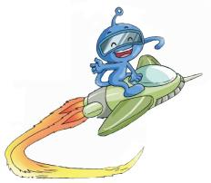
义务教育教科书英语（广州版） 三年级下册
Module 4 Fruits
Unit 8 Apples are good for us
WWW.PPT818.COM
Notes:
1

Slide 2
An apple a day
keeps the doctor away An apple a day
keeps the doctor away An apple a day
keeps the doctor away A-P-P-L-E apple
Notes:
2

Slide 3
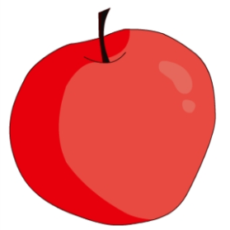
A: What is this ?
B: It’s .
an apple
I like apples .
Notes:
3

Slide 4
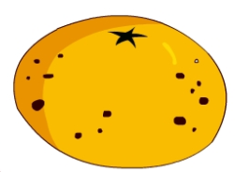
A: What is this ?
B: It’s .
an orange
I like oranges.

Slide 5
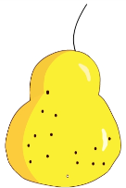
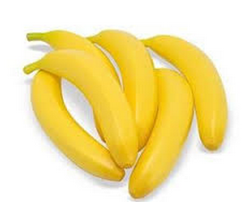
three pears
six bananas

Slide 6
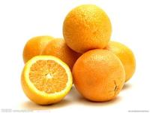
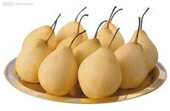
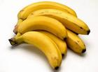
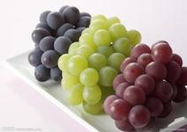
some oranges
some pears
some bananas
some grapes
Notes:
6

Slide 7
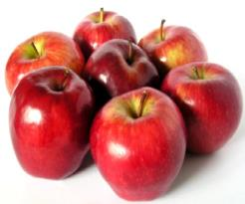
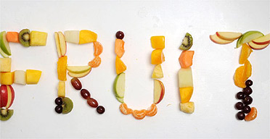
Apples, oranges, bananas and grapes are fruits.
Notes:
7

Slide 8
fruit指“水果”时，为集体名词，只用单数，不用复数。如果指不同种类的水果或事情的结果时，则用复数fruits。
我们课文中出现的都是单数。

Slide 9
Let’s chant
Do you like some apples?
Yes I do,
One for me and one for you.
Do you like some apples?
Yes, I do,
Two for dad and two for mum!
Notes:
9

Slide 10
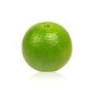
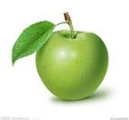
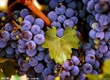
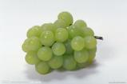
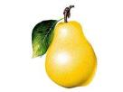
A:What fruit do you like ?
B: I like …
Notes:
10

Slide 11
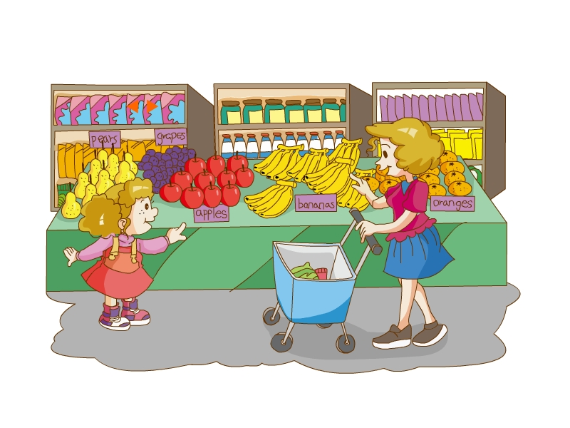
Let’s talk
A: What fruit do you like ?
B: I like …
B: … are good for us.
Notes:
11

Slide 12
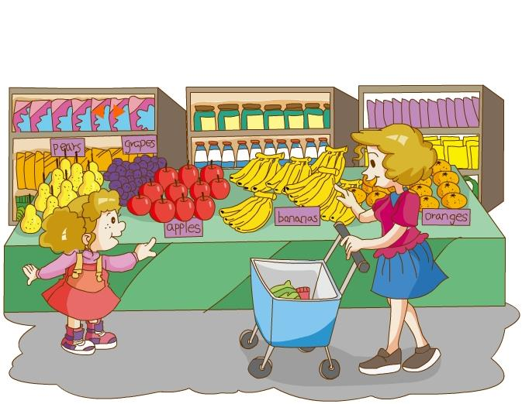
Notes:
12

Slide 13
（1）The lady is Janet’s aunt. ( )
（2）The lady is at home(在家). ( )
（3）Janet likes fruit. ( )
（4）Apples are good for us. ( )
（5）Janet and her mother get seven apples.( )
(6) Janet liks apples and grapes. ( )
T
T
F
T
F
T
Notes:
13

Slide 14
Janet: I have some , Mum ?
Can
fruit
Mum:
Of course.
What
fruit do you like ?
Some
apples ?
Janet: OK. Mum. Apples good
us.
are
for
Mum: Let’s six apples, two you,
two dad and two for .
get
for
for
me
Janet: And some grapes, . I grapes.
too
like
Mum:
OK.
Notes:
14

Slide 15
Janet: Can I have ________, Mum ?
some fruit
Mum:
Of course.
What
fruit do you like ?
Some _____?
apples
good for us
Janet: OK. Mum. Apples are ________.
.
Mum: Let’s get _______ , ___ for you,
two dad and two for .
six apples
two
for
me
Janet: And some _____, too. I like _____ .
grapes
grapes.
Mum:
OK.
口头完成挖空练习，帮助记忆和复习本课内容。
Notes:
15

Slide 16
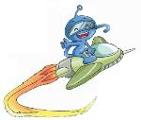
Homework:
1.抄写Unit 8单词一个一行。
2.背诵Unit 8。
Notes:
16

