Slide 1
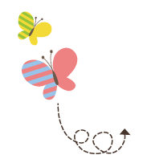
1111111111111111111111111111111111111111111111111111111111111111
Unit 3 Writing Home
五年级下册
Again, Please!
WWW.PPT818.COM

Slide 2
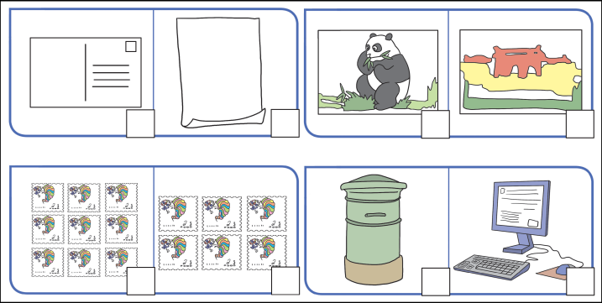
1. Listen and tick.
1 2
3 4
×
√
√
√

Slide 3
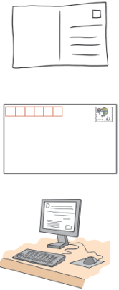
2. Listen and match.
mother
Emma
parents
teacher

Slide 4
3. Read and write
picture how fine left send write right
Tom: Look，Mum ！ This postcard has a ________of a panda on it. I want to ______this postcard to Mike. It’s two yuan.
Mum: Okay. Let’s take it.
Tom: How do I ______a postcard ？
Mum: You write on the______. Put the address on the ______.
Tom: Okay.
picture
send
write
left
right
Dear Mike，
______ are you ？ I’m ______ ．China is great. I am having fun here.
Yours，
Tom
How
fine

Slide 5
4. Look and write
1. You write an e on a c ．
2. Twenty three and forty four is seventy six. That’s w .
3. Go straight and t right. Then you can see the cinema.
4. I like my English teacher. She is very k .
mail
omputer
rong
urn
ind

Slide 6
5. Read and match .
1. You don’t use your pen. You write and send it on your computer. What is it ？
2. You buy it in a shop when you travel. You send it to your friend or your family. It has a beautiful picture on it. What is it ？
3. You write it on paper. You use a stamp. You send it at the post office. What is it ？
4. You write “Happy Birthday ！” on it. Then you send it to your friend on his or her birthday. What is it ？
4
3
1
2

Slide 7
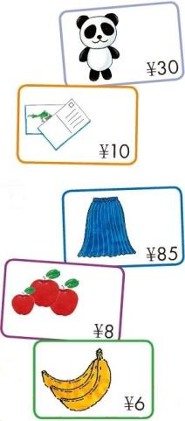
6. Read, draw and order.
1. A: Excuse me, how much _____the toy panda ?
B: _____ _____ 30 yuan.
2. A: Hi. How much _____ the postcards ?
B: _____ _____ 10 yuan.
3. A: Look! How much _____ the skirt ?
B: _____ _____ 85 yuan.
4. A: How much _____ the apples ?
B: _____ _____ 8 yuan.
A: I also like those bananas. How much _____ _____?
B: _____ _____ 6 yuan.
is
It is
are
They are
is
It is
are
They are
are
they
They are

Slide 8
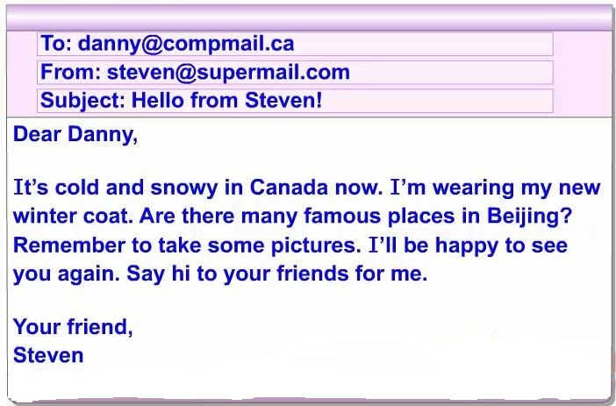
7. Read. Tick or cross.

Slide 9
7. Read. Tick or cross.
1. Anna is a student.
2. She has short brown hair.
3. Her favourite colour is blue.
4. She likes reading.
5. She likes math.
6. This is a letter from Mike to Anna.
√
×
×
√
√
×

Slide 10
8. Look and say.
Danny and Jenny’s Trip
They go on a trip ... They want to buy ... It has ...
Jenny wants to ...
It has ... Danny sends an email to ... They have fun in Beijing
Danny wants to ...

Slide 11
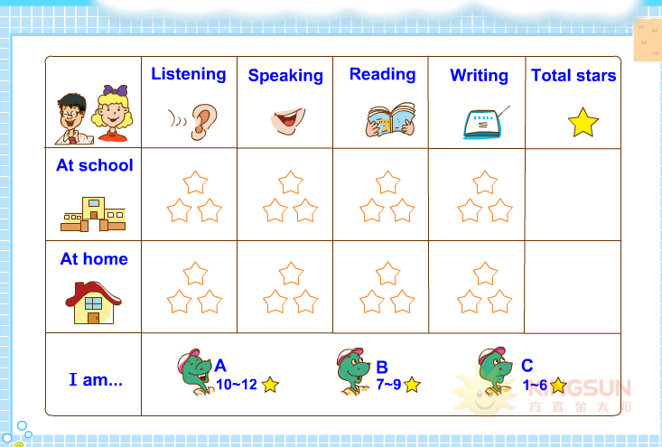
9. How am I doing?

